Slide 1
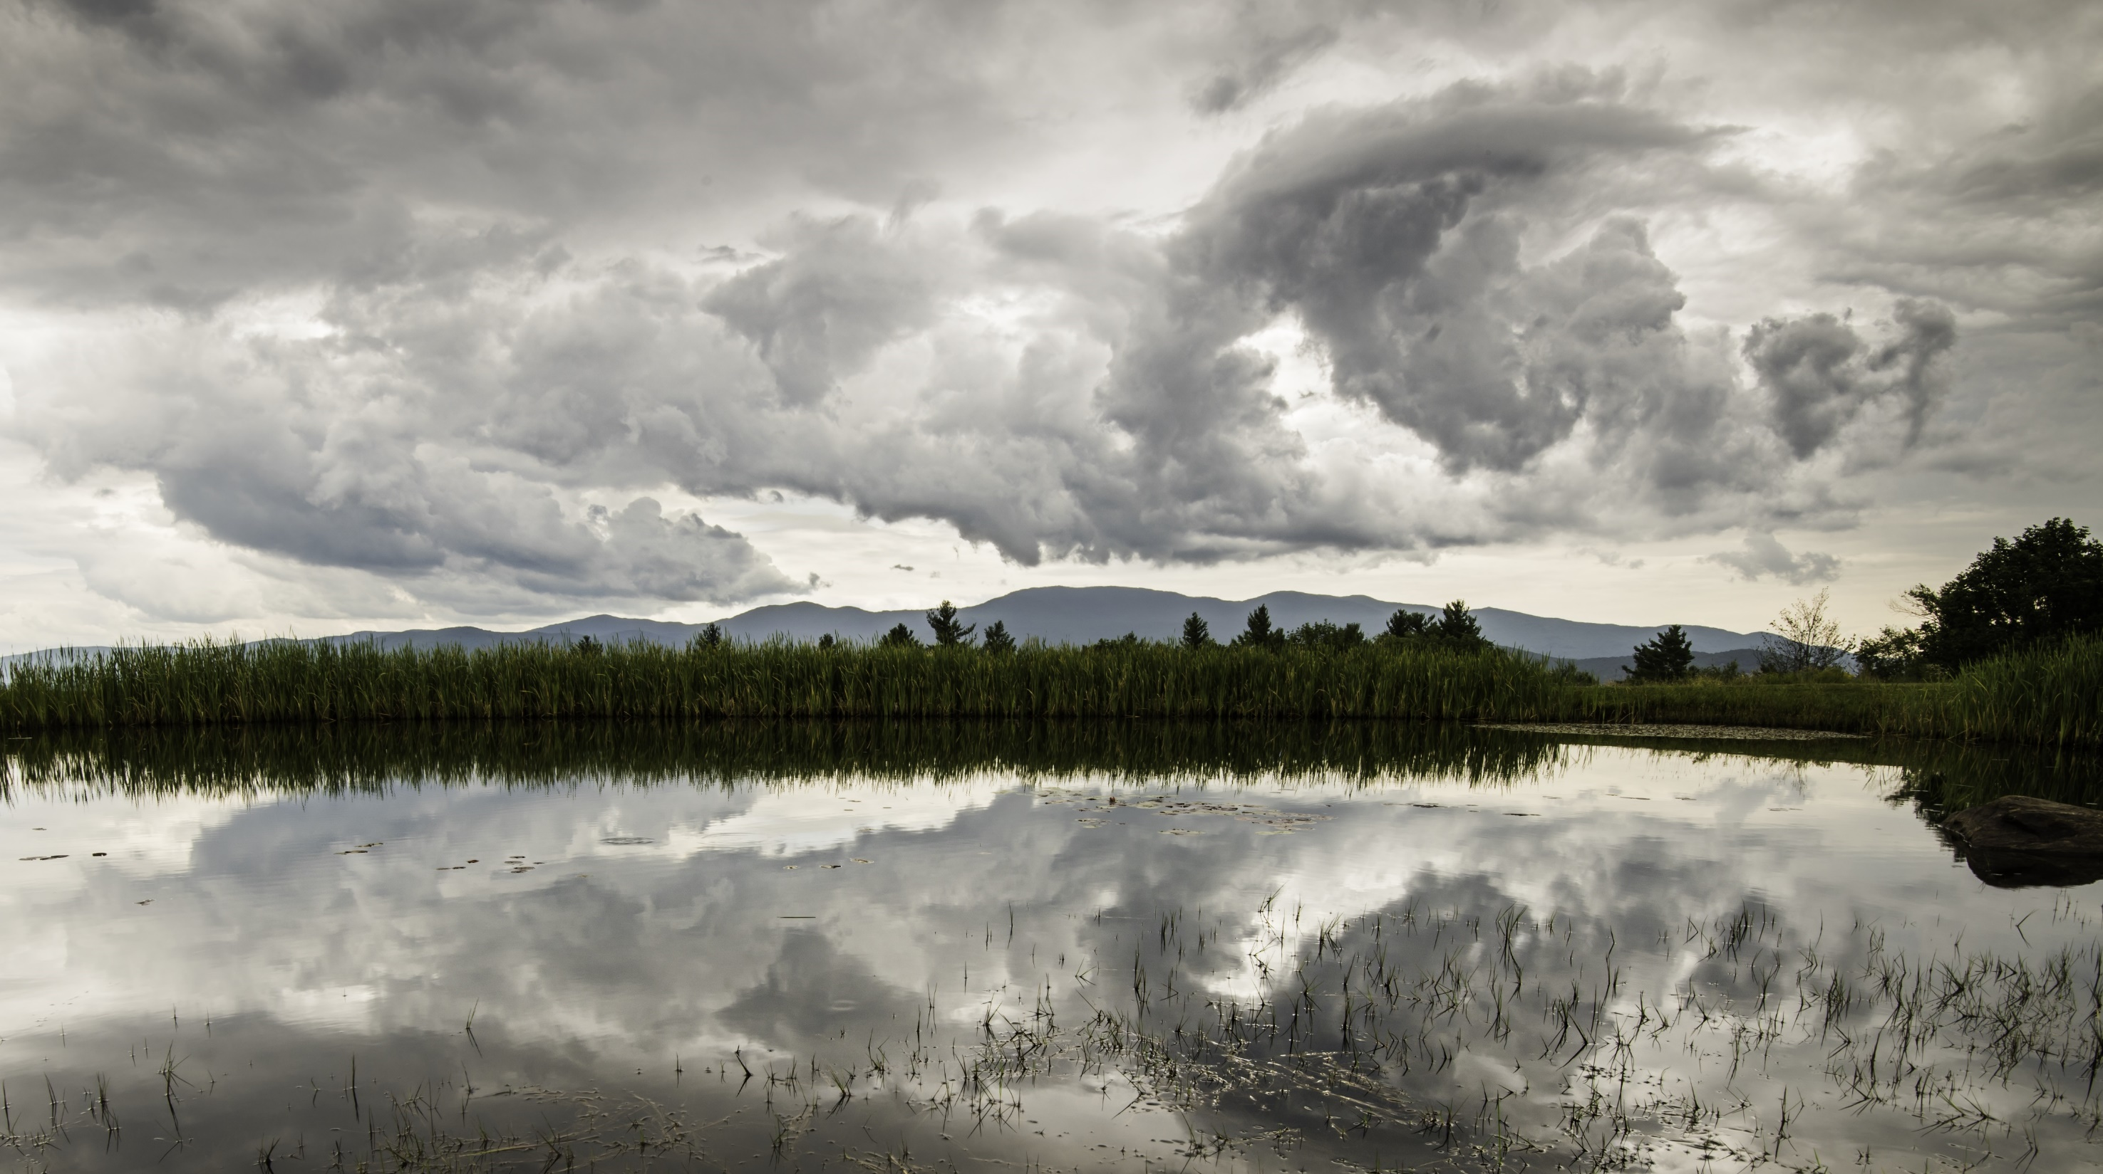
WPI and COACHE:
Data and Navigating Transitions
Art Heinricher,
Former Faculty, Former Dean,
Interim Provost(2) … and Finally Faculty

Slide 2
WPI and COACHE: 2014, 2017, 2021, 2024
Three (tangled) Threads:
  Data supports transitions in leadership
  Data builds community during transitions
  Community can make change sustainable
  Aside: I will focus on transitions…
  …but you are always in transition!

Slide 3
WPI & COACHE 2014: Letter to the New President
President Departs May 2013
Interim President through June 2014
COACHE Survey Spring 2014
New President formed COACHE Working Group
COACHE
COACHE Working Group
Interim President
May 2013
July 2014
June 2015
Notes:
The COACHE Survey in spring 2014 was viewed as “a letter to the new president”
The COACHE Working group helped serve as a framework for the new president’s “listening tour”

Slide 4
WPI & COACHE 2014
Interim President during the Survey
  Framed the purpose as a “Letter to the new president”
New President arrived with the COACHE Report
  Used the report to start conversations
  Framework for her first-year “Listening Tour”
  Data shared widely and discussed openly

Slide 5
Two Examples: Tenure and Promotion
WPI Tenure
4.0
3.5
Strength: But… Tenure at WPI is unusual
Department and school are not central in evaluation
Strong support for interdisciplinary work
Need to defend this process with every new academic leader
3.0
WPI Promotion
2.5

Slide 6
Promotion Problem:
“Department culture encourages promotion to full professor”
 | % Agree + Strongly Agree
 | WPI | Peers | ALL
All Faculty | 39% | 63% | 61%
Full Professors | 52% | 76% | 75%
Assoc. Professors | 27% | 47% | 44%
Men | 45% | 66% | 66%
Women | 17% | 55% | 54%
Notes:
Area of Concern: Promotion
WPI is well below our Peers and the COACHE population
For Women: 4 out of 23 A or SA while 12 out of 23 D or SD
For Assoc: 14 out of 53 A or SA while 31 out of 53 D or SD

Slide 7
WPI and COACHE…
2014
  Change in Leadership:
    Interim President
  Strength: Tenure (+)
  Concern: Promotion (-)
  2017
    New promotion criteria & process
    Greatest improvement: promotion process

Slide 8
Pause…
COACHE 2014:
Helped the faculty talk to leadership
Helped leadership learn about the culture
Gave the community problems to focus on

Slide 9
Leap Ahead…
COACHE 2024:
Followed three turbulent years
Forming a new COACHE Working Group now

Slide 10
WPI & COACHE 2024
President Departs May 2022
Interim President and Provost
New President April 2023
Provost departs October 2023
COACHE Survey Spring 2024
New Provost receives COACHE report August 2024
COACHE
Interim President
Interim Provost
Interim Provost
May 2022
April 2023
October 2023
August 2024

Slide 11
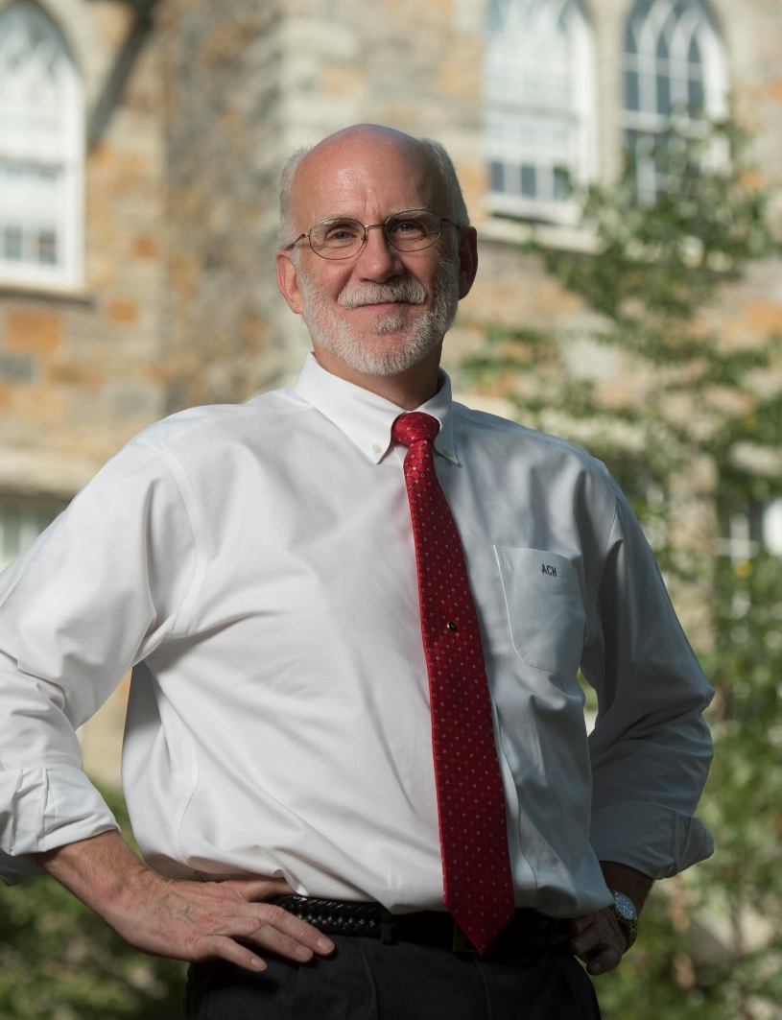


About that Interim Provost (2):
An adjusted nameplate on my door:
Art Heinricher
Recurrem
Provost ad Interim
I have had many roles at WPI:
I think I have always been “interim”!

Slide 12
WPI and COACHE…
2014
  Change in Leadership: Interim President
  Strength: Tenure (+)
  Concern: Promotion (-)
  2017
    New promotion criteria
    Greatest improvement: promotion process
2021
  Pandemic Impact
  “No areas of concern”
  Variation between schools
2024
  Just completed two years with
    2 presidents and 1 interim
    1 provost and 2 interim
  New COACHE Report:
    19 Areas of Strength
    1 Area of Concern
    Lots to talk about!

Slide 13
COACHE Working Group:
Membership:
  Co-Chair: Administrator + Faculty Governance Chair
  Director Teaching & Learning Center
  4 Faculty
  Staff support
Aside:
The Teaching & Learning Center is a “trusted campus hub” where faculty share work related to professional development
Notes:
Charge from President and Provost: emphasize commitment to share the report and the data.

Slide 14
Charge to the 2024 COACHE Working Group:
Conduct a top-level review of the COACHE report; prepare and deliver a preliminary presentation of strengths, weaknesses, significant within-group differences, and changes since 2021 (and 2017) to the following audiences:
  the faculty in October,
  academic leadership by December, and
  the Board of Trustees at its February 2025 meeting;
Seek community input on areas that should be prioritized for additional conversation, inquiry, and action;
Encourage and facilitate examination of the data by any other interested individuals and groups;
Prepare a brief report with recommendations for a small number of focus areas, and appropriate groups to address each area in the next phase of study and action.
Notes:
The Director of our Teaching and Learning Center (where we base much of our faculty development effort) has always been co-chair or member of the Working Group. (Member this year because she started last month!) The Center has structures for communicating with faculty around faculty issues of interest.

Slide 15

Comments:
Scientists (Engineers) want to answer questions
  Use data to start conversations, not end them
Comparison and conversations with peers
  Connecting with this community is powerful…

Slide 16
Thank you!
Time for Conversation?

