Slide 1
Re-engaging with Data and Stakeholders After Common Survey Administration Setbacks
Heather Kelly, Director of Institutional Research
Matt Kinservik, Vice Provost for Faculty Affairs
21 October 2022

Slide 2

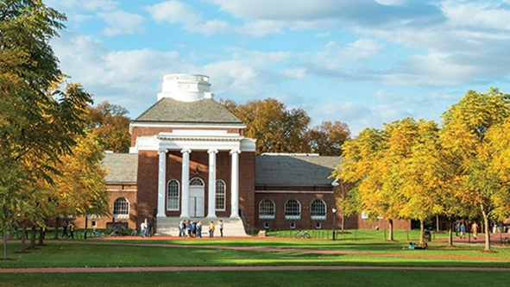
About the University of Delaware
State-assisted yet privately governed public institution
Land Grant, Sea Grant, Space Grant and Carnegie Doctoral University – Very High Research Activity (R1)
Received the Carnegie Community Engagement classification in 2015
Located in Newark, Delaware, a suburban community of more than 33,800, situated midway between Philadelphia and Baltimore
24,039 students in fall 2022 [34% Delaware residents; non-residents primarily from NJ, NY, PA, MD; ~ 11% are International]
1,347 faculty members in fall 2022
The University of Delaware is committed to excellence in undergraduate and graduate education, research and service.
Notes:
Heather
When we are asked is the University of Delaware public or private the answer is yes! For example, while most public institutions use GASB (Governmental Accounting Standards Board) reporting standards, UD uses FASB (Financial Accounting Standards Board).
Carnegie Classification based on 2021 update
We currently have six definitions for faculty (CDS, F&F, BOT, AAUP, IPEDS, Provost). Faculty count based on Facts & Figures and includes tenured/tenure track full-time faculty, non-tenure continuing track full-time faculty, non-tenure temporary or S-contract full-time faculty, chairs and center directors, and tenured faculty with administrative appointments, and part-time faculty (n=20).

Slide 3

UD’s COACHE Timeline
February - April 2020: Survey administered
July 2020: Results provided to UD
Fall 2020: Process suspended due to pandemic
Spring 2021: Results disseminated to academic leadership
June 2021: Town Hall meeting to share results; Web site established
Fall 2021: Working groups formed
Summer 2022: Leadership Changes - Provost and Chair of Board of Trustees
Fall 2022: Final report
This Photo by Unknown Author is licensed under CC BY-NC
Notes:
Heather

Slide 4
Recalibration #1: COVID
UD had the first confirmed COVID cases in the state of Delaware
Cleared the campus on 13 March 2020
COACHE survey closed on 20 April 2020
Received results in July 2020
Provost directed that all non-essential service activities be suspended in Fall 2020
Relaunched with Informational Session with COACHE on 4 June 2021
Provided updates to academic leadership and Board of Trustees in Fall 2021
Assembled working groups in Fall 2021
Notes:
Matt

Slide 5
Leadership Updates: Goals of COACHE Process
Survey → Analyze → Recommend Actions
Faculty job satisfaction is more important now than ever.
Survey results are pre-pandemic.
The stresses of the pandemic and of the national conversation about structural racism are significant factors in interpreting our results and making recommendations to address areas of concern.
Academic labor market is fierce. Retention of talent is a key priority.
Notes:
Matt

Slide 6
Working Groups
Working Groups formed to address areas for further study:
Nature of Work: Service
Department Collegiality
Senior Leadership
Promotion & Tenure
Diversity, Equity, & Inclusion
Notes:
Heather

Slide 7
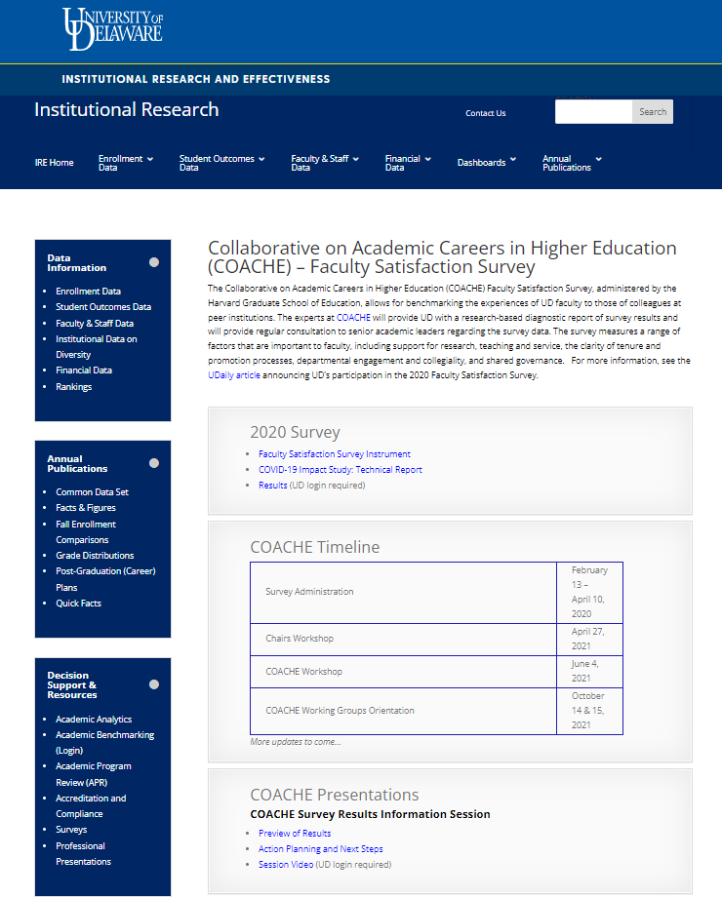
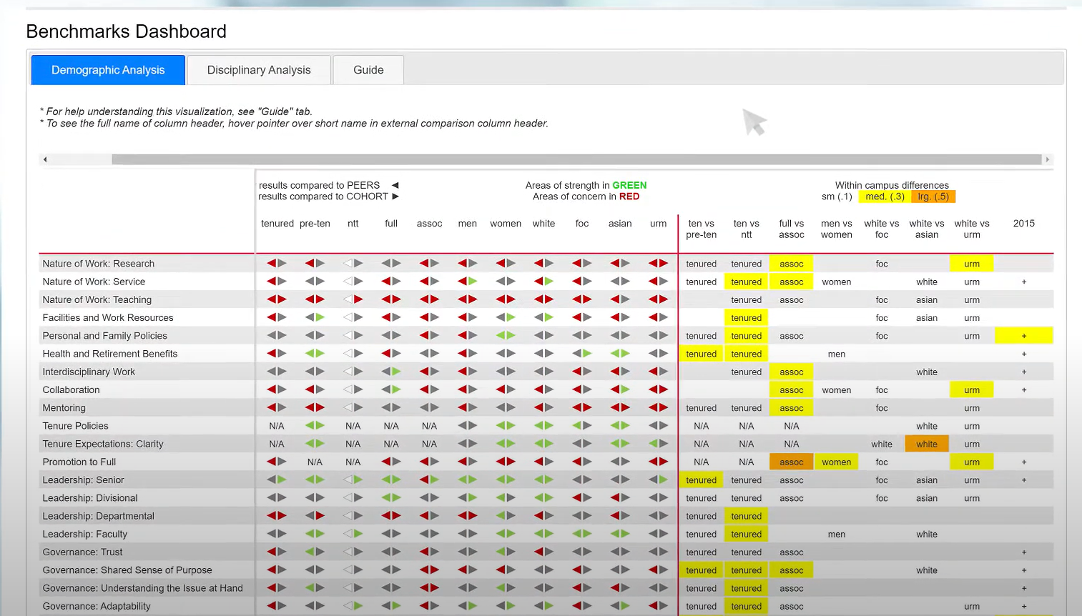
A New Level of Transparency
From Getting to know COACHE’s Chief Academic Officer Report
Notes:
Heather
Data and Support of Working Groups

Slide 8
Recalibration #2: Leadership Turnover
Board of Trustees adopts university strategic plan, Spring 2022
New Provost and New Board Chair, Summer 2022
Issuing final COACHE report delayed in order to engage the Provost
COACHE final report recommendations are an opportunity for new leadership to engage with faculty and commit to actionable steps to implement strategic priorities
Notes:
Matt

Slide 9
Outline of Final Report:
The Four Three C’s of COACHE
Communication
Collaboration
Coaching
Climate
Notes:
Matt

Slide 10
Climate
Climate is of primary importance. A poor climate is a chief reason for attrition, whereas a good climate promotes happiness and high achievement. We can do many things in response to the survey, but if we fail to improve the climate for faculty, we will not ultimately be successful.
Notes:
Matt

Slide 11
Coaching
Coaching is the key to improving and maintaining a good climate. For example, effective coaching can empower campus leaders and faculty peers to improve the climate by addressing issues of poor performance and uncollegiality. And building a culture of care and mentorship will promote and celebrate faculty success.
Notes:
Matt

Slide 12
Collaboration
Collaboration is the foundation of shared governance. Honesty, candor, transparency, and consistency are the hallmarks of effective collaboration. It depends upon trust, clarity of roles, good communication, and a strong sense of a shared mission. Identified as an institutional strength in the survey results, collaboration means both working together and equitably distributing and rewarding our work.
Notes:
Matt

Slide 13
Lessons Learned
Setbacks cost in time but realize the benefits. For example:
COVID interruption led to a more thoughtful process
Able to engage new Provost in COACHE discussions which leads to faculty engagement and boosts implementation of the University’s strategic plan
Notes:
Matt

Slide 14

Ask questions, share your experiences…

