Slide 1
Strengthening Institutional Success Through Collaboration:
Insights from Iowa State University
Tera R. Jordan, Ph.D.
Assistant Provost for Faculty Success
Thursday, July 30, 2026

Slide 2
Overview
Iowa State University
Our commitment to COACHE
Our approach to COACHE
Comments and questions

Slide 3
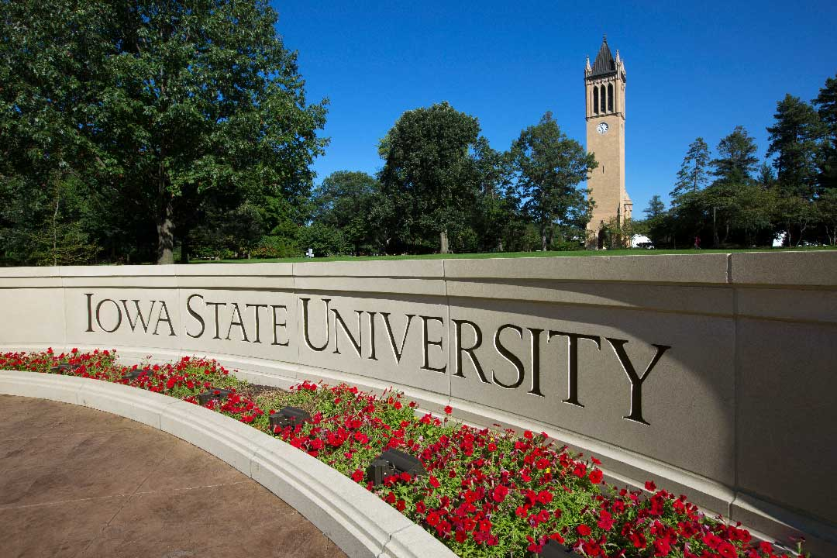
Iowa State University
A land-grant institution in the heart of central Iowa
Founded in 1858 (First Morrill Act)
1,700 faculty
31,105 total students (fall 2025)
The Cyclones
Notes:
Land-grant institution in the heart of central Iowa, 35 minutes from Des Moines, Iowa
Founded in 1858 (First Morrill Act)
1,700 faculty
Fall 2025 At a Glance
Total Enrollment: 31,105 students
Undergraduate Enrollment: 26,346 students
Graduate Enrollment: 4,116 students
Professional Program Enrollment: 643 students
The Cyclones

Slide 4
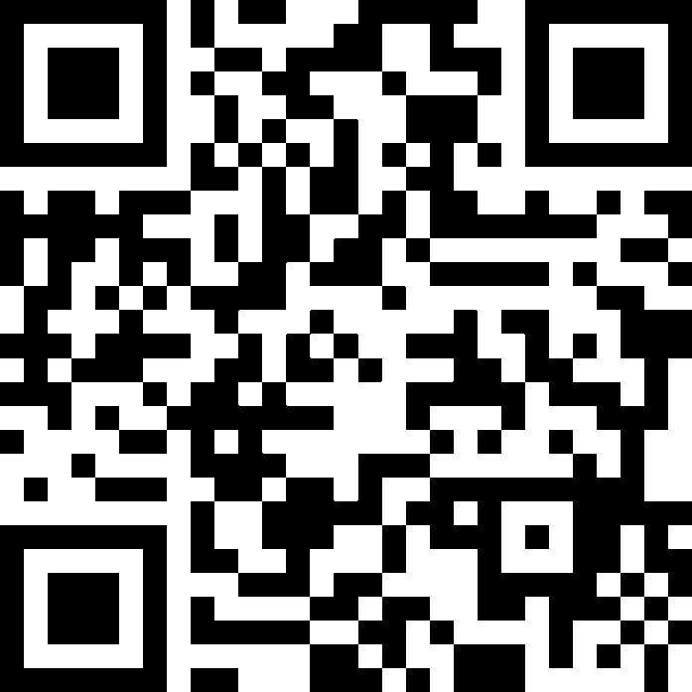
2026 COACHE Faculty Job Satisfaction Survey
February 2026 – April 2026
Key consideration: Presidential Transition
Achieved a 58% response rate
  Peers: 34%
  Cohort: 39%
  2021 response rate: 56%
Notes:
Highest response rate thus far—
2021: Iowa State – 56%, peers – 40%, cohort – 42%
Winter 2016 – 2027: Iowa State: 49%, peers – 45%, cohort – 47%
2014 : Iowa State – 50%, peers – 47%, cohort – 49%

Slide 5
Trusting the Process
Experience is the best teacher.
Joint video message from the Provost and Faculty Senate President
News articles, announcements, and reminders in university-wide and college-level faculty and staff newsletters and department-level, faculty meetings
Notes:
Experience is the best teacher.
Second survey administration with COACHE
Lessons learned in 2021
A COACHE institution since 2006
Joint video message from the Provost and Faculty Senate President
News articles, announcements, and reminders in university-wide and college-level faculty and staff newsletters and department-level, faculty meetings

Slide 6
Trusting the Process
Two presentations to the Faculty Senate
COACHE Reminders
Institutional reminders:
  Provost
  Assistant Provost for Faculty Success
  Faculty Senate President
Notes:
Two presentations to the Faculty Senate: (1) What did we learn about COACHE? (2) Planning for COACHE – What to expect?

Slide 7
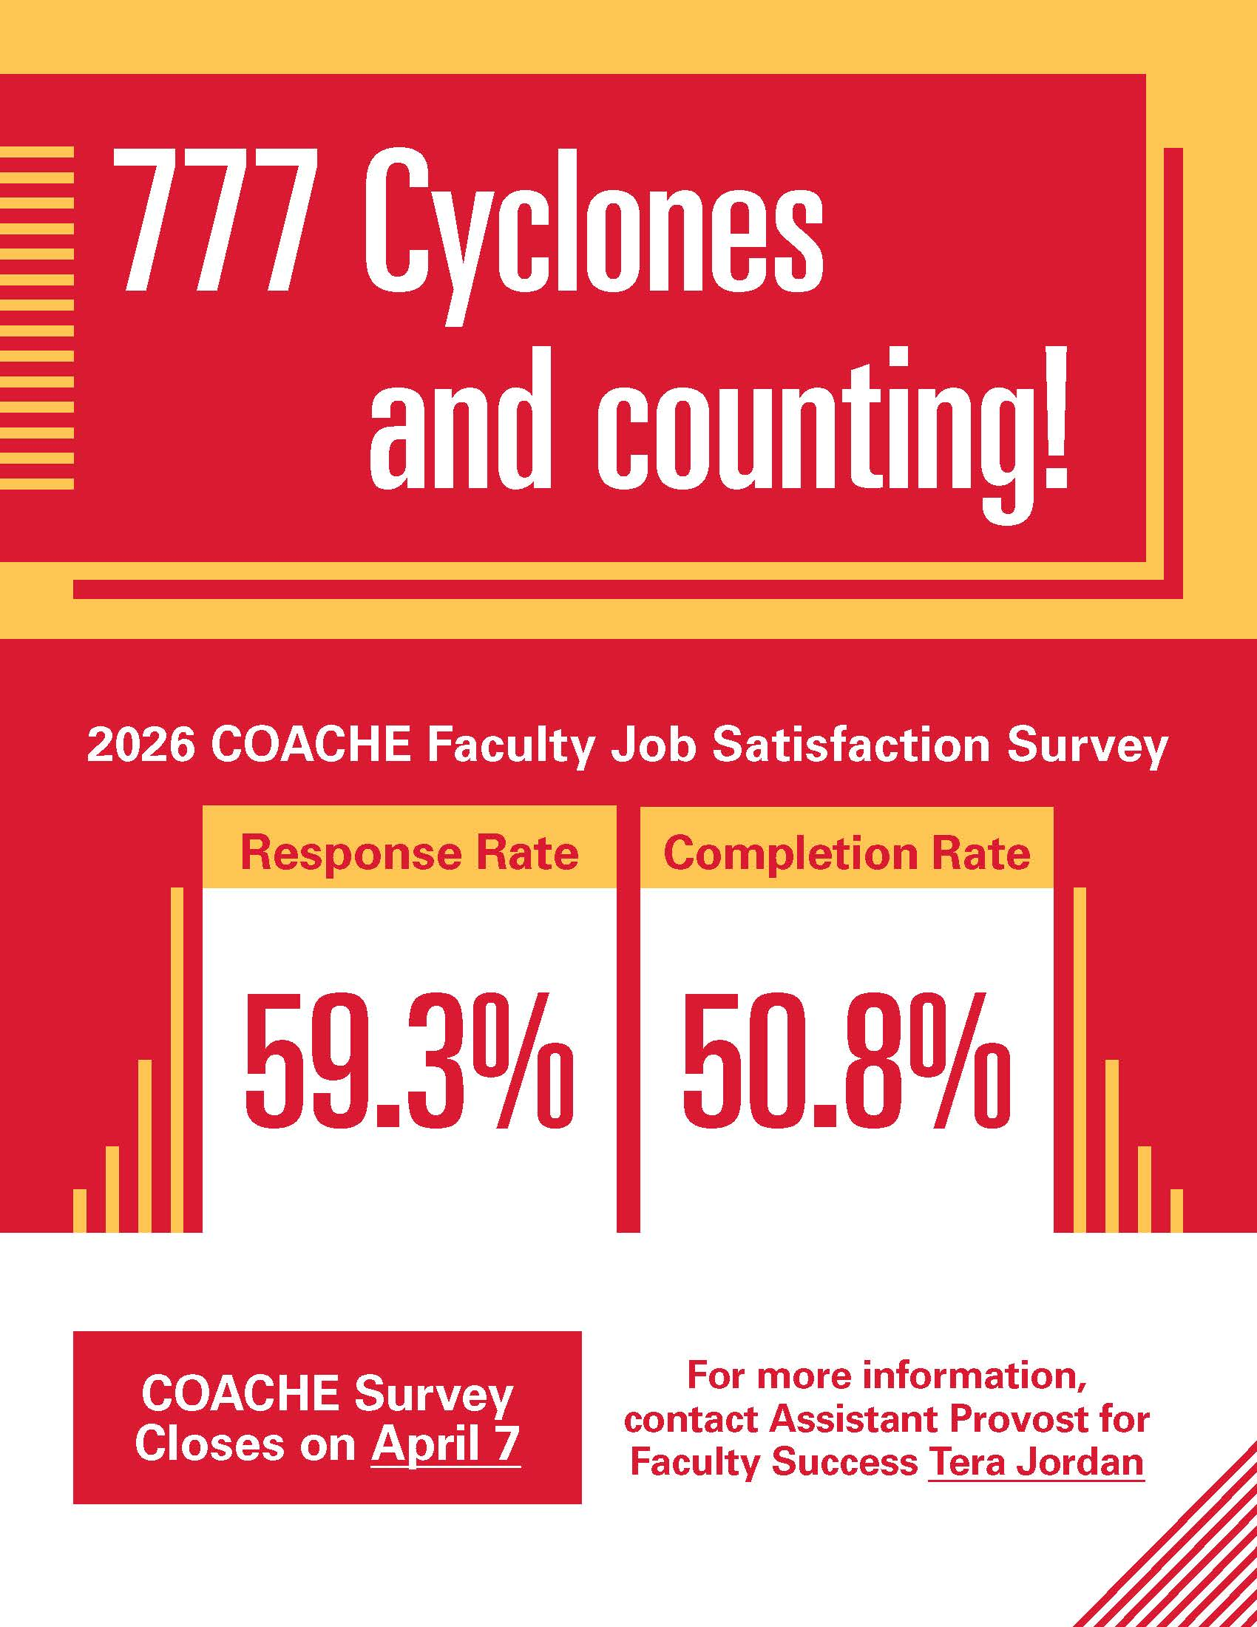
Notes:
April 1, before the data was cleaned

Slide 8
What was new?
Closer collaboration with Faculty Senators to share prepared talking points and underscore significance of the COACHE survey
Closer collaboration with Associate Deans for Academic Personnel
  Prepare talking points
  Share college-level response and completion rates
  Send department-level response and completion rates
Notes:
Faculty Senators = Faculty Development and Administrative Relations Council

Slide 9
What was new?
Direct communication with leaders in the Chinese faculty community to overcome more marginal response to the 2021 COACHE survey
  Achieved response rate: 46%;
  Peers: 26%; cohort: 32%
Endorsements from Faculty Success Advisors, College Peer Mentors, department chairs/school directors, and other key stakeholders
Notes:
Highest response rate thus far—
2021: Iowa State – 42%, peers – 30%, cohort – 35%
2016-2017: Iowa State – 42%, peers – 35%, cohort – 38%

Slide 10
What was new?
Department Chair: “OK, I just wanted to put a fire under them.”
Requested department-level response and completion rates from Shabreena and sent this information to Associate Deans for Academic Personnel

Slide 11
What was new?
Ability to see visible improvements in the faculty experience based on actionable steps from the last survey
Regular acknowledgement that the improvements resulted from COACHE motivated faculty to complete the survey

Slide 12
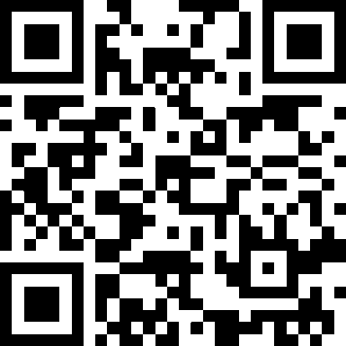
Case Example: Build Collegiality
Area of concern: Departmental collegiality in the 2021 COACHE Faculty Job Satisfaction Survey benchmark
Who is doing it well?
“Why COACHE Teams Should Phone a Friend”
Practical approaches and best practices
Notes:
Example: Strengthening department collegiality
Area of concern: Departmental collegiality in the 2021 COACHE Faculty Job Satisfaction Survey benchmark
Sensitive topic: Resistance to why people are leaving; what was the reason they started looking?
In workshop where I rolled out the data, department chair asked: Who is doing it well?
Reached back to COACHE and asked for connections to peers who are doing it well and leveraged those conversations to “phone a friend” and obtain guidance with
Goal was to process findings and seek solutions in a proactive matter
Reminder: We are a part of a community of practice (increase social interactions, professional conduct in governance documents, restructuring annual performance review meetings: faculty focused)

Slide 13
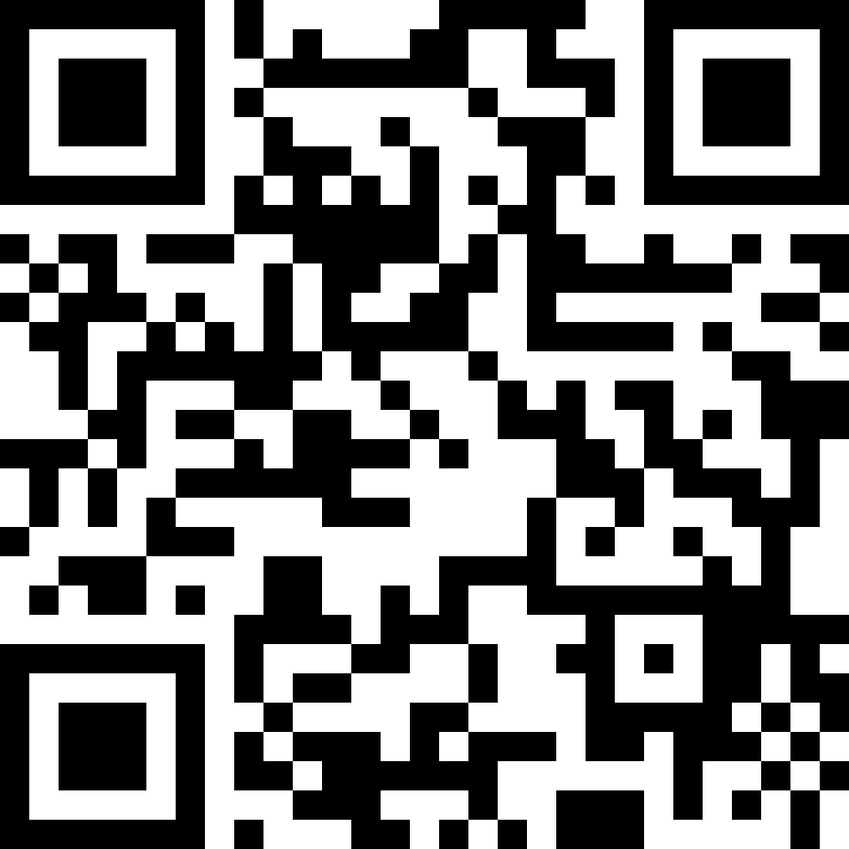
For More Information
Tera Jordan Profile
Institutional COACHE Website

