Slide 1


COACHE Faculty Job Satisfaction Survey: Basic to Advanced
Website
coache.gse.harvard.edu
Notes:
Today, we are going to engage in a simple exercise with the benchmarks and focus our conversation on benchmarks around governance.

Slide 2

LOOKING INTO COMPARATIVE BENCHMARK RESULTS
Strategy Workshop Institutions
Georgia State University
Harvey Mudd College
Iowa State University
Missouri University of Science and Technology
Roger Williams University
San José State University
The Ohio State University
University of Cincinnati
Washington State University
Wellesley College
2026 Institutions
Florida Gulf Coast University
Georgia State University
Harvey Mudd College
Indiana University Bloomington
Iowa State University
Missouri University of Science and Technology
Roger Williams University
Rutgers University - Camden
Rutgers University - Newark
San Jose State University
The Ohio State University
University of Cincinnati
University of Richmond
Virginia Polytechnic Institute and State University
Washington State University
Wellesley College
2026 COACHE Strategy Workshop
Notes:
I've prepared a simple heatmap and graphs to highlight benchmark strengths and concerns. We are looking only at institutions that participated in 2026. However, the designation of a benchmark as a strength or concern is determined by comparison to the entire cohort and selected peers, which include institutions that participated in 2025, 2024, and 2023 as well.

Slide 3
WHERE ARE OUR OPPORTUNITIES TO LEARN?
2026 COACHE Strategy Workshop
Notes:
Notes: When we look at the benchmark heatmap, we can see that within the SW group as well as the 2026 group, there is variation across benchmarks. This means there are opportunities to learn from each other. This is part of why peer benchmarking is valuable.
While it looks like there are many areas we can discuss, we will be focusing in on Governance for this session. The overall means for governance across the cohort are low, and there is a balanced split among this group for whom certain areas were a strength while for others it's a concern. Governance also relates to some of the other benchmarks that showed up frequently as an area of concern, like leadership.
I wanted to focus on these benchmarks because if we think about it, governance is really at the heart of faculty satisfaction. How do they feel about how the institution is being lead and what voice or power they have in that process.

Slide 4
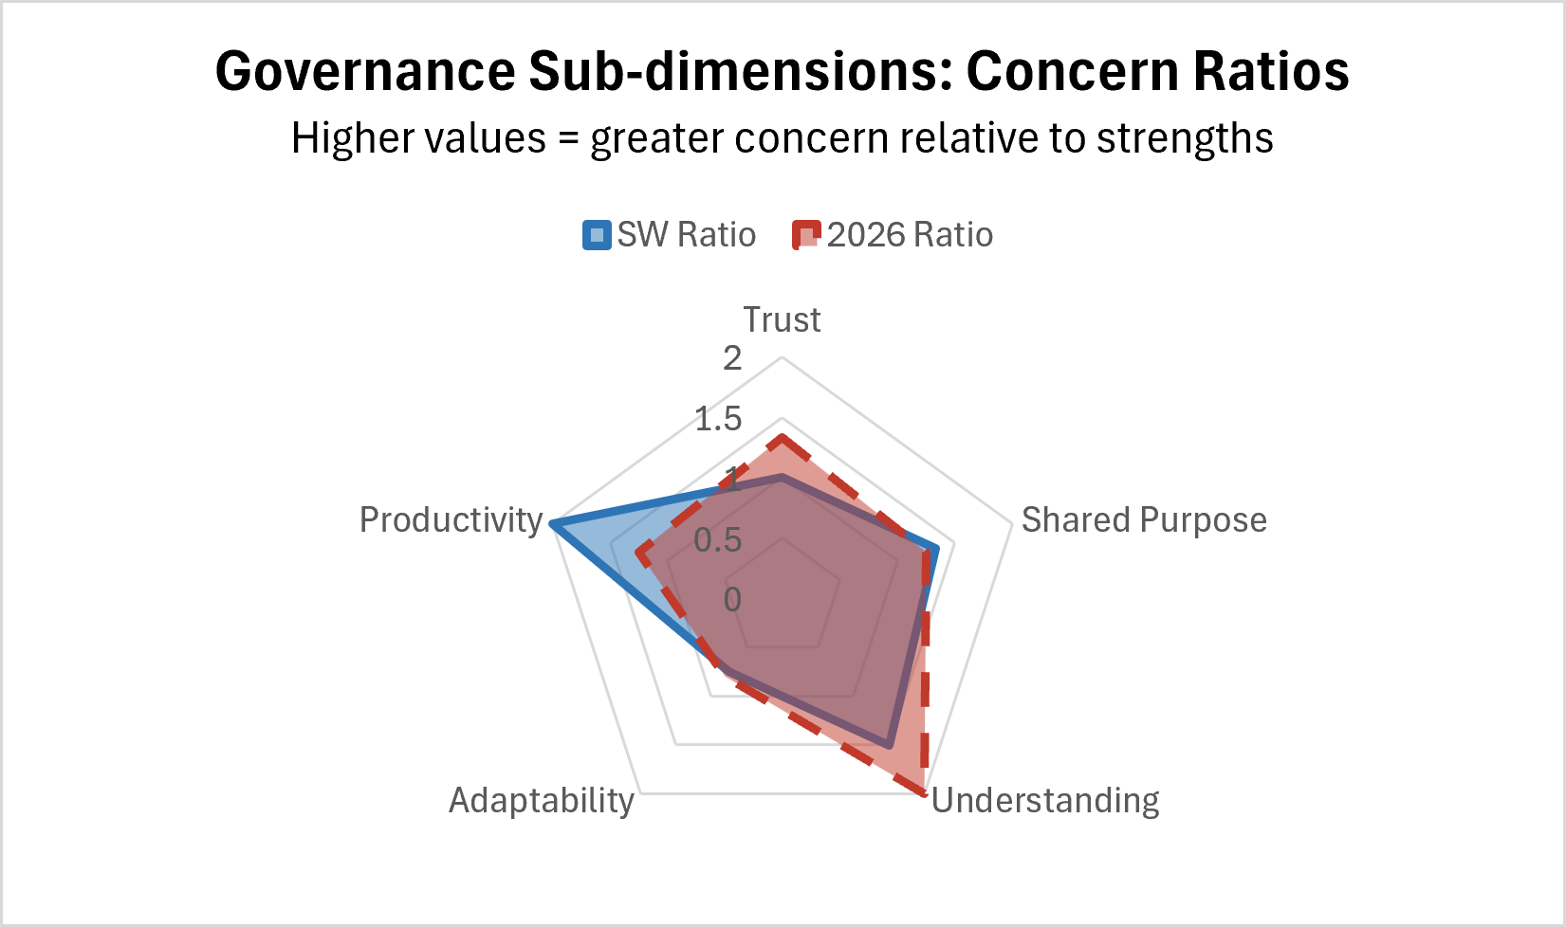
METHODOLOGY
SUMMARY
Methodology Summary: Concern-to-Strength Ratios in Radar Charts
We utilize ratios to account for size differences for the 2026 group vs. SW institutions.
Ratio calculation=number of concerns ÷ number of strengths
  Ratios below 1: strengths outnumber concerns in that category,
  Ratios equal to 1: there are equal number of strengths and concerns,
  Ratios above 1: concerns outnumber strengths.
2026 COACHE Strategy Workshop
Notes:
Methodology: We utilize ratios to account for size differences for the 2026 group vs. SW institutions, and creating radar charts requires a common scale.
The ratio has a simple and straightforward calculation=number of concerns ÷ number of strengths
When interpreting the ratios, ratios below 1 mean that strengths outnumber concerns in that category, equal to 1 means there are equal number of strengths and concerns, and above 1 means the concerns outnumber the strengths.
When we look at the ratios, we can target areas that are of most concern to each groups respectively, by highlighting the benchmarks or categories with ratios higher than 1.
It's important to note that when a benchmark has zero strengths, it is not possible to calculate a true ratio but we use the whole number of concern to reflect that benchmark in the visualization. For example divisional leadership for the SW group has a ratio of 3.
The ratio also does not reflect the total number of instances, which is why we focus on those benchmarks that received a meaningful number of selections (more than 1/3 of the group; more than 3 in the SW group, and more than 5 in the 2026 group).

Slide 5
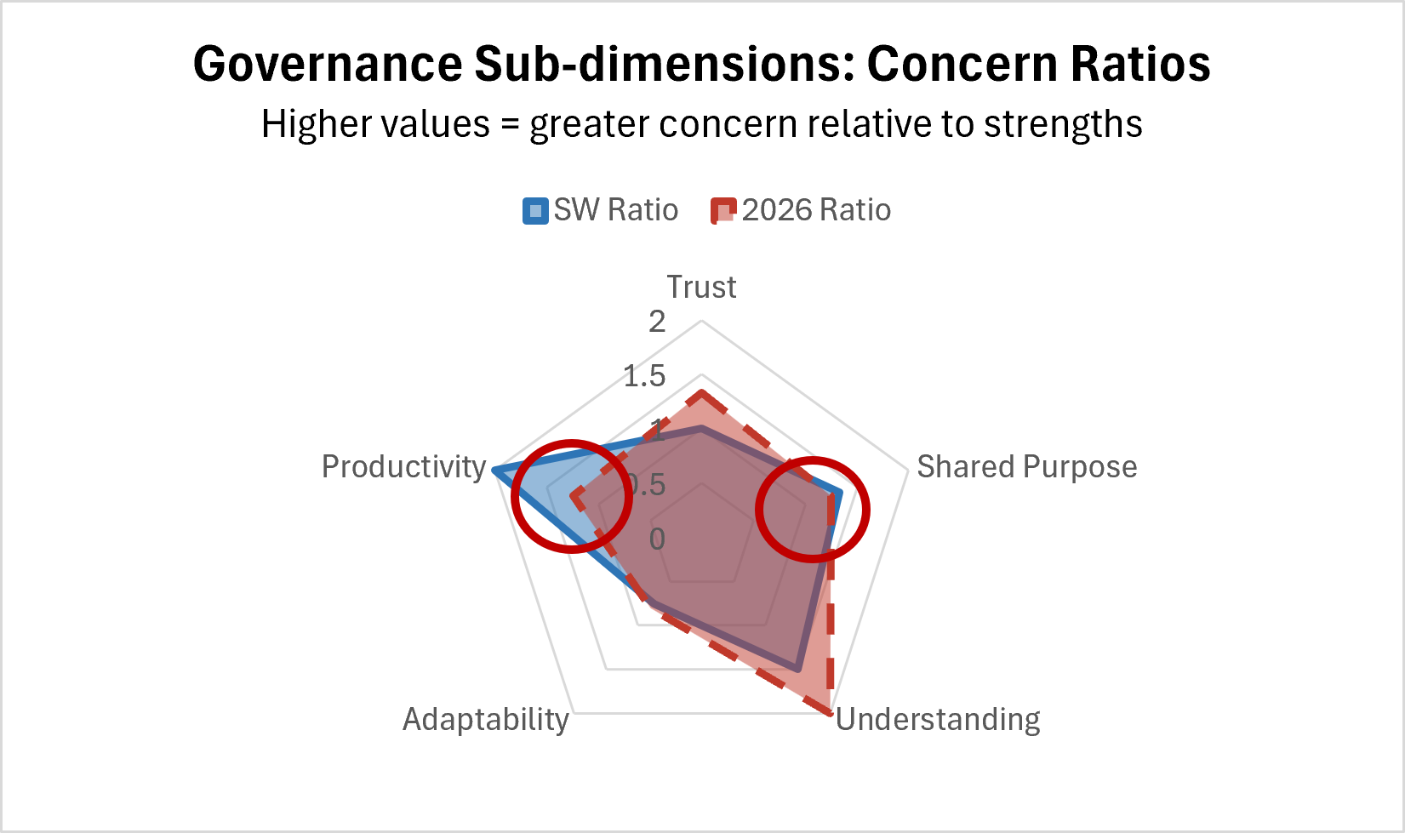
WHERE ARE OUR OPPORTUNITIES TO LEARN?
Questions to consider:
Where are the ratios at or near 1, where some of you succeeding while others are struggling?
What might be driving these concerns for different institutions?
What can we learn from the institutions that are doing well in those areas?
Where is the area that has the highest concern ratios as well as the lowest?
2026 COACHE Strategy Workshop
Notes:
The radar chart points out for us the areas that seem to be the most challenging for the 2026 group and for the SW group, together as well as respectively. Despite these shared areas of concern, and the importance of reflecting on what might be driving these concerns for different institutions, the more fruitful activity for this group would be to focus on areas that have ratios at or near 1, where some of your are succeeding while others are struggling, which means there is an opportunity for insight exchange.
Notes: Further examination in narrowing down which areas might be worthwhile to look into. It's an opportunity to learn and to gain insight in the community of practice. The area that has the highest concern ratios as well as lower means overall are governance benchmarks (shared purpose and productivity) as well as leadership. Shared purpose is indicative of alignment and productivity refers to what is getting done and how quickly.

Slide 6
Do not edit
How to change the design
What are the key areas at your institution where shared governance seems to be the biggest challenge? (Select all that apply)
The Slido app must be installed on every computer you’re presenting from

Slide 7
GOVERNANCE BENCHMARKS
Governance: Shared Sense of Purpose
Q189A_D | How often do you experience the following: Important institutional decisions are not made until consensus among faculty leaders and senior administrators is achieved.
Q189A_E | How often do you experience the following: Senior administrators ensure that there is sufficient time for faculty to provide input on important decisions.
Q189B_C | How often do faculty leaders and senior administrators: Respectfully consider one another's views before making important decisions.
Q189B_F | How often do faculty leaders and senior administrators: Share a sense of responsibility for the welfare of the institution.
Governance: Productivity
Q187B | On the whole, rate the effectiveness or ineffectiveness of the shared governance system at your institution.
Q189A_A | How often do you experience the following: The governance committees on which I currently serve make observable progress toward goals.
Q189A_B | How often do you experience the following: The progress achieved through governance efforts is publicly recognized.
2026 COACHE Strategy Workshop
Notes:
Notes: These governance benchmarks can serve as a reflection of sentiment towards leadership as well.

Slide 8
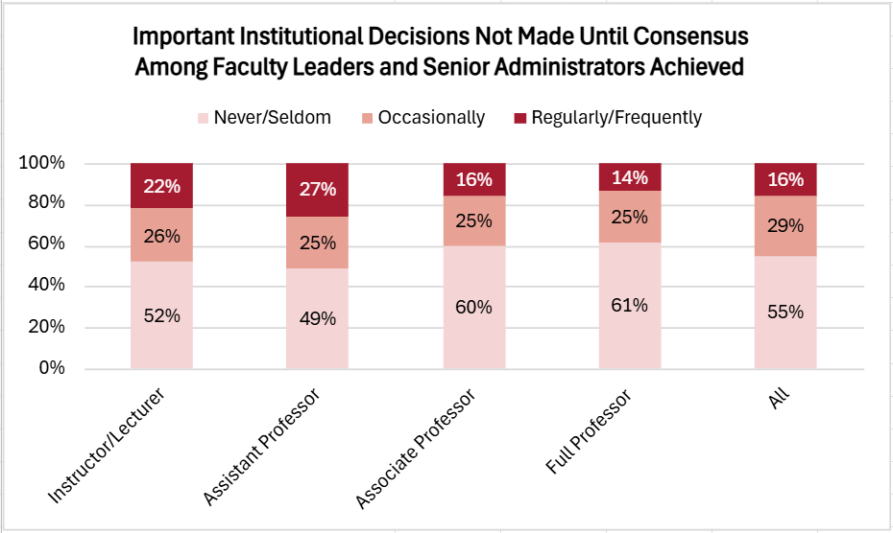
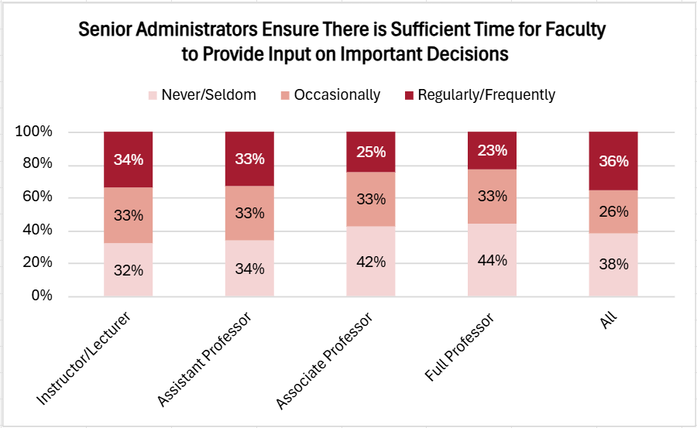
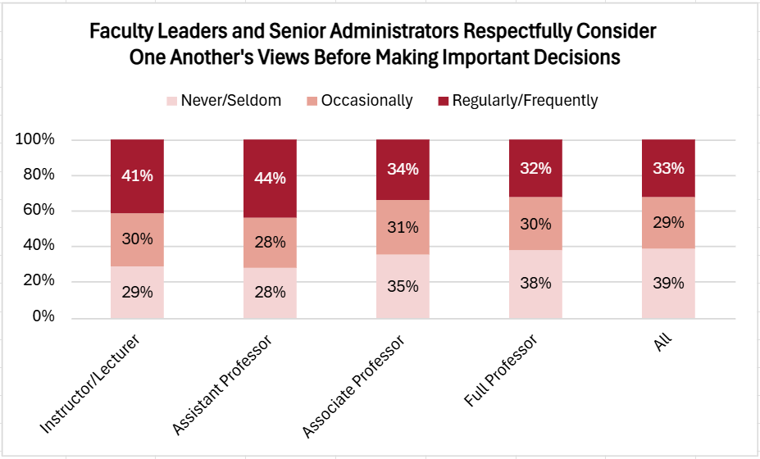
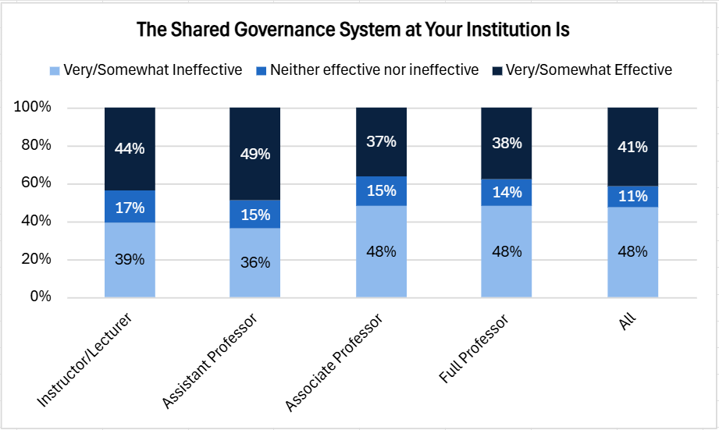

Slide 9
GROUP DISCUSSION
  As a simple and hopefully more universal exercise, we are looking at a few questions by rank.
  Discuss the graph that is placed on your table and consider the following questions:
01
02
03
04
First, consider the differences that you see and discuss what might explain those differences.
How would you describe what shared governance looks like on your campus?
What are some of the biggest challenges your institution faces with successful shared governance?
What processes can be addressed or put into place to help improve shared governance?
2026 COACHE Strategy Workshop

