Slide 1
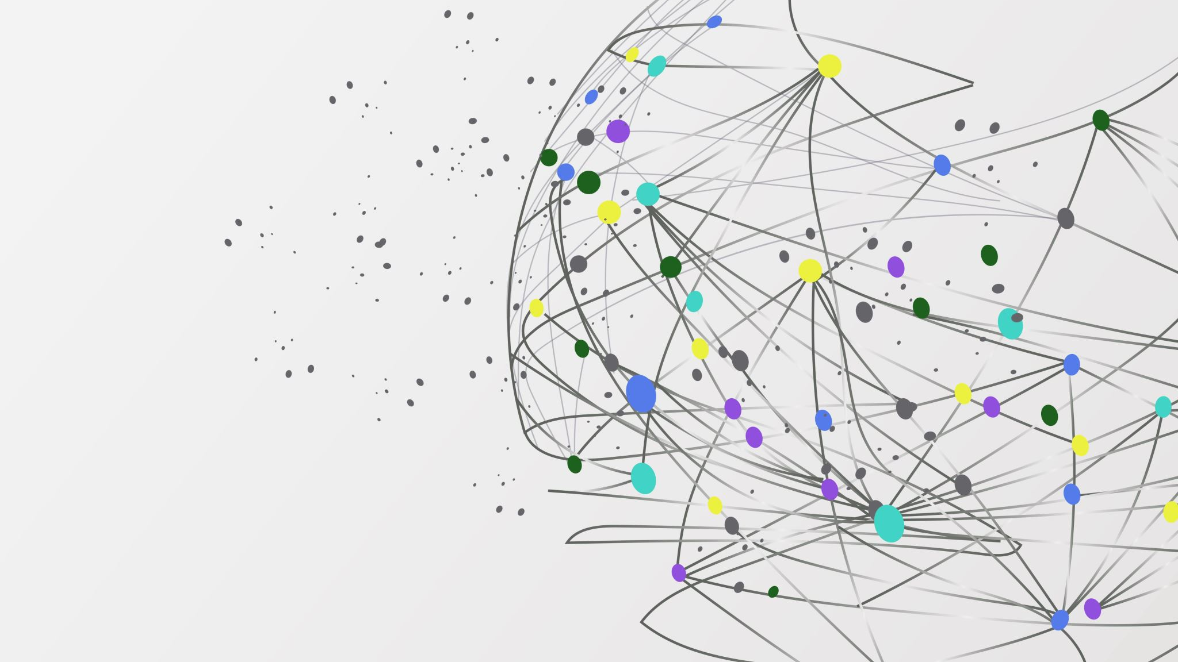

How to Integrate COACHE Results into Strategic Planning
Laura Palucki Blake
Harvey Mudd College
lpblake@hmc.edu |🧵 @lpblake1

Slide 2
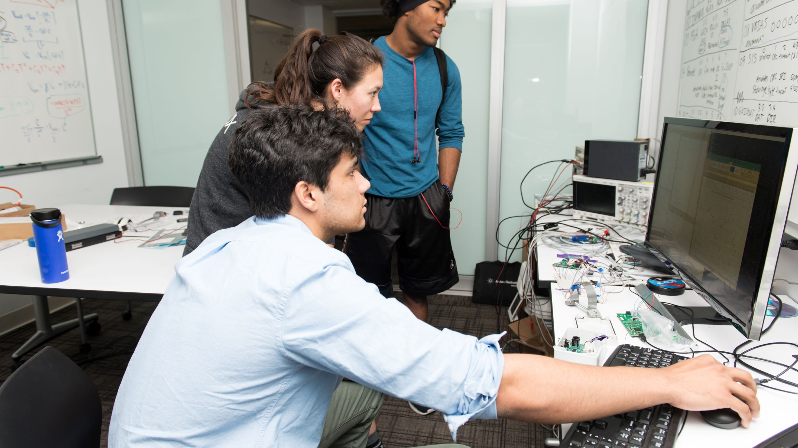
A bit of background…
Notes:
Harvey Mudd College is a small, private, liberal arts college, STEM focus.
~900 UG Students, all STEM majors.
~100 Full Time, Tenure Track faculty, low reliance on contingent faculty.
3rd COACHE administration (2017, 2020, 2023).
New Dean, New President since last COACHE administration. We are heading into a new Strategic Plan.
ME: I am AVP for IR and Effectiveness, been at HMC for 10 years, before that I worked at UCLA in Higher Education Research Institute as the Assistant Director of CIRP. Started career out as Director of Assessment and Faculty in Psychology at Agnes Scott College and taught at Occidental College.
I love this work. At each of the places I worked, I cultivated relationships with Deans, Provosts, faculty that have helped me think about how to use survey data to help make improvements to colleges and universities. Nothing makes me happier than when someone stops by my office or emails and says “I have a question, and I wonder if we have data on…”
My time today is going to be a lot about process. Hot to make inroads with data, specifically with COACHE data.
And I'm going to tell you right off the top, I am not the one putting the COACHE data into strategic planning process, I’m empowering others to use the data and to bring it to strategic planning at the departmental and institutional level.

Slide 3
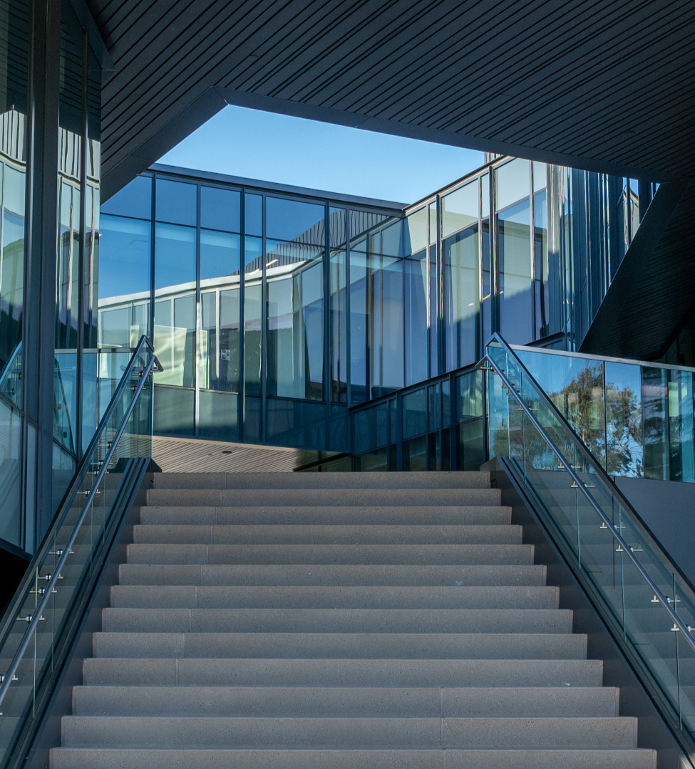
Setting the Stage
Notes:
Right now, sitting here today, I have a list of questions that the leadership at my institution is asking, and I have done a couple of things before I start digging in to the data to set myself up for success.
Our last COACHE administration highlighted a couple of issues that were important for us to tackle. Two benchmarks, clarity of tenure expectations and tenure policies, suggested we had work to do in those areas, so two faculty committees worked to update and reform our faculty notebook. My Dean, the chair of our Faculty Executive Committee, and our new president are all looking forward to seeing how our work in these areas is reflected in those benchmarks.
Super important because we have 11 new faculty members starting this year. I’m starting with this, and I am making sure that the information also gets to our Associate Dean, who is in charge of new faculty orientation
The committees that worked on the changes to tenure policies were ad hoc, otherwise I would share with them as well.
Second thing to think about, Are there themes or urgent concerns that motivated your participation? Tackle those first.
Data on Nature of work - Teaching should go to CTL or Associate Dean
Data on Tenure Policies, faculty leadership to Faculty Executive Committee
Data on Departmental Collegiality, engagement, quality goes to department chairs
(notice these are all going to the faculty, not to the president?)
I also talk to faculty in leadership positions (department chairs, associate deans, head of Hixon Center for sustainability)
We hired a new Director for Sponsored Research and she has emailed me no fewer than 3 times this summer asking me when the COACHE data will be ready, she has items in the “Nature of Work: Research” benchmark that she wants to look at to inform her work.
Identify policies and practices that COACHE data can inform. For HMC it was tenure policies, but in thinking about our issues of workload, there are also practices that have shifted considerably during the pandemic, like emailing off hours, flexibility with meeting times and locations, that we hope will have had an impact on workload for faculty, if not across the board, then maybe in departments or within ranks. And if we spy something that is working, we want to ask, what's going on here and how do we make sure others have access?

Slide 4
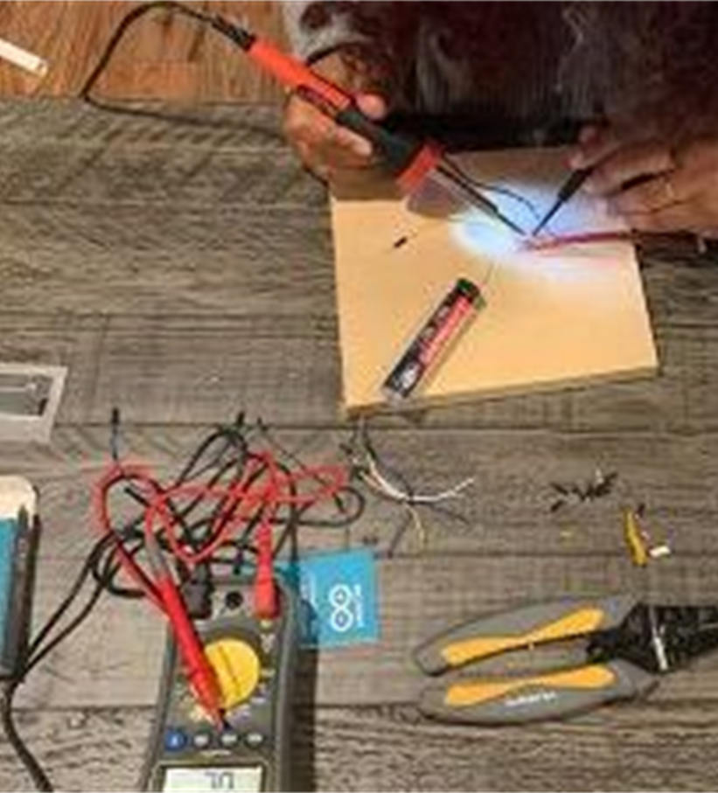
Practical Tips:
Establish priorities and partnerships.
Block time on calendars in advance.
Have places for findings to land BEFORE results are in hand.
Notes:
Establish priorities and partnerships
I have 2 hours next week on my Deans calendar. My previous dean and I spent our 1:1 meetings talking about what we saw and how to share over the course of the fall. There are lots of ways to make this work, but making meaning of this data does not happen by accident.
Block time on calendars in advance. Ask for time in standing meetings with Department Chairs Make those meetings enjoyable.
Having places for the data to go before you know what the results say means the data are expected there, even if the news is not what you were expecting. It means data are less likely to be buried.
Corollary to this is when you block peoples calendars or get on agendas, you have to have to establish the agenda and deliver what’s expected. If it’s a preliminary conversation, a full blown analysis, etc.

Slide 5
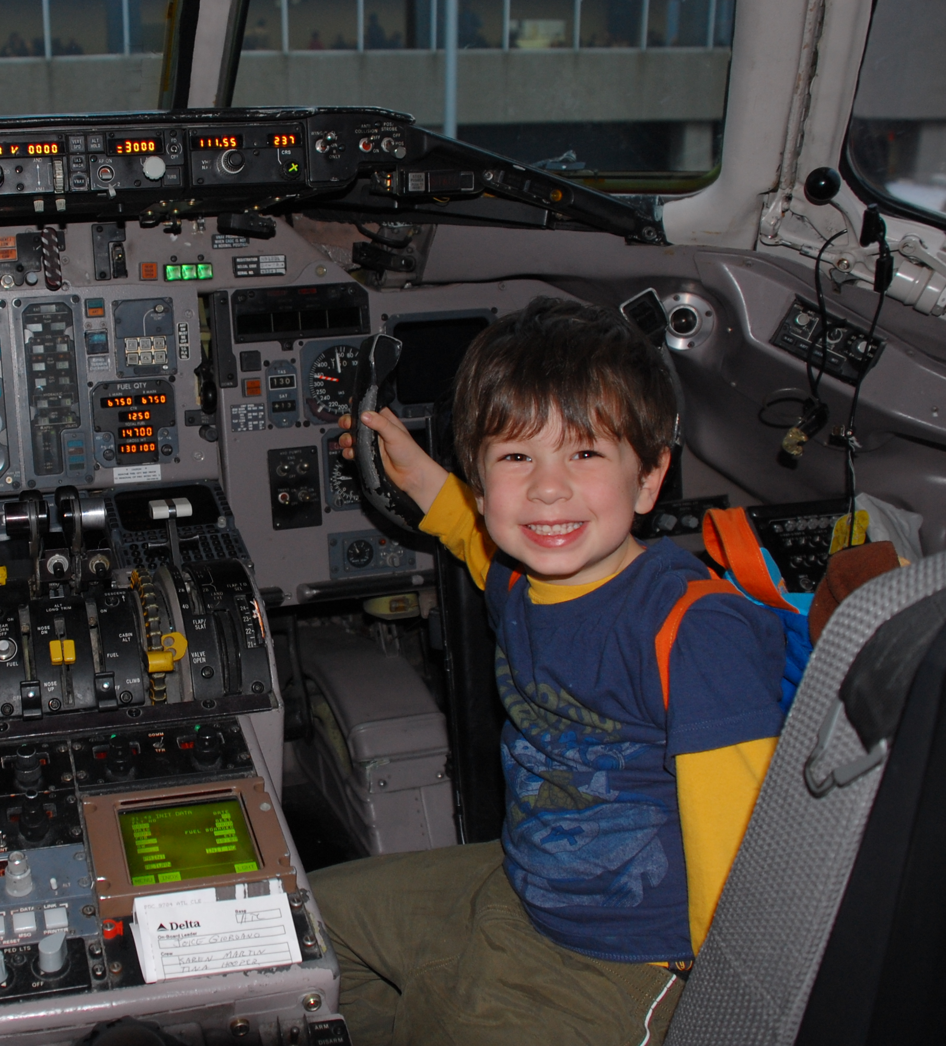
The Importance of Data Stewardship
Notes:
Your COACHE results are like an unaccompanied minor about to embark on a long plane trip.
You would never put a kiddo in an Uber to the airport and just wish them well. You drive them to the airport, park the car, help them check their bags, get them through security, while you are walking them to the gate you make sure they have a snack, have been to the bathroom, know who is meeting them at their destination, at the gate you stay with them until they board. Along the way the airline helps as well, they get a big lanyard to wear with their info, a flight attendant escorts them onto the plane. You must stay until the plane takes off.
Being a data steward is similar. You must stay until the plane takes off. What do I mean by that? I mean I don’t create reports and hand them off to someone else, hoping they will use them.
While it is absolutely true that I collect, analyze, interpret and report on our COACHE data, data stewardship is more than that.
Identify data needs-always listening to my leadership and making links between issues we face and data we have available. Do not always do this in public, and its not always “senior leadership” sometimes its an associate dean, department chair, or committee.
Collect and analyze. I am responsible for the quality of the data and for establishing trust in the findings And I don’t use a lot of sophisticated analysis. Means are usually enough. O my campus I often ask “are you curious, or does the analysis impact your decision making”
Plan and evaluate-I think about how things compare to last administration, how Monitor use to assist teams-how can this be helpful to various committees, etc.
Trusted resource, who keep others from misrepresenting data, or reminding them to use data rather than anecdote
5) Educate data consumers- whether it is establishing and sharing common definitions, providing examples of how similar data could be used my job is to make sure people know what they data can (and cannot) do
Much of my work is about getting people up to speed and in alignment so they can think together about what decisions to make, why they are being made, and how the outcome will be assessed
Data stewardship is the caretaking of data. All data users contribute to data stewardship.
And I stick around until the plane takes off.
(also worth talking about what I don’t do:
Try to be the smartest person in the room, I will lose every time.
Do everything myself-at the risk of too many scientific metaphors, I am a catalyst
Impose my style of work. They have to own the data, that means they get to shape it. I'm there as guardrails to keep them from misinterpreting. But if they want to talk about shared governance data before workload data, so be it.
Avoid conflict – giving feedback isn’t mean, its important offer suggestions to solve the problem and focus on positive impact working together can have

Slide 6

Practical Tips for Data Stewardship
Have a data access plan.
Know your audience.
Emphasize the inquiry model of data use.
Be accessible to leadership.
Be a “neutral” stakeholder
Data as a form of communication.
Work iteratively.
Notes:
So now that I have hopefully convinced you to steward your COACHE data, its good to have some practical tips about how I do that.
Know your audience- I have a faculty full of scientists.
Inquiry model of data use -
Be accessible – if someone has a question, I’m here to answer it. Sometimes Ill put as much as I can on the website, and refer people there. I have emailed Todd with questions my faculty ask. So that they trust.
Be “neutral” - This is not something you can do immediately, but I don’t have skin in the faculty game. I am not on my Dean’s side, or the Department Chairs side or the Presidents side I'm on the side of the COACHE data. I'm going to present it, share what can and cannot be concluded about it,
I use data as a form of communication
Work iteratively. I am not going to stand up here and tell you that each and every time I shared COACHE results its been a wild success. It has not. DEPARTMENT CHAIRS EXAMPLE
Shared what I called the “departmental comparison report” had each benchmark, then overall mean, and mean for each department. I thought this was great. Chairs had been clamoring for this data, and I thought they would love it.
They hated it. It was a set of tables in a 20ish page report. They could not find their way through the data, it was just too much. So they do what faculty do, they asked for significance testing between the means, they asked for confidence intervals, they wanted to know what the N was not for the department ,but for the question.
My dean and I were disheartened. That was not what we wanted them to do. SO we thought about it, I went back to the charts, and I simply highlighted the highest and lowest mean for every question. When you did that, you could see patterns in the data. Both within and between benchmarks. My dean took it back to the department chairs. A totally different discussion happened. They could find their path. They could talk to one another about the data, and not how the data were constructed.
If something does not get your folks to where they should be, talking about what this means. Think about what else they might need. Sometimes what they need is time. Sometimes it’s a different way of presenting the information, sometimes it

Slide 7

Overcoming Resistance
Notes:
(these are hazard communication standard labels they use to label chemicals, but you might also use them to label faculty and administrators. They are explosive, fire danger, accelerant, corrosive, poison, irritant, contents under pressure, and health hazard)
Ask audience for some of the critiques they have heard when sharing results:
The sample is not large enough
The sample is not representative of every demographic that is important to us
Some groups are too small to report on
Data are not as good/bad/clear as we need it to be
This item is worded poorly/not the way our institution works
The results do not represent my experience

Slide 8
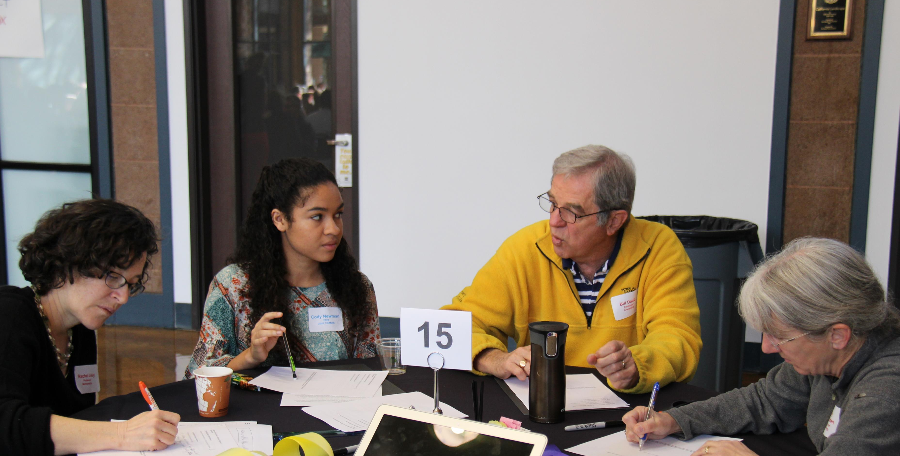
Practical Tips for Overcoming Resistance
Lean into the discomfort.
Create space and time for discussion.
Don’t overload people.
Empower others.
Framing matters.
Use your COACHE partners.
Diffuse. Connect. Persuade.
Notes:
Lean into discomfort—we readily accept that discomfort and challenge are essential components for our students to learn. Same is true here, discomfort and challenge are necessary to creating lasting improvement and change
Create times for people to digest the data, to ask questions, to really think about and make meaning of it together
Give results to them in “chunks” and let them talk, let them circle back to issues and themes.
Empower others.
The way you frame the question matters.
We need to make changes VS what challenges might we face if we don’t make any changes?
X is holding back your department VS in what ways is X impacting the achievement of your department’s goals?
What do we do with this information VS what is the cost of not taking action based on this information?
Use your COACHE Partners
Conflict is not something to fear. Be prepared. Try to understand why the person is so upset, are they afraid? What are they afraid of? Show them you hear their concern and are responding to it, then you can talk with them about the importance of the information you have.

Slide 9
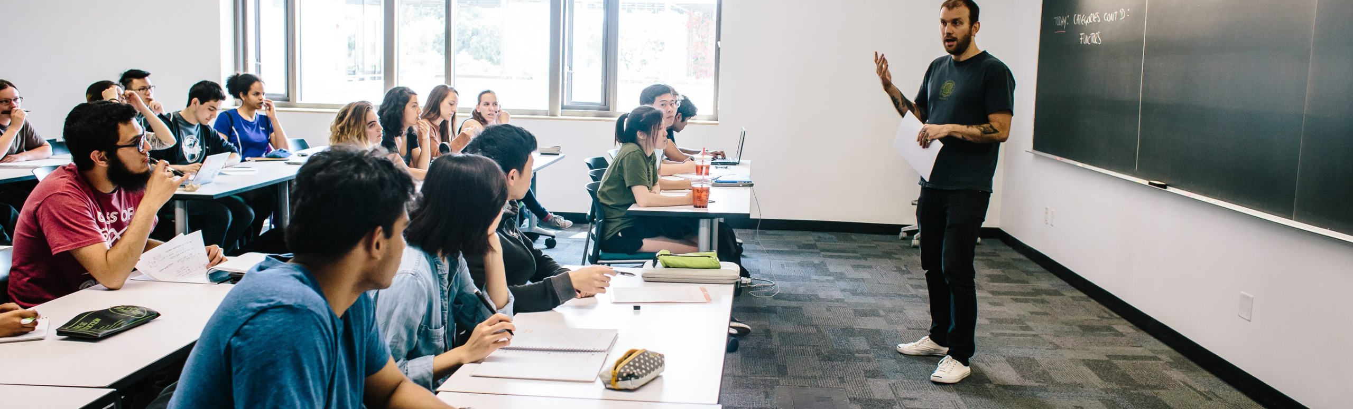
Don’t Lose Sight of the Work
Notes:
COACHE DATA REALLY IS ABOUT THE LONG GAME.
I keep a list of where the findings “go” and the impact they have had. Some of these things are big, like changing the tenure policies or hiring a full time grants person. Others will be smaller victories—all are important.
Think of this as keeping track, not keeping score.
For example, HMC’s 2020 COACHE results have been used to:
Hire a full time Director of Sponsored Research who assists faculty members with proposal development, preparation, and submission, funding agencies liaison (Nature of work: Research)
Update our RPT policies (Tenure Policies)
Inform Faculty Workload conversations (Nature of work: teaching)
Secure additional funding for faculty doing summer research with undergraduate students (Nature of work: research)
Inform decisions about reappointment of department chairs (leadership: Department)
As evidence in WSCUC Reaffirmation
Shared with finalists in presidential search
Inform strategic planning efforts
Why do I do this? Because our COACHE results are not just data. Data is always about people. And not just any people, my people. COACHE results represent my colleagues. The faculty at HMC work tirelessly to teach and research and make our community what it is. I work to center the faculty. these means and red triangles and green triangles are telling our story and pointing us in the directions we need to go. The best way for us to predict the future is to make it ourselves.

Slide 10

Thank you.

