Slide 1



Speak, Inspire, Transform
COACHE: Strategies for Positive
Faculty Survey Engagement
Addrain Conyers
Assistant Provost for Faculty Development
Marist College
A Research-Practice Partnership | 2024

Slide 2



Marist College Context
225 full-time faculty lines
329 part-time faculty
16:1 student to faculty ratio
Faculty
Academic Programs
6 Schools
47 Bachelor's programs
59 Minor's programs
14 Master's programs
1 Doctoral program
15 Certificate programs
6,474 students
5,475 undergraduates
989 graduate students
Students
Administration
5th President (2021)
Provost (2023)
Assistant Provosts (2023)
COACHE 2024

Slide 3
Marist's Path to an 80% Response Rate
Foundation Blocks
Identify key stakeholders
Assemble COACHE team
Communication
Track response rate
Bumps along the way
Next steps
80%
60%
40%
20%
COACHE 2024

Slide 4
Foundation Blocks
Commitment
Conflict
Trust
Accountability
What is COACHE?
  More than just a survey
Why COACHE?
  Improve faculty recruitment
  and retention
  Strategic plan
  Faculty development
  Resource allocation
How will we do this?
  Lencioni Team Model
    Trust
    Conflict
    Commitment
    Accountability
    Results
Results
COACHE 2024

Slide 5
Key Stakeholders
Administration
Faculty
Governance
Staff
Stakeholders
Part-time Faculty
Board of Trustees
Full-time Faculty
COACHE 2024

Slide 6
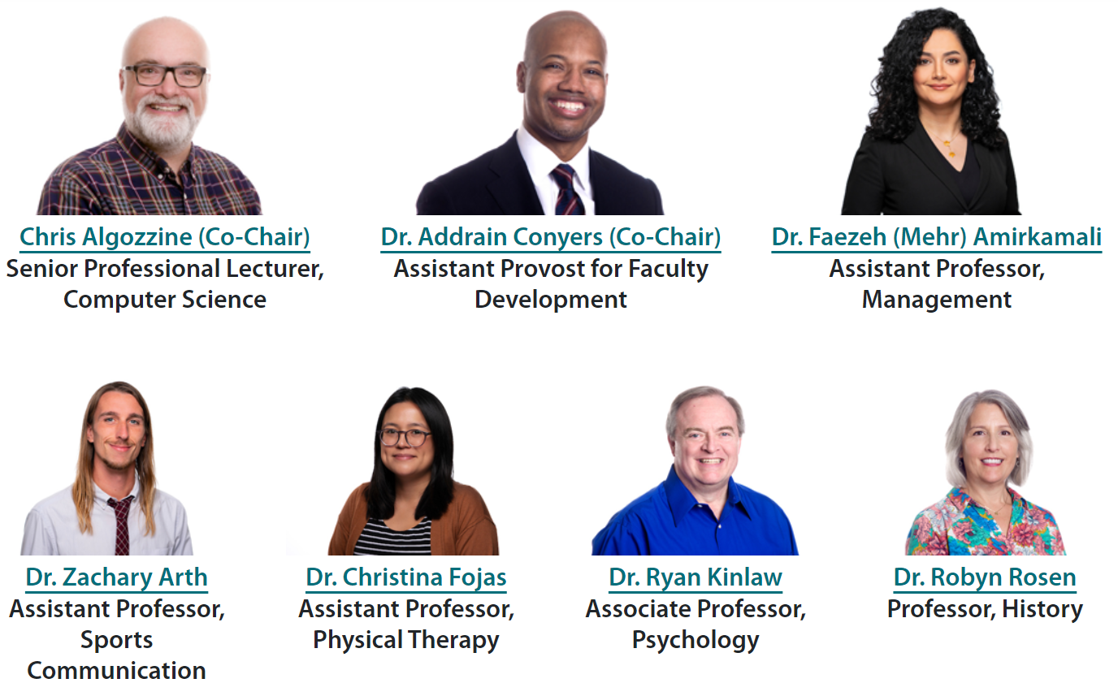
COACHE Team
Faculty Ambassadors
Influential and respected faculty
Mutually decided
Complementary
Representation
  Schools
  Faculty ranks
  Demographics
  Governance
COACHE 2024

Slide 7
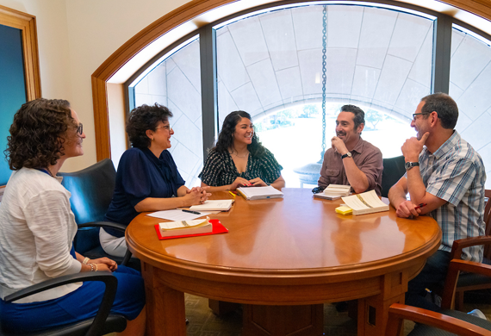
Communication with Faculty
Website
We created a COACHE email address for our institution
Email messages from different administrators (i.e., Provost, Assistant Provosts, and Deans)
Individual school presentations
    Straightforward
COACHE 2024

Slide 8




COACHE World Tour
Find us at a school near you!
17
07
06
JANUARY
FEBRUARY
MARCH
31
Faculty
Plenary
14
SOS
SCA
SLA
JANUARY
FEBRUARY
SBS
SOM
CSM
8
COACHE 2024

Slide 9

Survey Themes
Nature of Work: Research, Teaching, & Service
Interdisciplinary Work, Collaboration, & Mentoring
Tenure & Promotion
Department Engagement
Resources & Support
FACULTY EXPERIENCE
Workplace Conditions & Culture
Appreciation & Recognition
Negotiation
Shared Governance
COACHE 2024

Slide 10
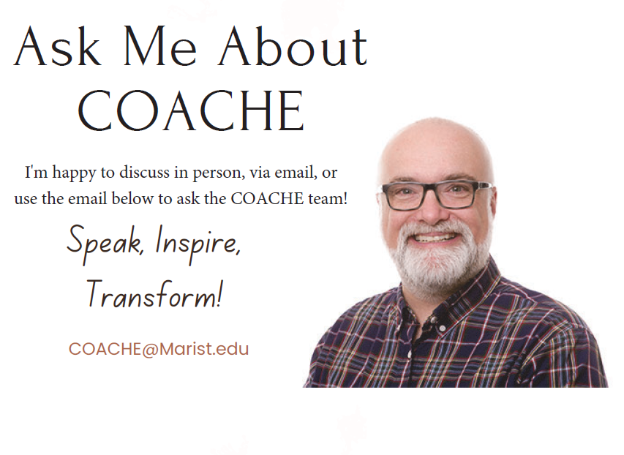
COACHE 2024

Slide 11
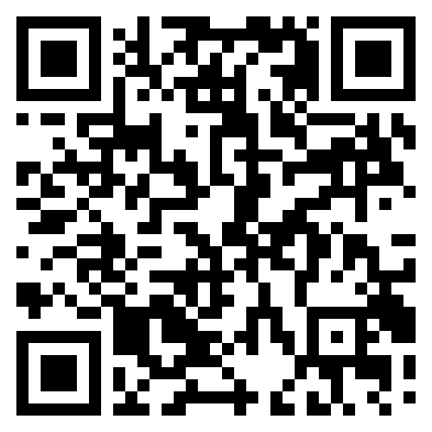
Marist COACHE Website
COACHE 2024

Slide 12
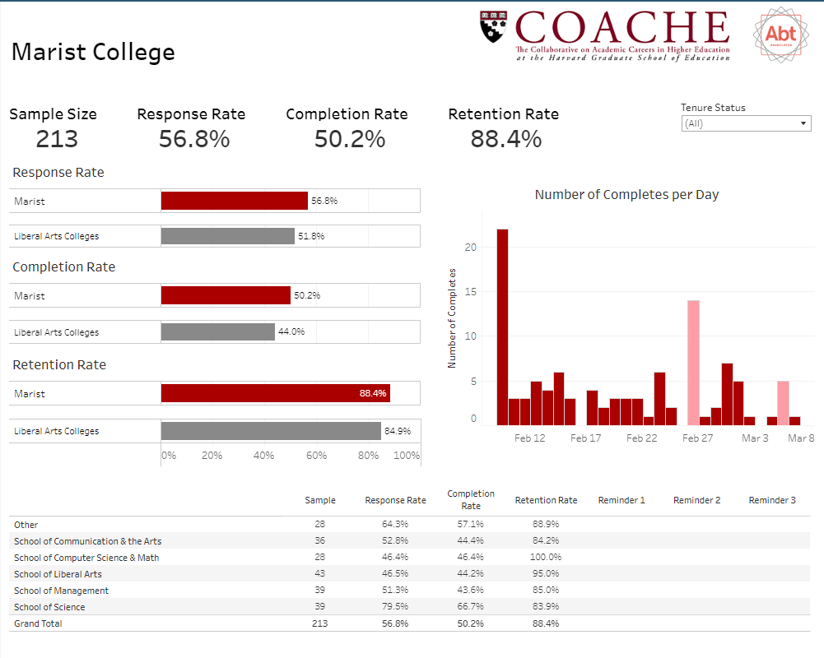
Email weekly updates to faculty ambassadors to encourage participation

Slide 13
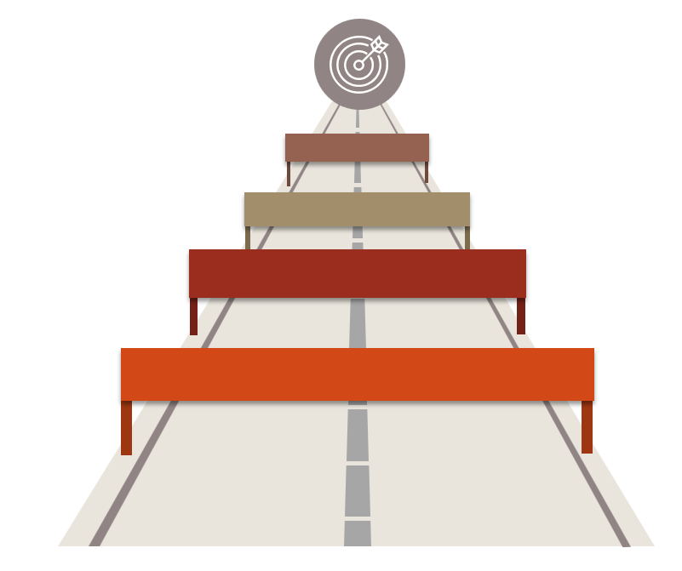
Roadblocks
Trust
Accountability
Lack of incentives
Return on investment
COACHE 2024

Slide 14

What’s Next?
Attend COACHE Workshops
Prepare for findings
  Innovative thinking sessions
  Retreats
Modify COACHE team
  Cultivate more vested faculty
Disseminate data
  Symposiums
  Listening sessions
Strategic thinking
COACHE 2024

Slide 15
Thank You!
Questions?

