Slide 1
2024 COACHE Survey Administration
Karyn E. Rabourn; Associate Professor, Higher Education
Kathleen VanderVeen, Ph.D., Associate Vice President and Deputy Chief Inclusion & Equity Officer
Notes:
Introductions—let’s share a bit about ourselves and how we came to be in this group and at this workshop.

Slide 2
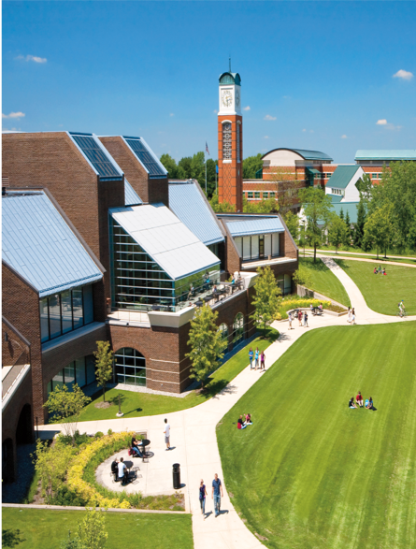
Grand Valley State University
Established in 1963 in Allendale, MI
7 (8) colleges across two campuses (Allendale and Grand Rapids, MI)
Approximately 22,000 students
1,234 faculty members

Slide 3
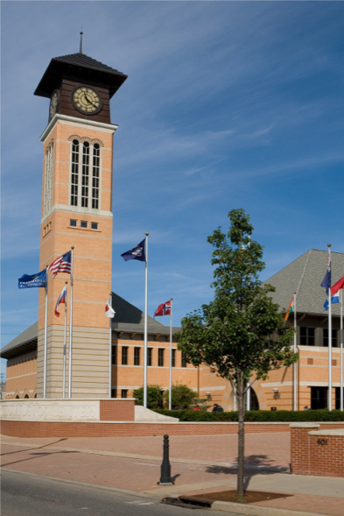
Grand Valley State University
GVSU has administered 7 climate surveys over 30 years (every 4 years approximately) for faculty, staff and students
  Women’s Climate Study was first administered in 1994
  Currently named myGVSU Climate Survey
University-wide task force recommended participation in the COACHE faculty satisfaction survey to gain a more robust understanding of faculty experiences at GVSU

Slide 4
Strategies for climate survey administration at GVSU
Encourage active engagement and community buy-in
  Create steering committee with representation from various colleges, disciplines, and governance committees
Advertising and incentivizing
  Create communication plan
    Website
    Emails
    Meeting with various faculty leadership groups
  Professional development/research dollars, contribution to student relief fund
GVSU has website that shows how the data informed university planning and initiatives

Slide 5
Strategies for climate survey administration at GVSU
Making the case to university leadership
  Tie to mission and strategic planning (accreditation)
  Build on the culture of assessment in IHEs
  Bottomline financial implications
  Recruitment, crisis response, retention, target limited resources
  Present a clear timeline with resource needs and outcomes
  Reiterate why climate is important
  Persistence and Retention of students and employees

Slide 6
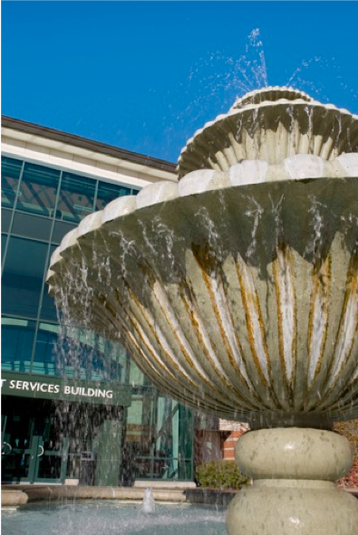
PREPARING FOR COACHE
Office of the Provost: COACHE webpage
COACHE Steering Committee 2023-2024
  Established in July 2023
    Office of the Provost (2, and Chair)
    VP and AVP, Inclusion and Equity (2)
    University Communications Dean/Associate Dean
    Faculty (5)
    AVP (Faculty Teaching and Learning)

Slide 7

COACHE Steering Committee 2023-2024
COACHE Implementation Plan
  July-December 2023 (arrangements with COACHE, planning, working groups)
  Pre-survey communications (October 2023-February 2024)
  Establish of Post-Survey Action Committee (March-April 2024)
  Initial Review of Survey Results and Planning for Fall 2024

Slide 8
COACHE Steering Committee 2023-2024 Working Groups
Communication
  Plan and implement pre-survey communication (written and otherwise)
  Draft email message from Provost’s Office
Custom Questions
  Worked with subgroup to decide if you need them
  Analyze what your goal is for asking

Slide 9
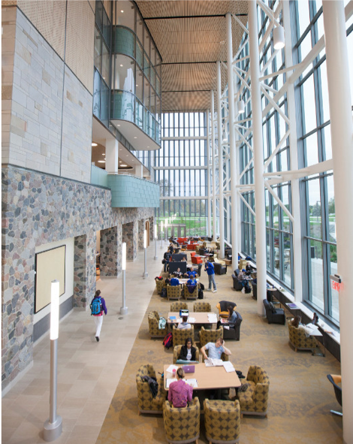
COACHE Steering Committee (2.0) 2024-2025
Committee Membership
  Provost’s Office (2), Division of Inclusion and Equity (1), Senior Leadership Team (1), University Communications (1), Faculty (11)
  Faculty members include affiliate and tenure stream, teaching and library faculty
  Some faculty representatives also serve on University Academic Senate (and its executive committee)

Slide 10
Faculty engagement in their own words…
  I am here because I care a lot about faculty satisfaction and work-life balance.
  There are a lot of really excellent aspects to working at GVSU, in our colleges, with our colleagues, etc. and we should celebrate those. We also have some real challenges that need to be addressed. COACHE will help us uncover both, and provide some nuance through the Dean's Reports, data slicers, etc.
  One reason I’m here is to “sanity check” the results. If the results don’t line up with what I see and hear as part of faculty governance, I want to help us “drill down” and figure out why.

Slide 11
Communication Plan (a few tips)
Know how results will be used before starting
  Clear goals (established by steering committee)
  Clear outcomes
  Clear plan for “action”
Commit to action with results – in writing and statements from leadership on your campus
Engage the community throughout the process
Response rate monitoring
Introduce the timeline to the community once it is established

Slide 12
Questions?
Karyn E. Rabourn: rabournk@gvsu.edu
Kathleen VanderVeen: vandervk@gvsu.edu

Slide 13
Sample timeline

Slide 14
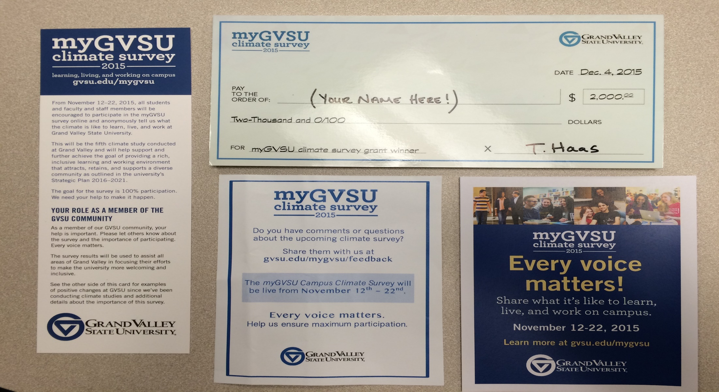
Sample materials

