Slide 1


FIU Bystander Program and Working with COACHE Data
Suzanna Rose, Ph.D.
Assoc. Provost, AWED
Caroline Simpson, Ph.D.
Assoc. Director, AWED
Professor, Physics
Sanaz Farhangi, Ph.D.
Asst. Research Professor, AWED
Kirsten Wood, Ph.D.
Assoc. Director, AWED
Assoc. Professor, History

Slide 2
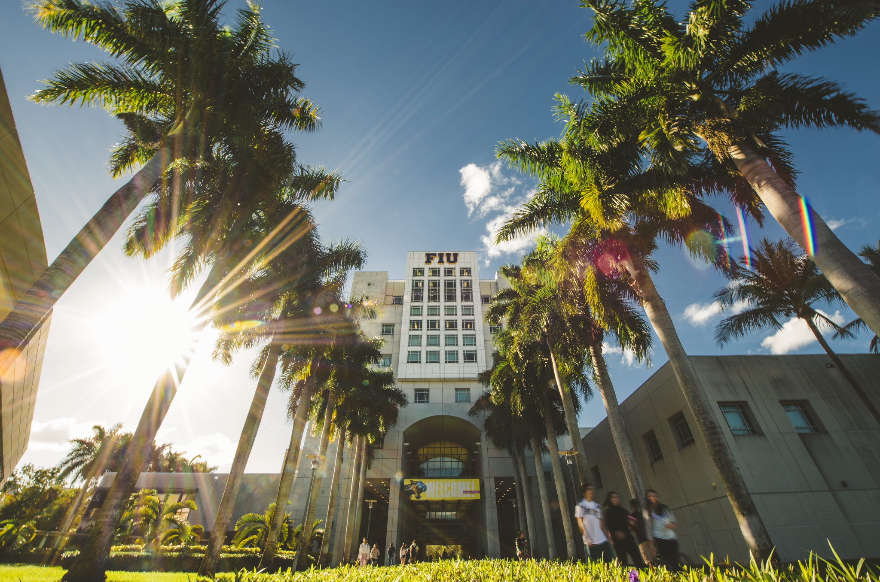
  Florida International University
  Largest Hispanic Serving Institution in U.S.
Student Count: 55,000
Hispanic/Latino: 61%
Black: 13%

Slide 3

The COACHE Faculty Satisfaction Survey
COACHE studies the work lives of faculty
  Focus on actionable data to improve the academic workplace.
  Measures in 25 benchmark areas
At FIU:
  2011, 2014, 2017, 2020
  2020: Sent to FIU full-time faculty including tenure, non-tenure, and clinical excluding Herbert Wertheim College of Medicine

Slide 4


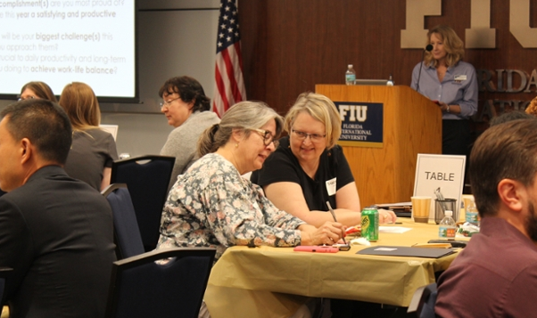

How does FIU use the COACHE survey?
2011 COACHE
  Area of Concern: Mentoring
Intervention
  Created the Faculty Mentoring Program matching faculty in different departments but similar areas and providing guidance for mentors and mentees
Outcome
  2014 COACHE Survey showed mentoring was now an area of strength
Notes:
An example, more to come

Slide 5
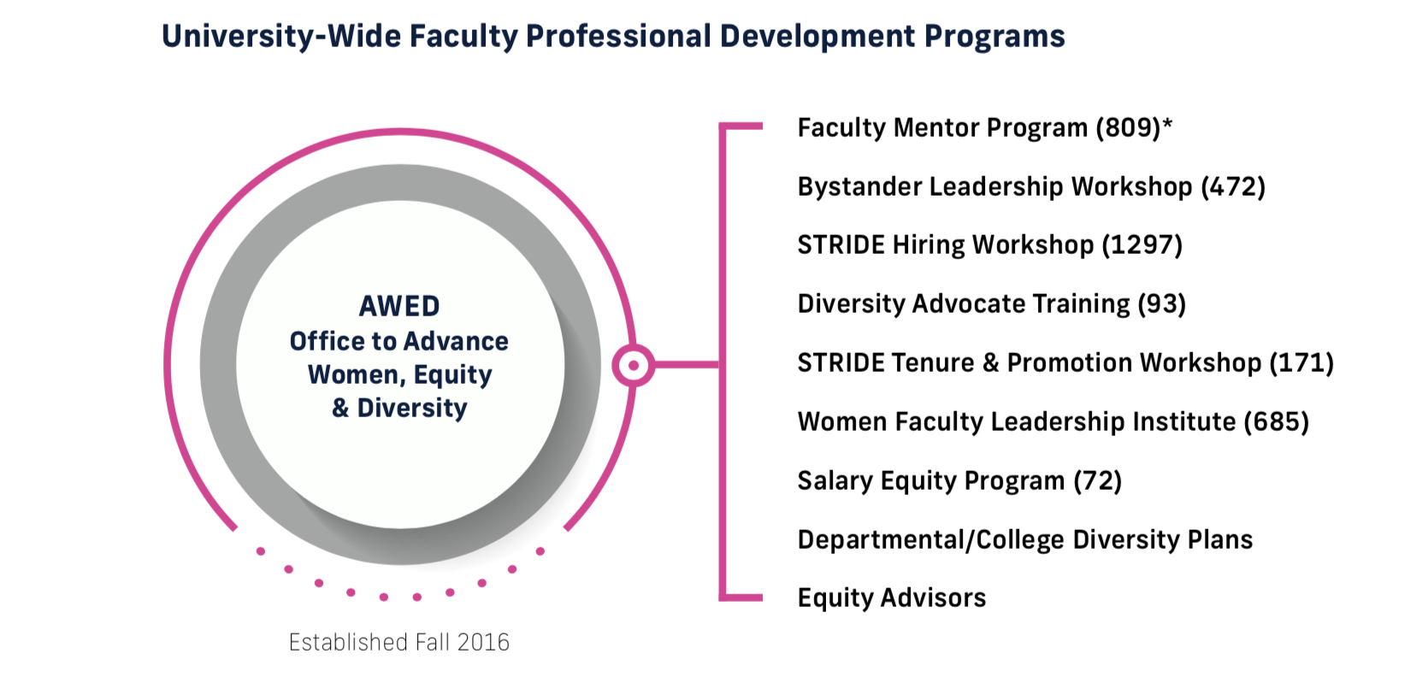

Actions to Increase Diversity and Faculty Satisfaction
AWED founded in 2016 to
administer an NSF ADVANCE Grant** and
leverage COACHE results to improve faculty satisfaction
** to increase the # of women faculty in STEM fields
Notes:
Most of this work was done under the NSF grant, but COACHE was and is used as a measure of its success

Slide 6
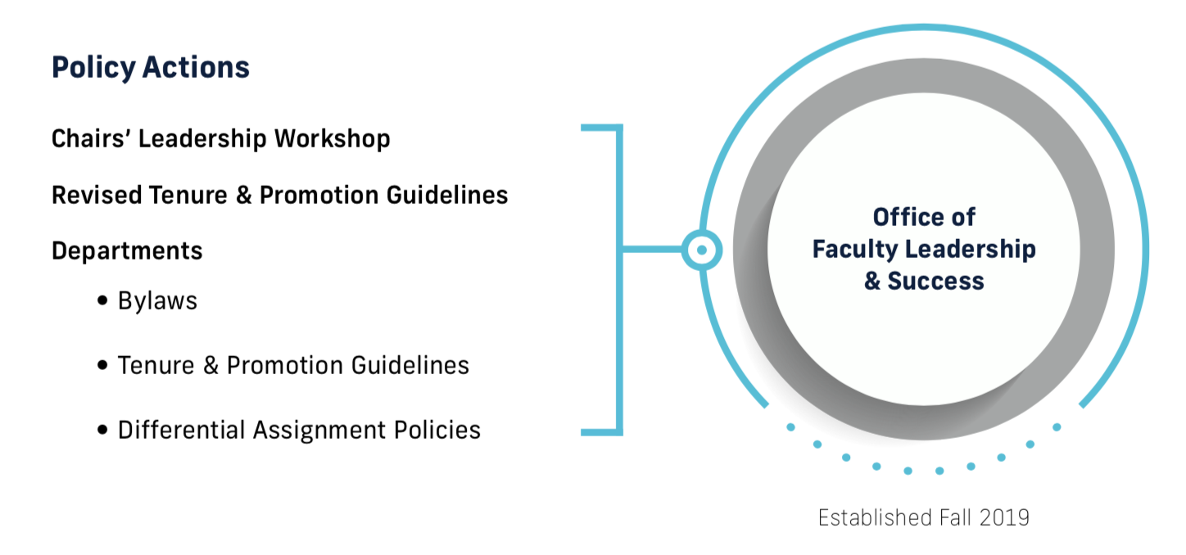
Actions in Response to 2017 Survey
OFLS provides
support, training and leadership opportunities for faculty
and recognizes faculty academic excellence.
Notes:
HR

Slide 7
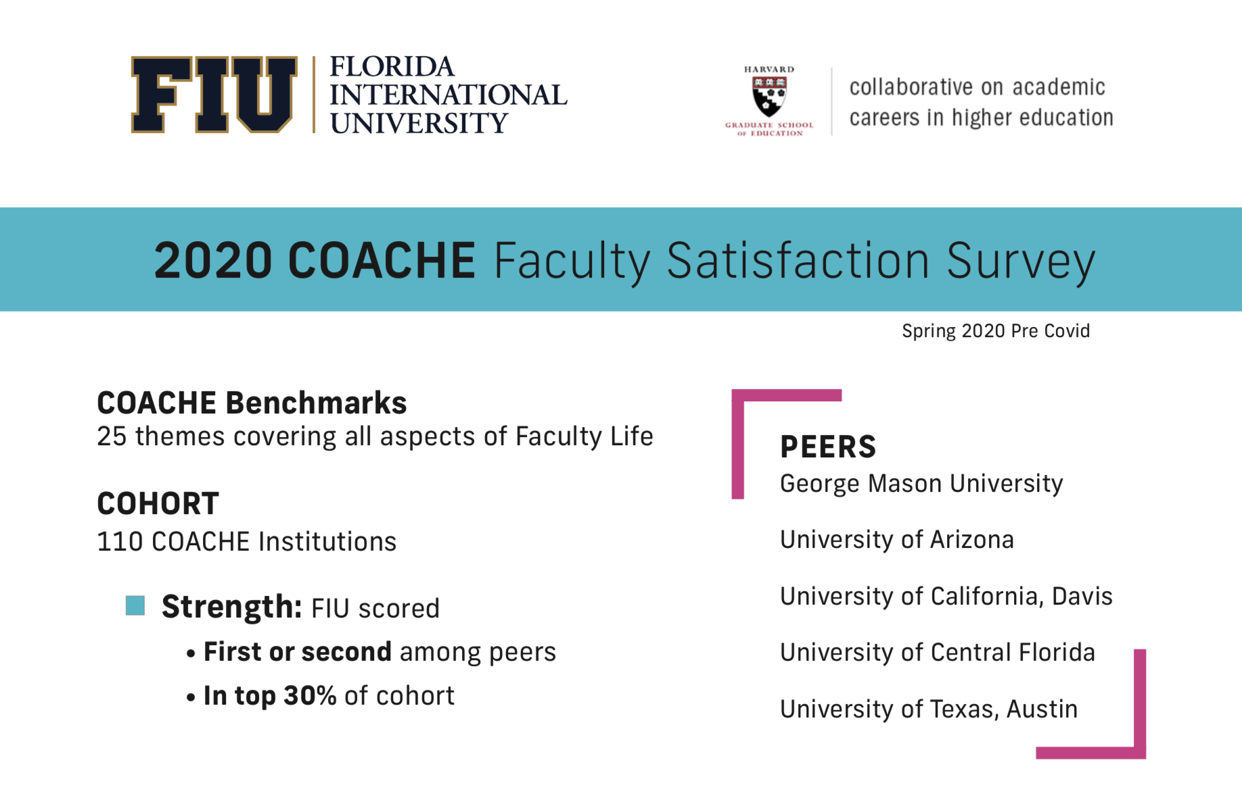
Strength Benchmark: FIU scored
First or second among 5 peers
In top 30% of 110 cohort
Concern Benchmark: FIU scored
Fifth or sixth among 5 peers
In bottom 30% of 110 cohort
Notes:
CS

Slide 8
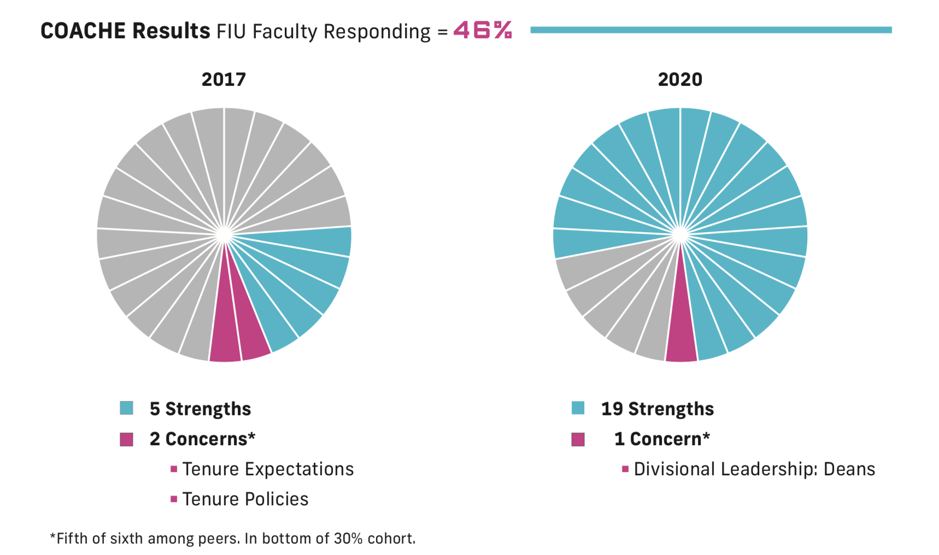
So How Did We Do?
567/1230
Strength Benchmark: FIU scored
First or second among 5 peers
In top 30% of 110 cohort
Neutral Benchmark: FIU scored
In middle 40% of 110 cohort
Concern Benchmark: FIU scored
Fifth or sixth among 5 peers
In bottom 30% of 110 cohort
Notes:
CS
Response rate = ~1.5% higher than peers; up from 40% in 2017!
In this COACHE Chief Academic Officer Report, we define a "response rate" as the percent of all qualified subjects whose responses, following the data conditioning process, were deemed eligible to be included in this analysis. The nonrespondents include faculty who were "screened out" by the survey application or by later data cleaning processes. Therefore, the proportion of faculty who started the survey may be higher than the response rate reported here.

Slide 9
2017 Areas of Strength | 2020 Areas of Strength
Collaboration Leadership: Senior Mentoring Nature of Work: Service Personal and Family Policies | Appreciation and Recognition Collaboration Departmental Collegiality Departmental Engagement Facilities and Work Resources Governance: Adaptability Governance: Productivity Governance: Shared Sense of Purpose Governance: Trust Nature of Work: Teaching | Personal and Family Policies Governance: Understanding the Issue at Hand Health and Retirement Benefits Interdisciplinary Work Leadership: Departmental Leadership: Faculty Leadership: Senior Mentoring Nature of Work: Service
2017 Areas of Concern | 2020 Areas of Concern
Tenure Expectations: Clarity Tenure Policies | Divisional Leadership

Slide 10
  Meanwhile…
FIU STEM Context
Annual number of women earning STEM Bachelor of Science degrees ~900
In 2011, only 11% of STEM research faculty were women (primarily White)

Slide 11
Phase One: NSF ADVANCE Grant 2011-2015
NSF ADVANCE Grant Goal
  To increase the number of women faculty in STEM, especially women of color.
Interventions
  Implemented Strategies and Tactics to Increase Diversity and Excellence (STRIDE) training for faculty on Best Practices for hiring and avoiding unconscious bias.
  Implemented Faculty Mentoring Program (limited to 2 Colleges)
Outcome
  Women in STEM percentage increase from 11% to 17%
Notes:
CASE and CEC

Slide 12

2016: More work to be done…
72% of engineering faculty were international scholars
Five years of hiring patterns revealed a strong preference for hiring same-nationality faculty and admitting same-nationality doctoral students.
Could this be a barrier to recruiting African-American and Hispanic-American women in STEM?

Slide 13



Phase Two: NSF ADVANCE Institutional Transformation Grant 2016-2022
Attract, recruit, retain, and promote:
More women STEM faculty, particularly Black and Hispanic women
Educate Faculty:
About gender-by-nationality preferences and microclimates that affect the advancement of women.
Turn Insight to Action:
Move faculty from insight to action through an evidence-based bystander intervention program to increase inclusion.

Slide 14

Social Science Research:
Bystander Leadership Program
How complex multi-ethnic cultural climates within FIU STEM departments affect the advancement of (URM) women in STEM.
Effectiveness of the program for improving diversity-related knowledge, beliefs, attitudes, and behaviors among STEM and SBS tenured and tenure-track professors.
Data from pre, post, and 3-month post workshop surveys have been collected and preliminary findings suggest the program is indeed effective.

Slide 15
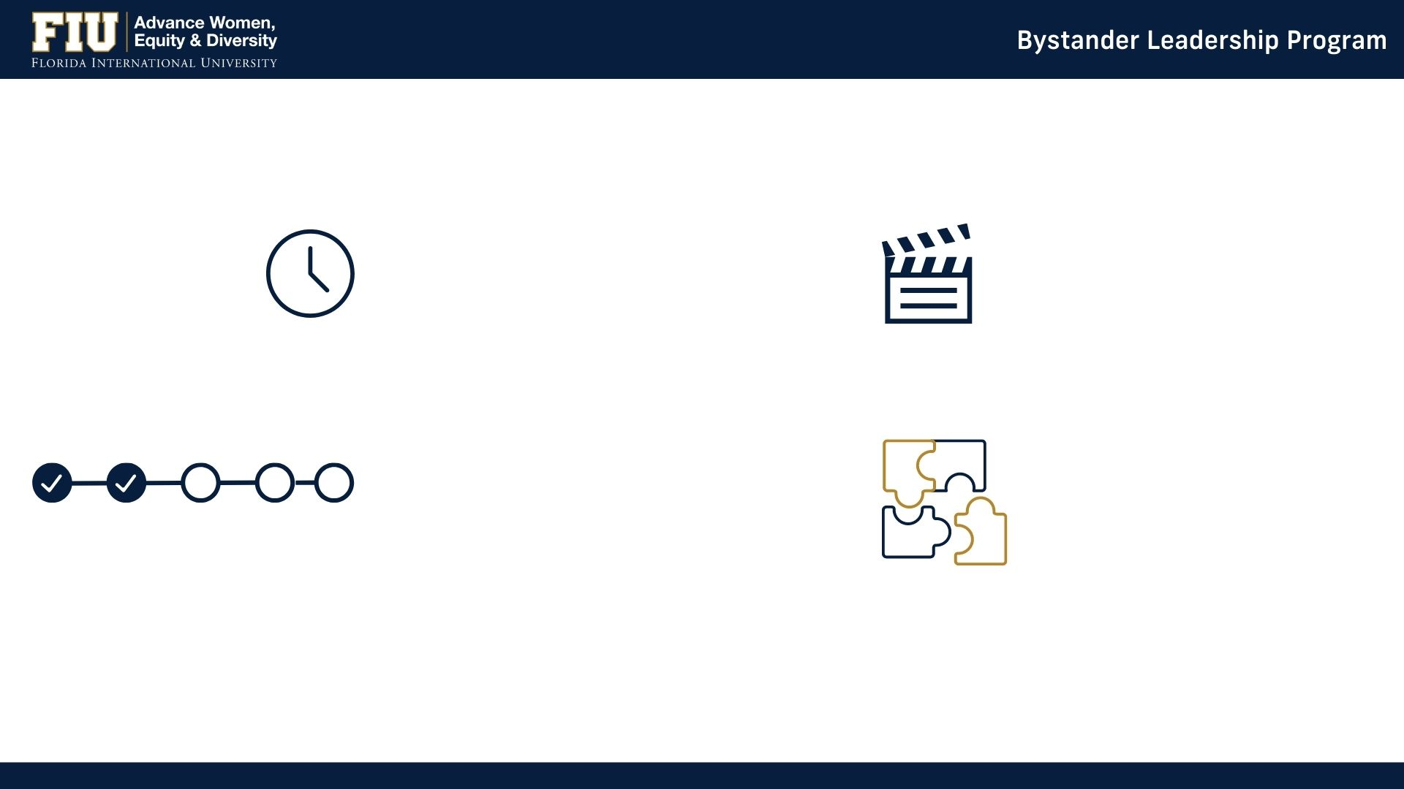
Bystander Leadership Workshop at a glance:
Full-day commitment
Professional Actors*
7.5 hours
Interactive theater with professional actors is used to illustrate Notice and Interpret
Teach 5 steps to intervention
Learning by practice
Notice
Interpret
Lead
Decide what to do
ACT
Provide numerous opportunities to practice intervening in role plays and in enacted case studies derived from our microclimate research
*Available for hire for various programs!

Slide 16
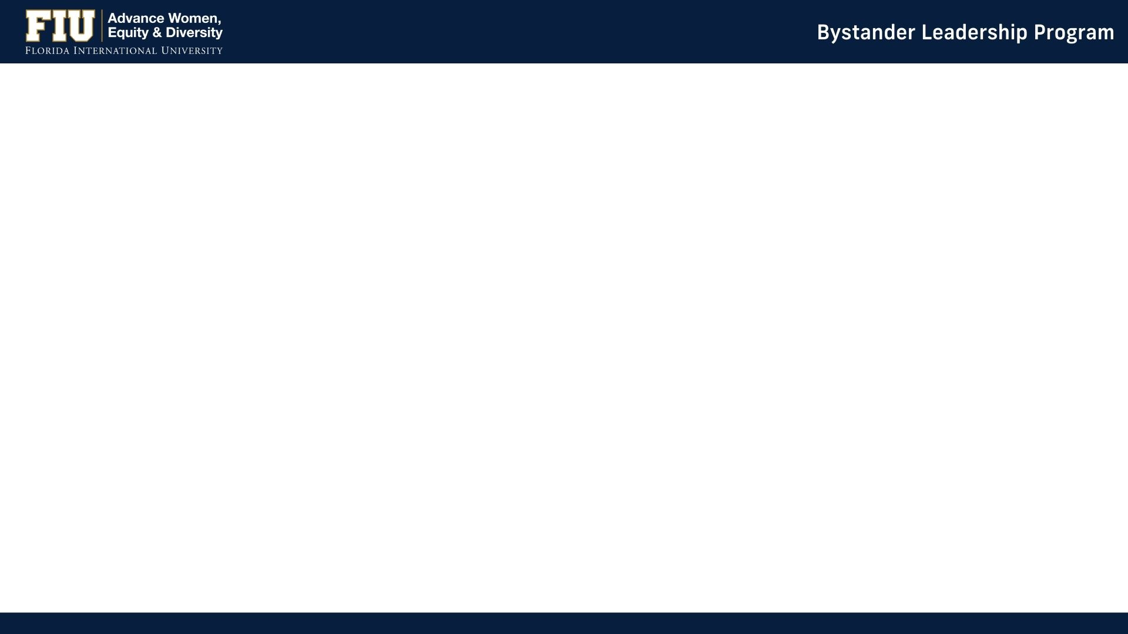
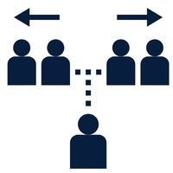




Research Design: 406 STEM & SBS Faculty Invited to Participate
Participant Data:
Analysis:
Comparison:
- 80 from comparison group
- 173 from intervention group
- (154 non-participants)
Attitude and Behavior Survey:
- Pre-test survey before the workshop
- Post-test survey after 3 months
Questions:
13 items (Likert scale 1-7) on
racial/ethnic and gender bias awareness
attitudes
and behaviors.
Gender:
- 74 women
- 179 men
Nationality:
- 141 international
- 112 domestic

Slide 17
Bystander Intervention Groups were Similar
 | Intervention Attended workshop, 2 surveys (pre-post) | Comparison Pre- & post-survey only | Non-Participants
Tenure-Track STEM & SBS | 173 | 80 | 154
Percent women | 30% | 20% | 21%
Percent Foreign-born | 57% | 51% | 50%
Percent URM | 13% | 14% | 18%

Slide 18
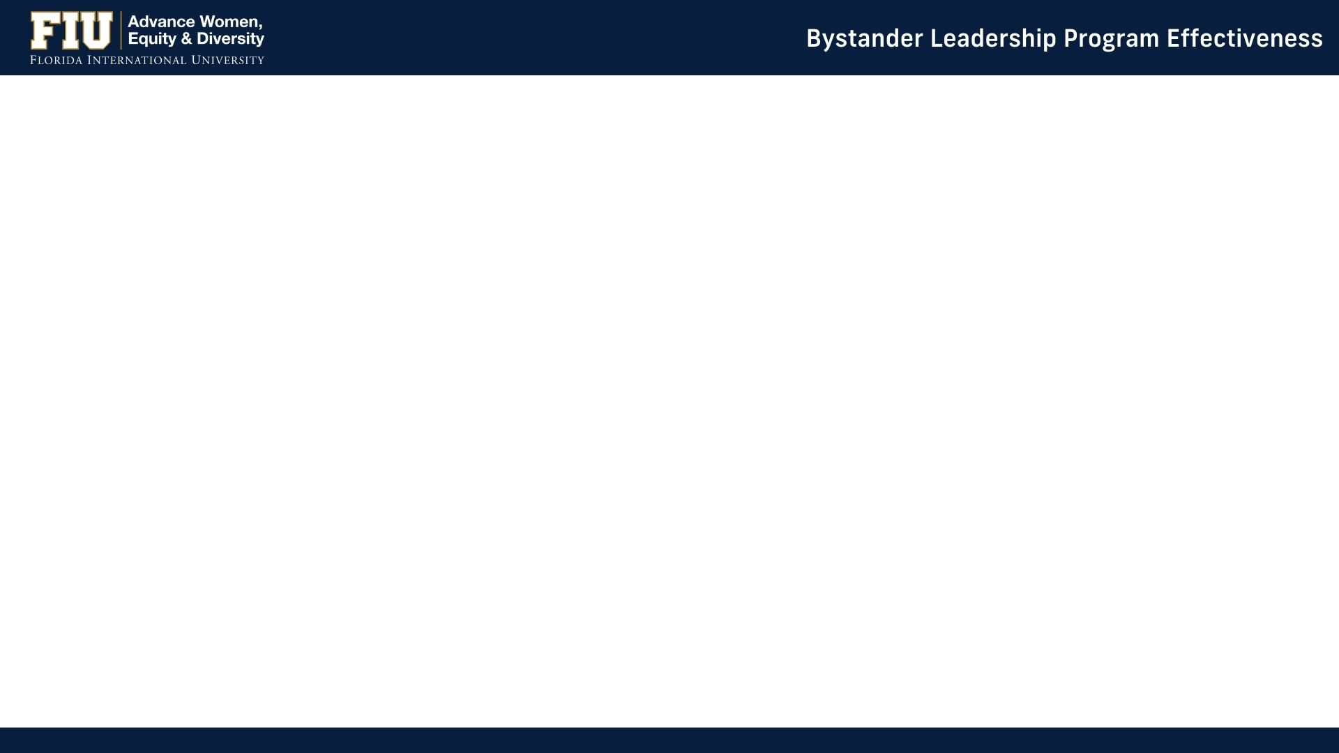
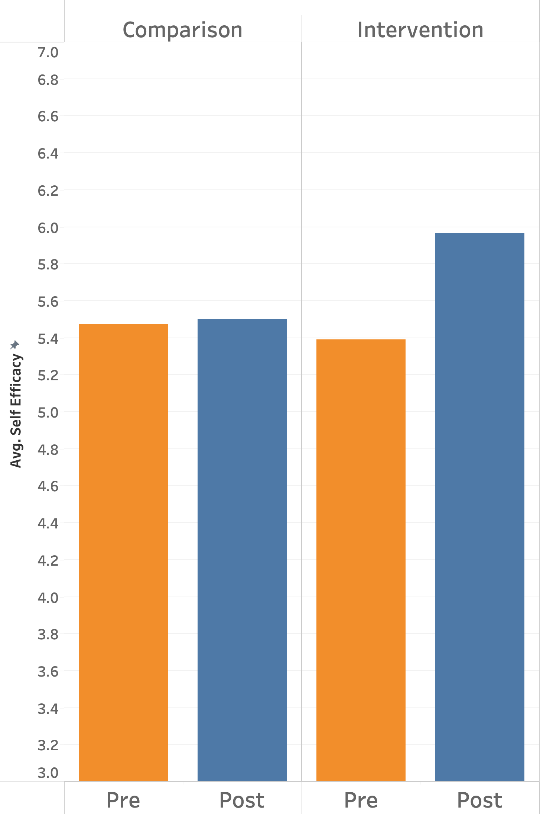
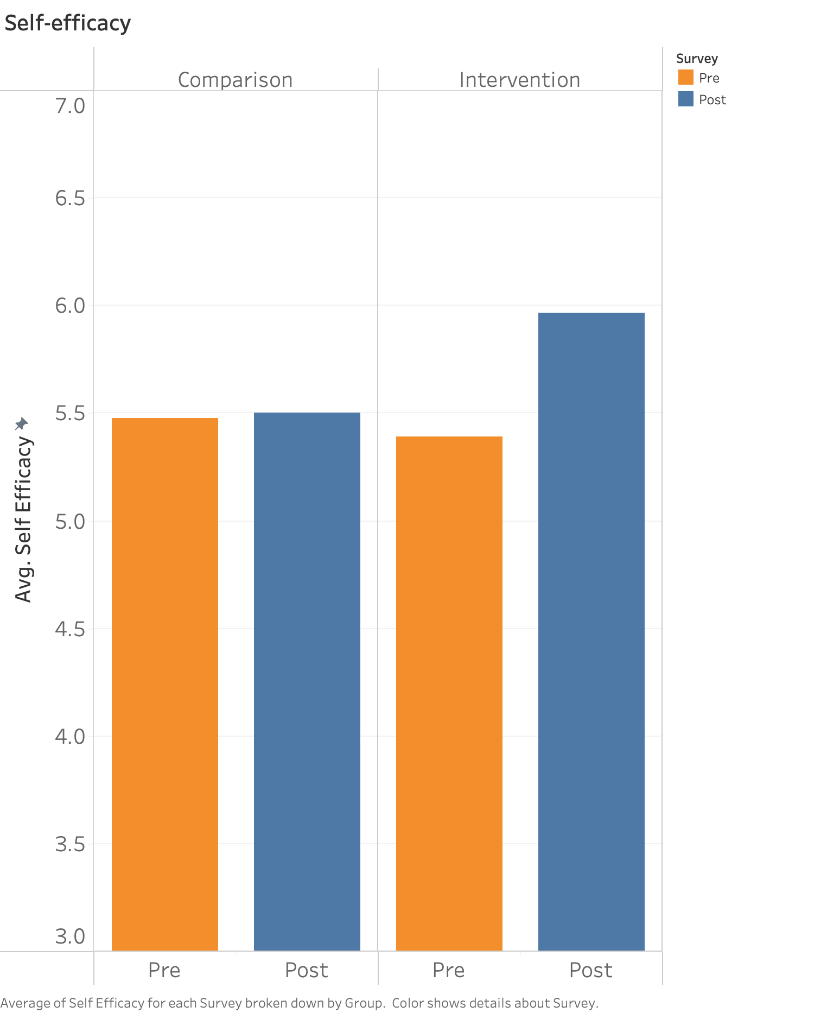
  Outcomes:
  All intervention group faculty had significant changes in attitudes pre- to post-test.
  The workshop significantly increased participants’ self-efficacy:
    belief in their ability to intervene - having the confidence and the tools to do something
Notes:
Outcomes:
All intervention group faculty had significant changes in attitudes and behaviors pre to post-test

Slide 19
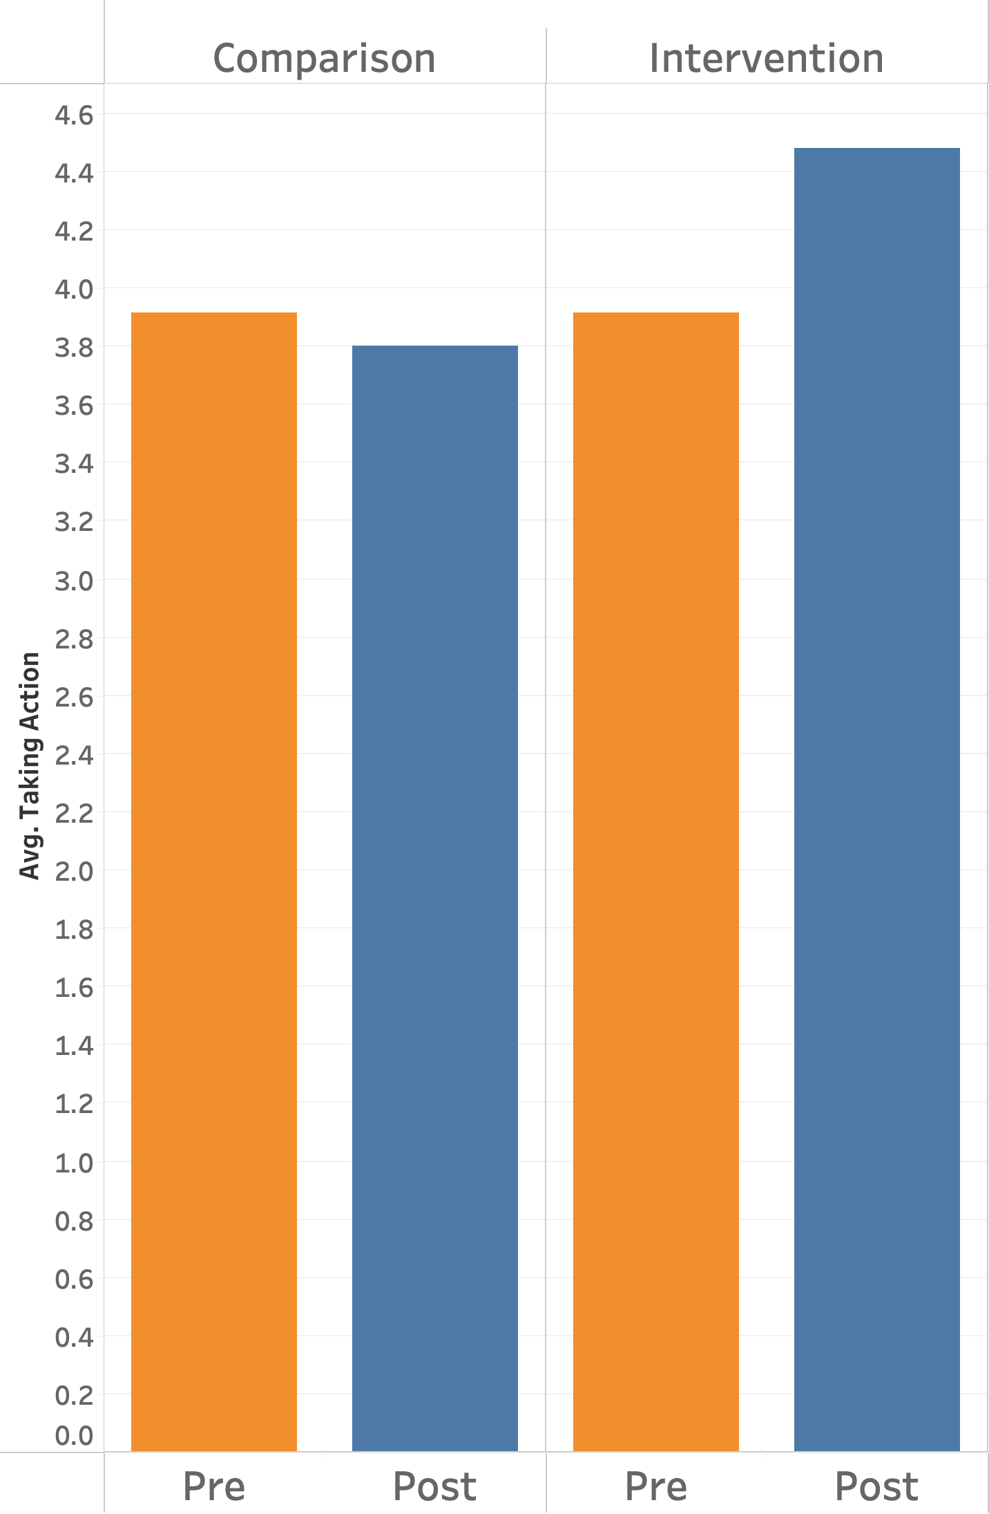
  Outcomes:
  All intervention group faculty had significant changes in behavior pre- to post-test.
  The workshop significantly increased participants’ actual interventions in biased incidents.

Slide 20
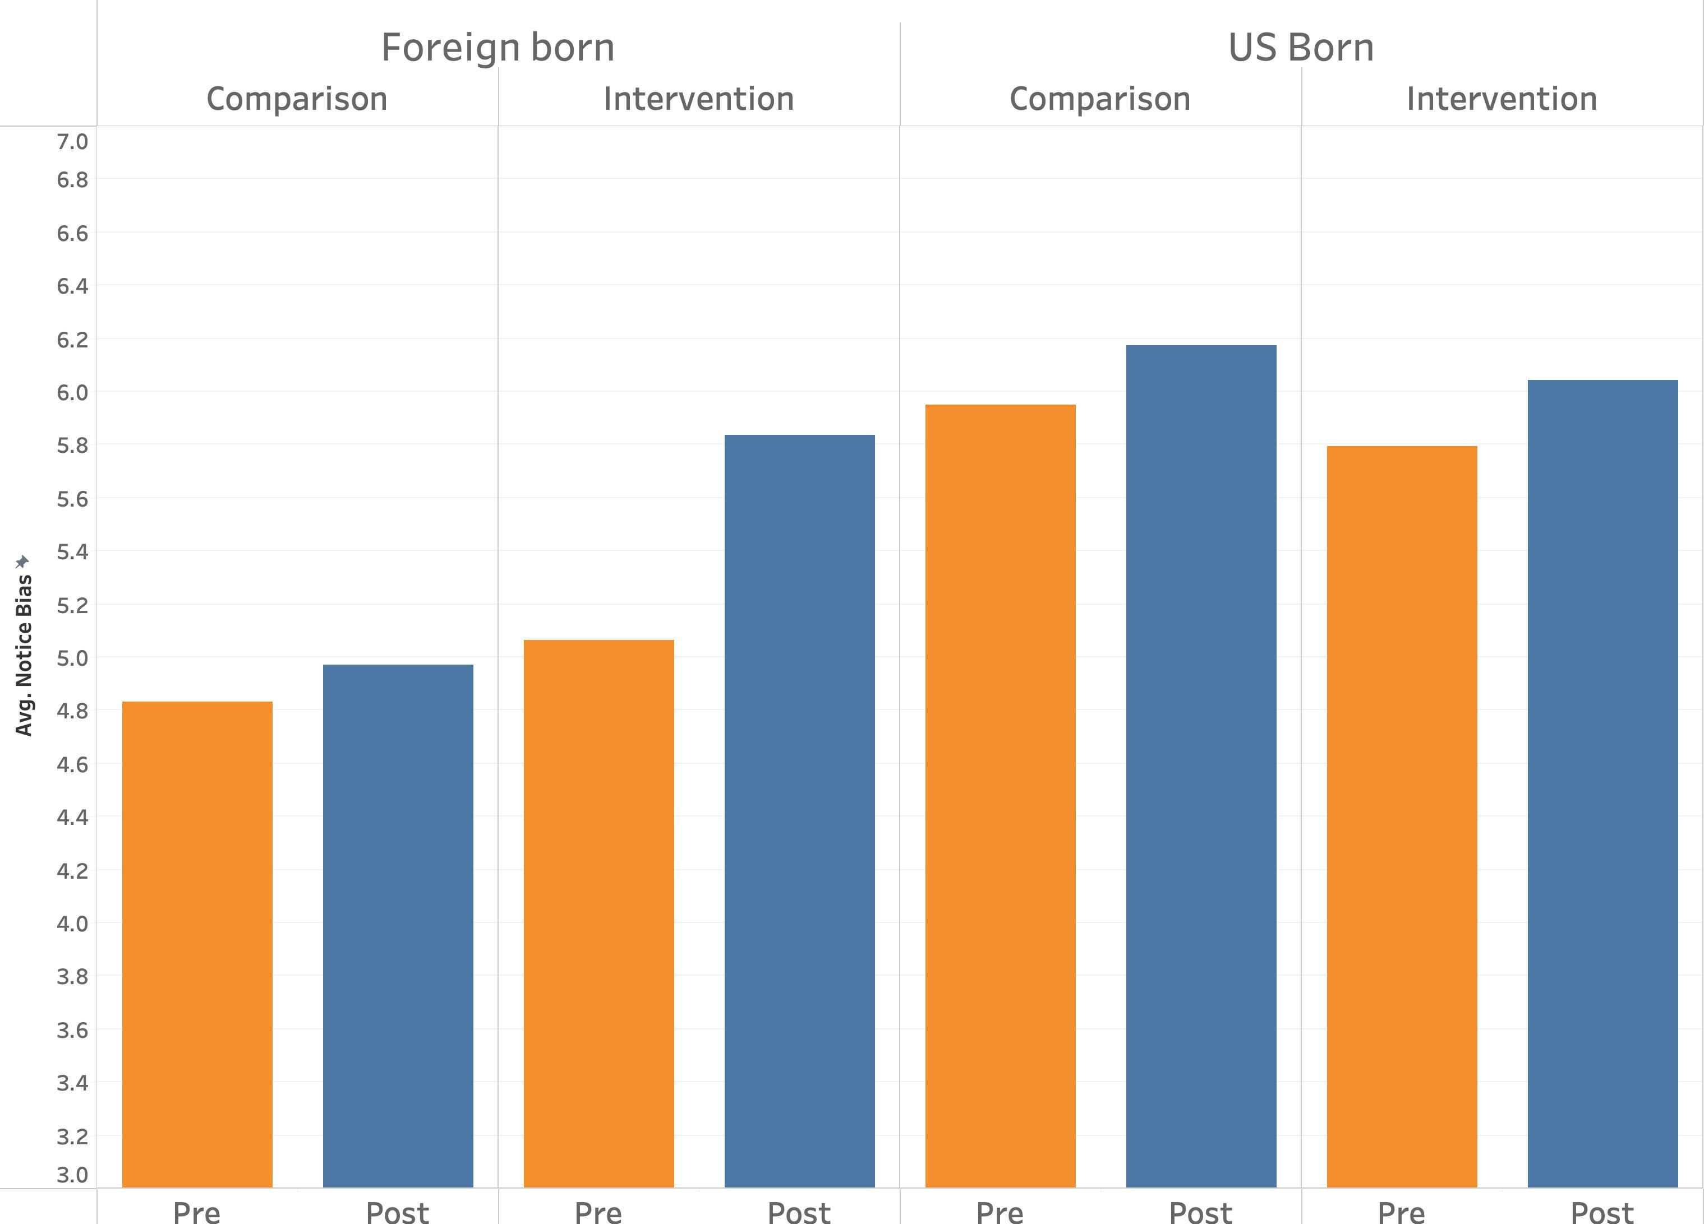
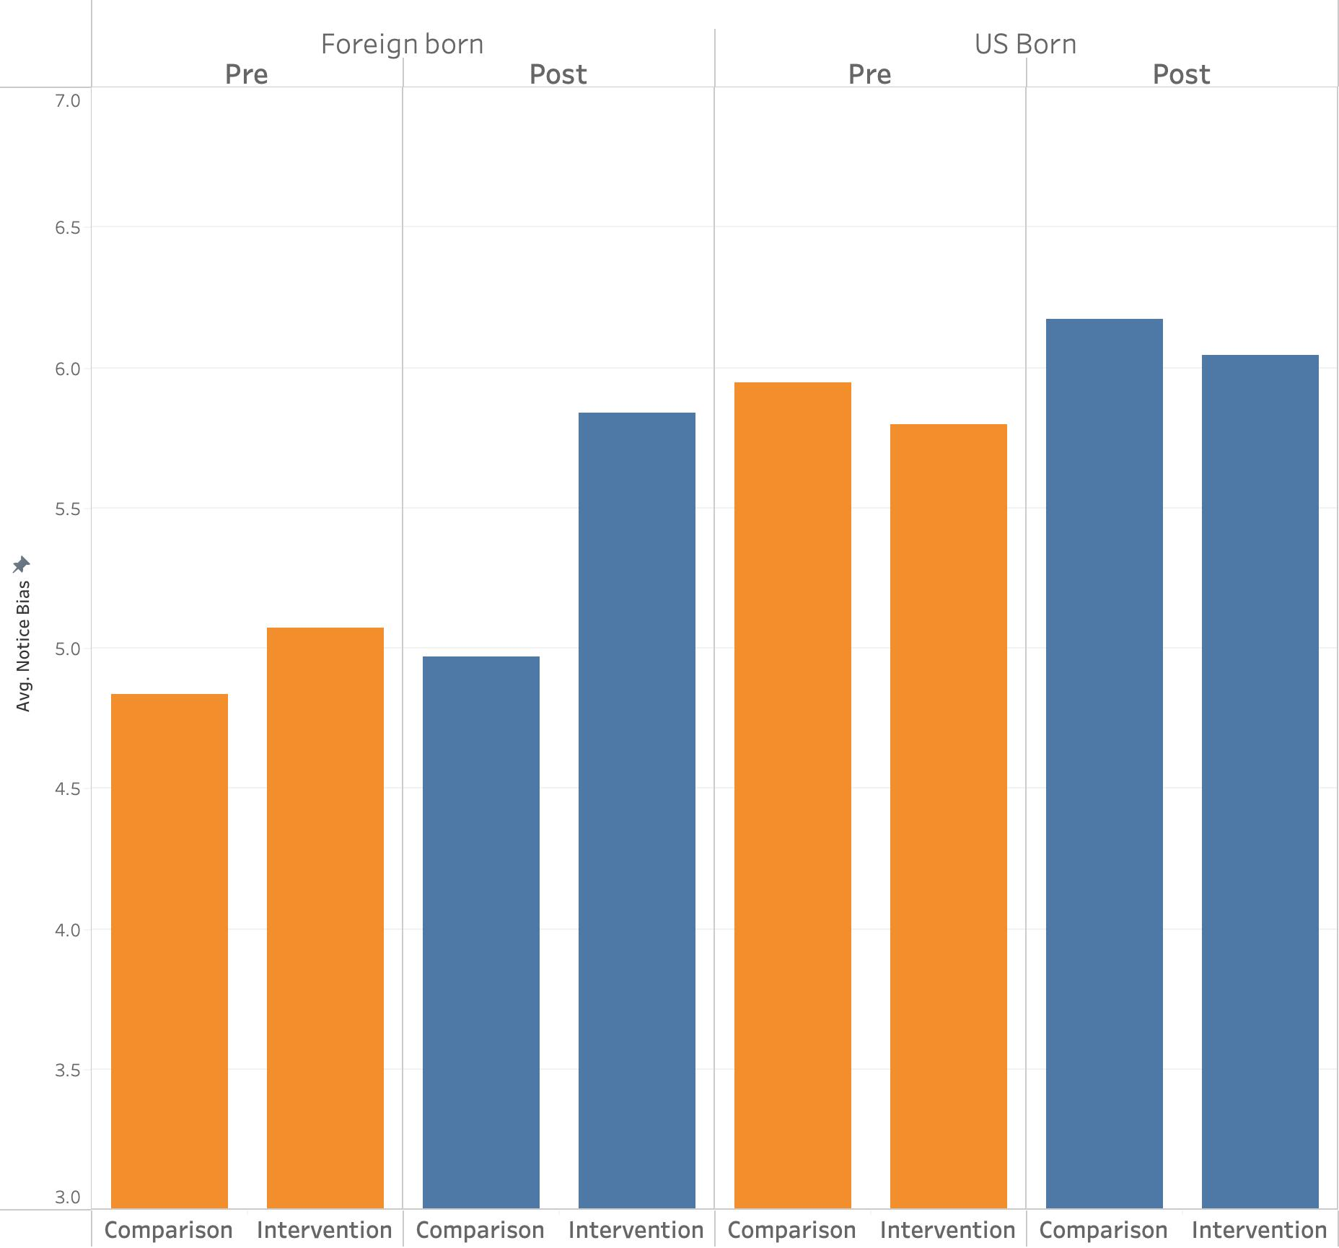
  Outcomes:
  Foreign-born faculty had a greater change in awareness and ability to notice bias than U.S. born faculty.

Slide 21
  Critical Mass: Participants from departments with 60%* or more faculty participating reported a significant impact on departmental climate and policies.
Has the workshop had any effect on your own or your department's practices (like the department's diversity plan)?
 |  | Count of answers
Dept Participation in Bystander |  | NO % (#) |  | YES % (#) |  | Total #
High (>60% attended) |  | 15% | (4) | 84% | (21) | 25
Medium (40-60% attended) |  | 28% | (27) | 72% | (68) | 95
Low (<40% attended) |  | 44% | (18) | 56% | (23) | 41
Total # |  | 49 |  | 112 |  | 161
* Preliminary Results

Slide 22
Answers to open-ended questions, 3 months post-workshop
“
I (a female faculty) attended a meeting with some of my colleagues and faculty from another department. I was constantly interrupted by the chair of the department. At some point I told him to stop interrupting because it was getting disrespectful and one of my colleagues (who had participated in a bystander workshop) also stepped in and took my part. Later, one of the other faculty (not the offender) sent an email to apologize on behalf of his colleague.
“
19 faculty reported witnessing a biased incident in the three-month span after the workshop
6 intervened based on what they had learned in the workshop
110 faculty talked about the program in department meetings or other venues and encouraged
others to participate, including administrators

Slide 23


Overall Outcomes 2015-2020
Statistics
FIU STEM female faculty are now 20% of STEM faculty (11% in 2011)
Percentage of Hispanic faculty increased from 15% to 21%
Percentage of Black faculty remained constant at 8%
COACHE 2020
Faculty satisfaction at FIU for women and faculty of color was very high compared to 110 universities
Female faculty had high satisfaction on 22 of 27 measures
Notes:
But we can dig deeper with COACHE

Slide 24

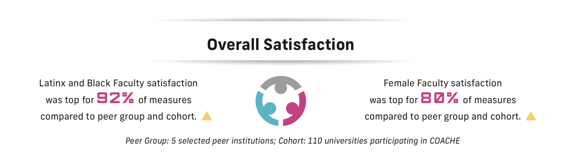
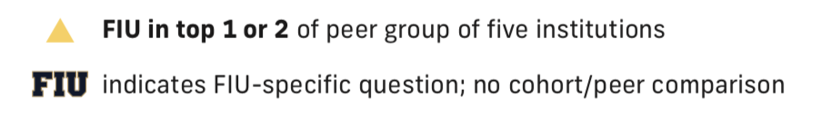
Notes:
CS

Slide 25
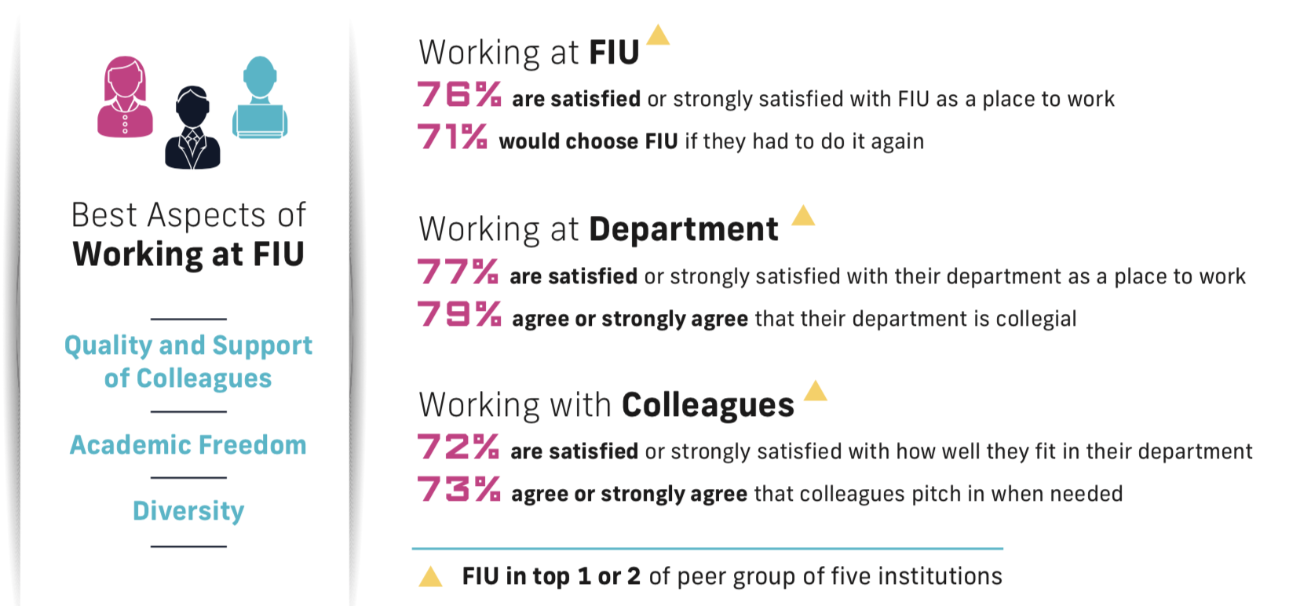

Slide 26
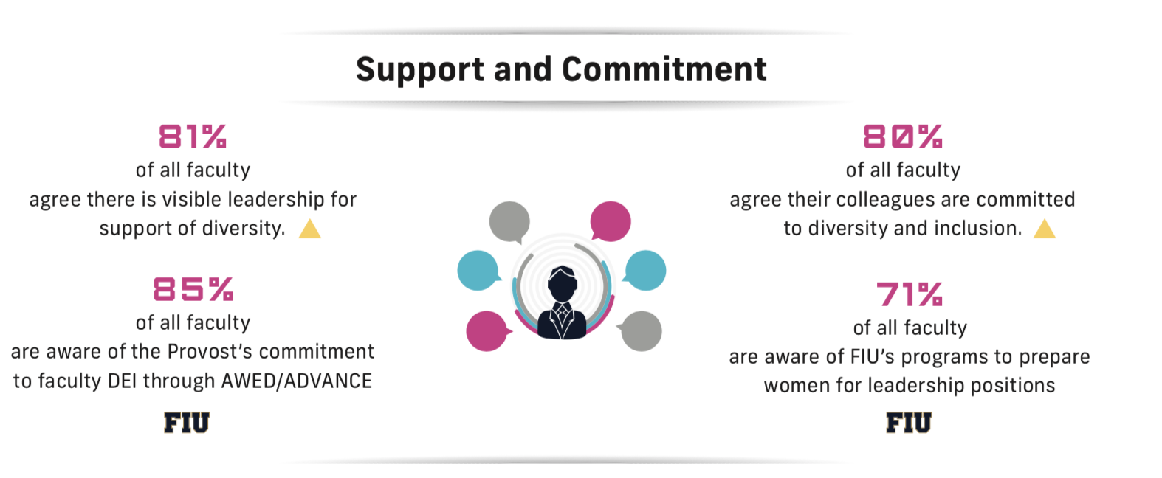
SsCf. 60% for cohort
75% of FIU URM agree
Notes:
75% of URM faculty agree there is visible leadership for support of diversity (vs. 60% cohort)
75% of URM faculty agree colleagues are committed to D&I

Slide 27
Summary
567/1230
Notes:
I mean, what can I say?

Slide 28
Find us at: http://awed.fiu.edu awed@fiu.edu simpsonc@fiu.edu

