Slide 1

COACHE Strategy Workshop
Tammie Cumming, Associate Provost
Isana Leshchinskaya, Assessment Manager
Notes:
Tammie

Slide 2
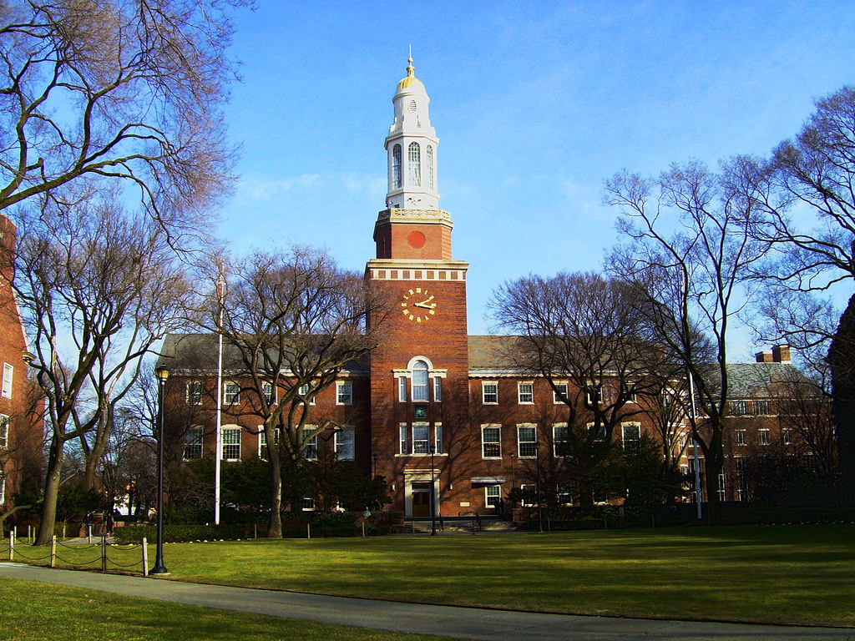
About Brooklyn College
4-year liberal arts college
  Baccalaureate and Master’s degrees
City University of New York (CUNY)
  25 colleges

Slide 3
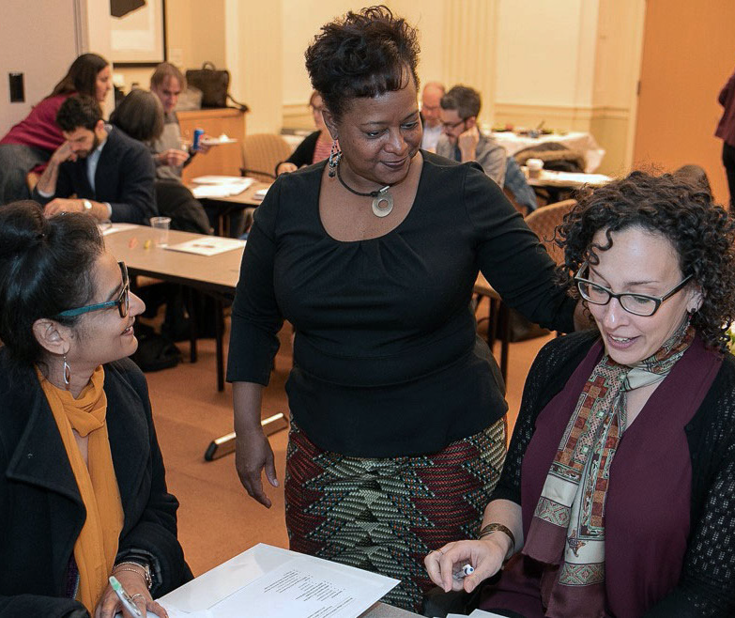
Brooklyn College Faculty
455 full-time faculty serving ~16,000 students
  35.2% of full-time faculty are under-represented minorities
  Strong commitment to faculty governance

Slide 4
Actions after 2019 COACHE
  Formed COACHE Evaluation Team
  Convened Town Hall
  Provided recommendations to Provost and President
  Articulated Goals
  Implemented Action Plan
  Monitored progress of attainment of goals

Slide 5
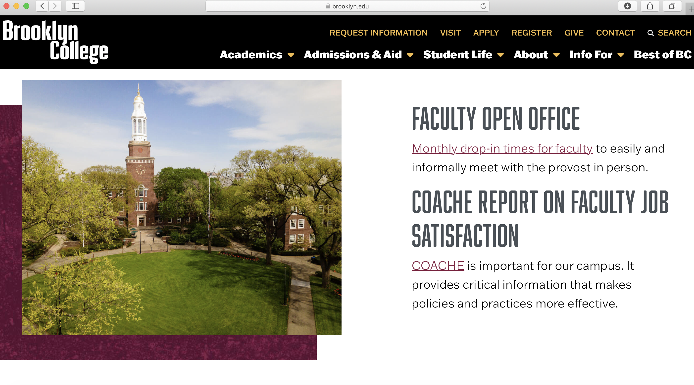
Notes:
Tammie

Slide 6
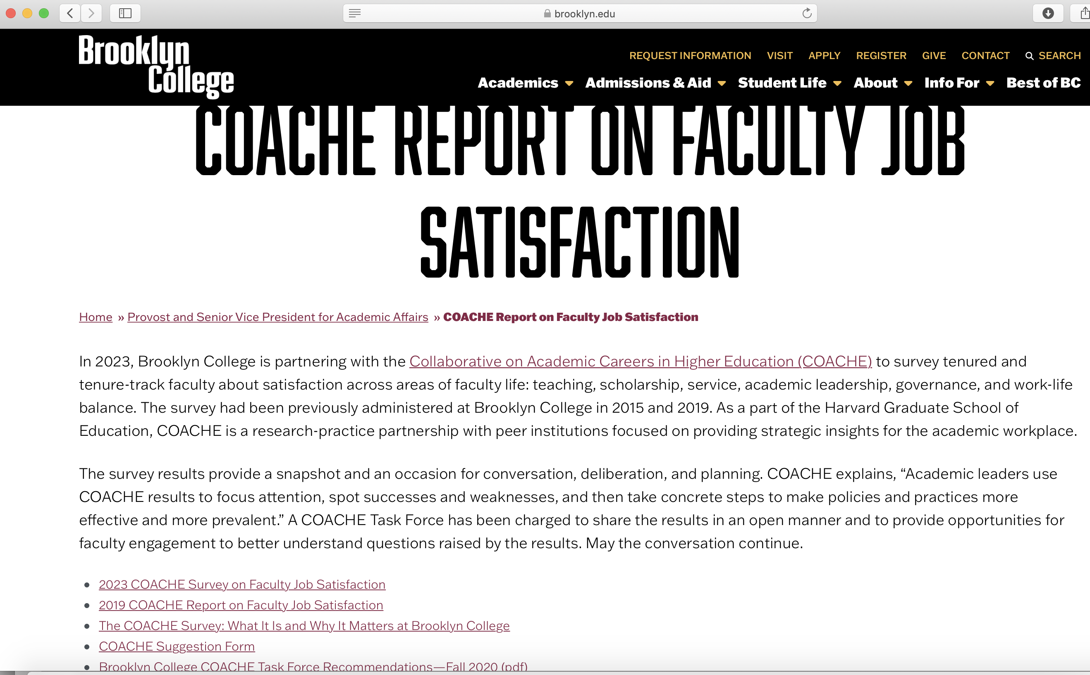
Notes:
Tammie

Slide 7
Overarching Lessons Learned
***** FACULTY CO-LEADERSHIP WAS CRUCIAL *****
Summarize actions and outcomes based on previous COACHE results
Consider COACHE Team composition
Develop robust communication plan
Build ”nimbleness” into COACHE Team meeting schedule
Track response rates
Think Outside of the Box
  Union support, utilizing faculty and student talent

Slide 8
COACHE Team – 16 members
Team Co-Chairs (2)
  Administration
    Associate Provost for Institutional Effectiveness
  Faculty
    Faculty Council Chair
Notes:
Tammie

Slide 9
COACHE Team (continued)
Administration Members - 6
  Chief Diversity Officer
  School Deans (5 schools)
Faculty Members - 8
  Distributed among 5 schools
Notes:
Tammie

Slide 10
COACHE Team (continued)
Ex-Officio
  Provost
  Assessment Manager
  Institutional Research Director
Notes:
Tammie

Slide 11
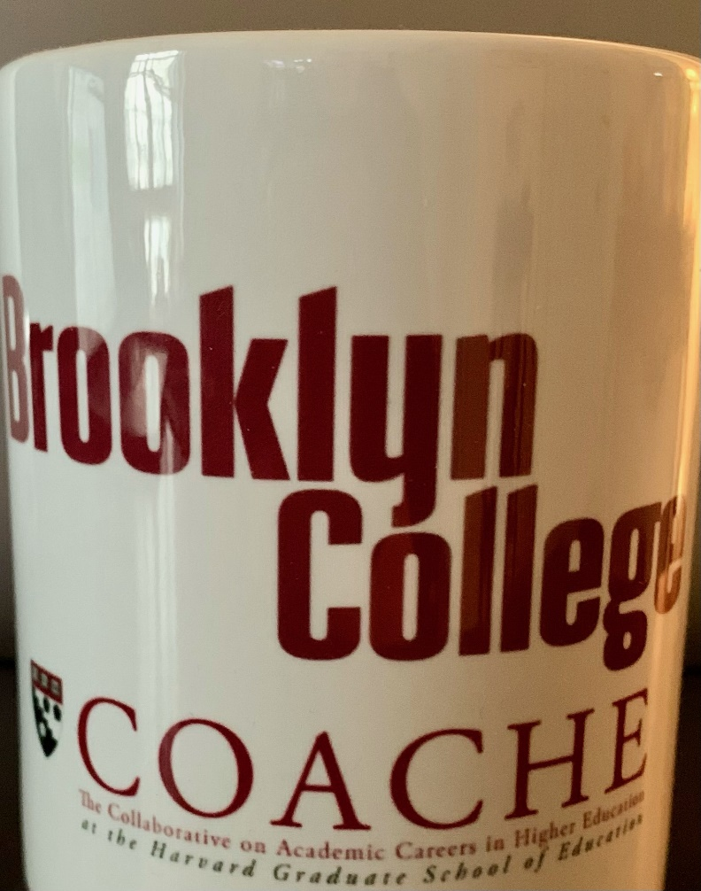
COACHE Team Working Groups
Communication Planning
Highlights - Previous COACHE
Custom Items
Short Film/Video
Dropbox was set up for COACHE Team
Notes:
Tammie

Slide 12
COACHE Activities - 6 months in advance
September
Verify Website content
Call for COACHE Team participation
October
Confirm COACHE Team
Announce Team meeting schedule
November
Convene COACHE Team Meeting
Draft custom items
  COACHE team vets items
Finalize Communication plan
Determine Theme/Tagline
  ”All In”

Slide 13
COACHE Activities
December
  Convene COACHE Team Meeting
  Update website
  Draft 1-page highlights of actions/outcomes
    Engage Graphics interns
  Announce COACHE administration at Faculty Council
  Consult with Marketing/Communications unit

Slide 14
COACHE Activities
January
Convene COACHE Team Meeting
Finalize Marketing/Communications support plan
    Social media
    Mailchimp
    Intern support

Slide 15
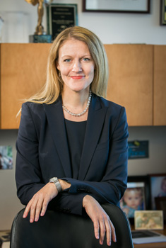
COACHE Activities
February
Discuss survey participation benefits at
  Faculty Council
  School-wide meetings
Endorse COACHE Survey participation
  President during first week of classes
Convene COACHE Team Meeting
President Michelle Anderson

Slide 16
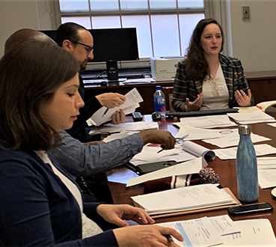
COACHE Administration Activities
WEEK 1
CAO endorsement email sent when survey was greenlit
Invitation email sent by COACHE
Department Chairs encouraged to consider time to complete survey as part of meeting agenda

Slide 17
COACHE Administration Activities
WEEK 2
“Thank you” email from Associate Provost
  Announce COACHE reminder #1
Response Rates to COACHE Team
WEEK 3
COACHE Reminder #1
Response Rates to COACHE Team

Slide 18

WEEK 4
“COACHE faculty experience survey” email from Faculty Council Chair
    1-page graphic
    Announce COACHE will send Reminder #2
COACHE Reminder #2
Response Rates to COACHE Team

Slide 19
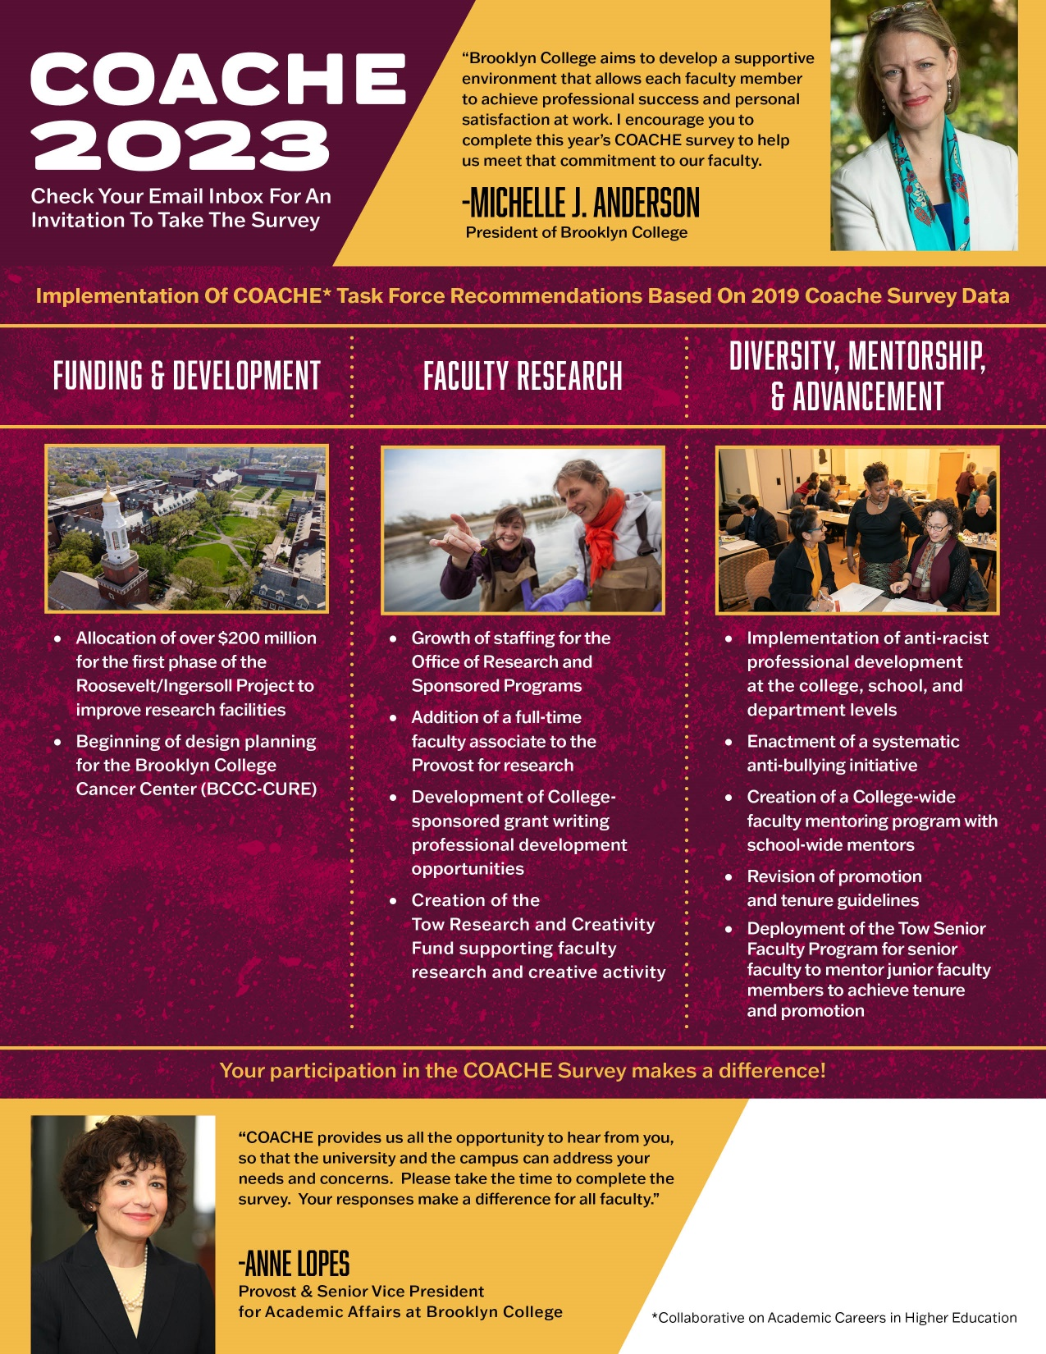
WEEK 5
“College improvements”
email from Associate Provost
    1-page graphic
    Quotes from President and Provost
    Announce COACHE will send Reminder #3
Response Rates to COACHE Team

Slide 20
COACHE Administration Activities
WEEK 6
COACHE Reminder #3
Email from Deans to COACHE-eligible faculty
COACHE Team Meeting
    Peer Institutions
    Response Rates
Faculty Council Chair announcement at Council for Administrative Policy Meeting
Response Rates to COACHE Team

Slide 21
COACHE Administration Activities
WEEK 7
Faculty Council Announcement
“Spring Recess next week” email from Associate Provost
Response Rates to COACHE Team

Slide 22
COACHE Administration Activities
“COACHE extended” email on behalf of COACHE Team
  COACHE will send Reminder #4
  Survey end date
COACHE Reminder #4
Faculty Union representative email to COACHE eligible faculty
WEEK 8
Department level response rates provided to Deans and Chairs
Deans request to Chairs to contact COACHE eligible faculty
Response Rates to COACHE Team

Slide 23
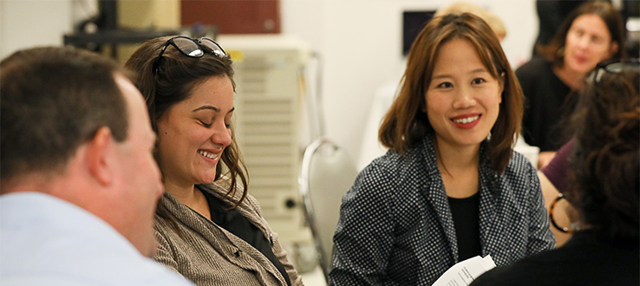
COACHE Administration Weeks
Day before Survey Closing Date
“You still have time!” email from Associate Provost

Slide 24
Brooklyn College COACHE Responses - Spring 2023

Slide 25
Summary of Outreach
Correspondence to faculty from:
  Associate Provost
  COACHE Team members
  Deans
  Department Chairs
  Faculty Council Chair
  President
  Provost
  Union Representative
Infographic design
Marketing/communications unit support
Meeting announcements:
  Council for Administrative Policy
  Faculty Council
  School-wide meetings
Response Rate monitoring
Website presence on Provost’s homepage

Slide 26
Faculty Engagement – Success?
WHERE WE WERE
Response Rate 2019 Administration: 44%
ACTIONS TAKEN
COACHE results were used to make improvements
Coordinated communications and marketing
WHERE WE ARE
Response Rate 2023 Administration: 61%

Slide 27
Next Steps Include…
Call for COACHE Evaluation Team members
Convene College-wide Town Hall with President and Provost
Present COACHE results at Faculty Council meeting
Communicate results via large college-wide campaign
Draft Recommendations
  Vetted through Faculty Council
  Aligned with College and University Strategic Plan
Develop Action Plans
Monitor Progress

