Slide 1
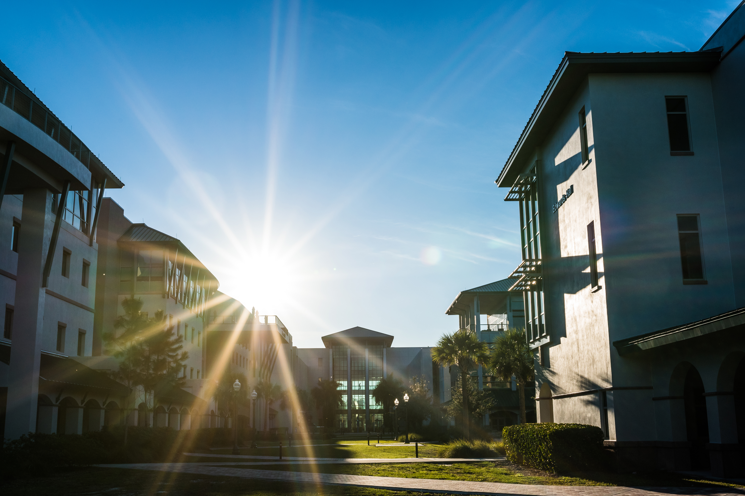
Building a Comprehensive Communications Plan to Drive Response Rates
Florida Gulf Coast University

Slide 2
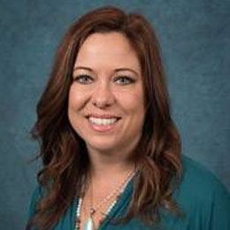
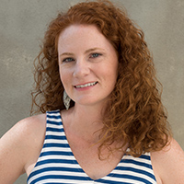
Our team
Andi Clemons
Dr. Lyndsay Rhodes
Director,
Academic Affairs, Administration, & Budget
Faculty Senate President & Associate Professor,
Department of Biological Sciences

Slide 3
Table of contents
01
02
03
04
Communications Strategy
Pre-Survey Climate
One Piece of Advice
What is Next for FGCU?

Slide 4

Pre-Survey Climate
01

Slide 5
Pre-Survey Climate
Unsure
Lack of Confidence
Still in Recovery
Faculty were unsure and uneasy about completing the survey
Faculty concerned results would “sit on a shelf”
Recently experienced both the global pandemic and a major hurricane

Slide 6
Pre-Survey Climate
Led by Faculty & Administrator Interest
Proposal idea generated through conversations between the Provost and Faculty Senate
Faculty led team
The FGCU COACHE Steering committee is led primarily by faculty and supported by Academic Affairs

Slide 7
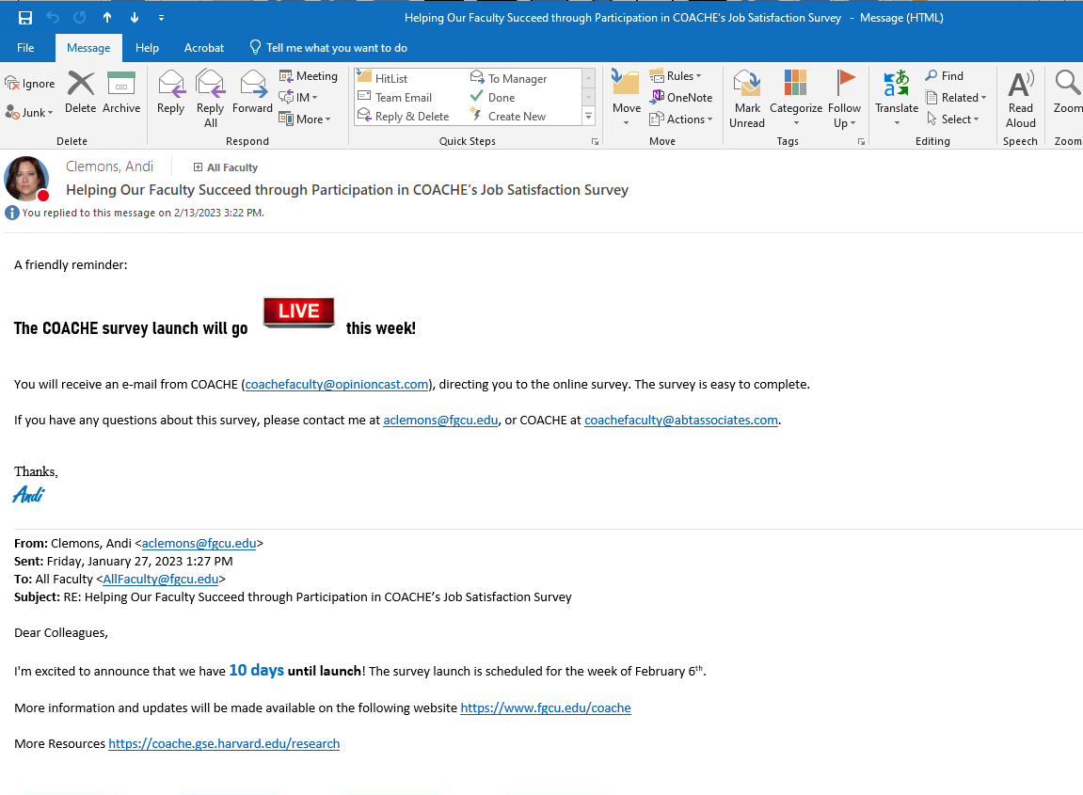
02
Communications Strategy

Slide 8
Communication Goals
Make it Meaningful
Use your resources
Make it Fun!
Demonstrate Commitment
Inspire Trust
Be Ready to Pivot

Slide 9

—Make it Meaningful
The Faculty Voice

Slide 10
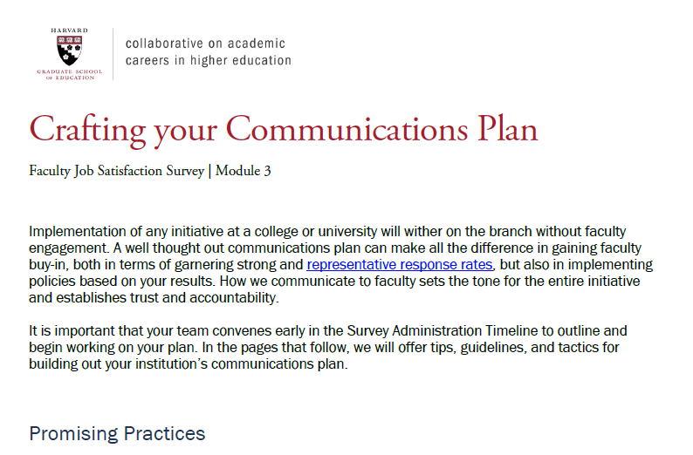
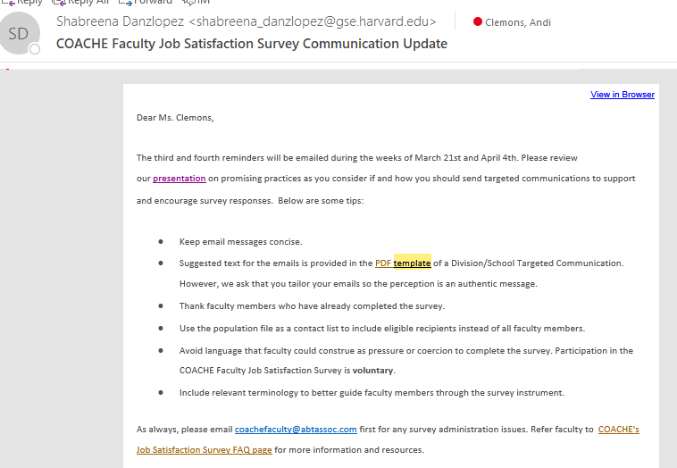
Use your COACHE resources
Communication Plan
COACHE provides several documents sharing best practicing for communication
Templates
COACHE provides templates for communication

Slide 11
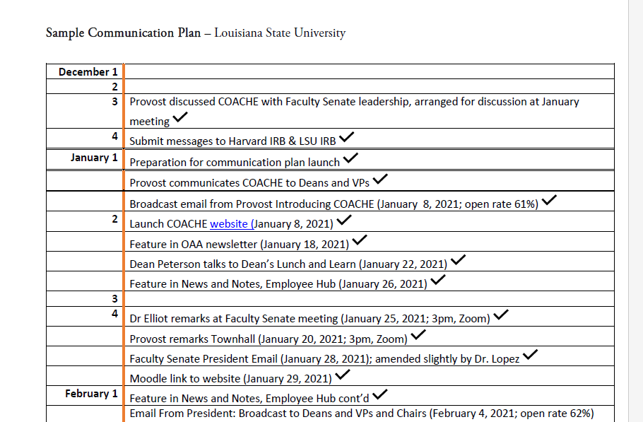
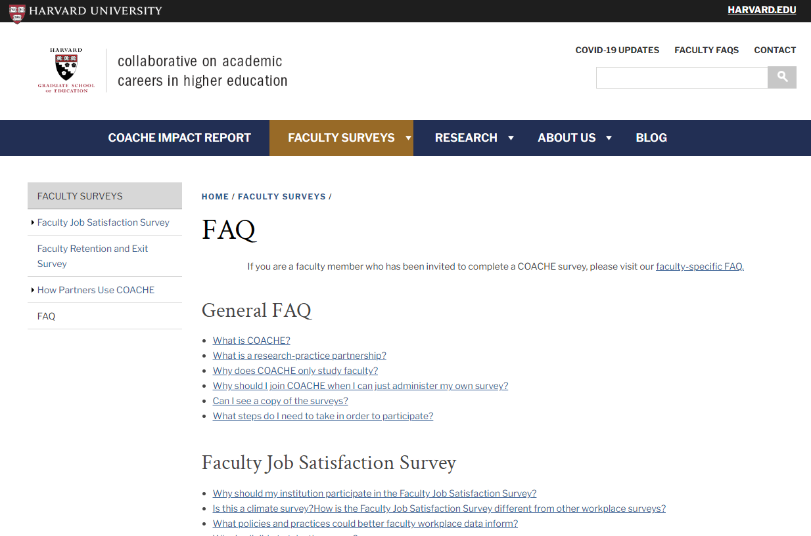
Use your COACHE resources
COACHE participant websites
Several institutions openly share their COACHE results
FAQ
Create an FAQ from information found on the COACHE website

Slide 12
Demonstrate Commitment
Campus-wide Communications
It’s a Process
Opportunities for Involvement
The Provost and Faculty Senate Leaders shared messages of shared commitment
Communications showed the stages of the 3-year process
Shared ways faculty can be involved in multiple stages of process

Slide 13
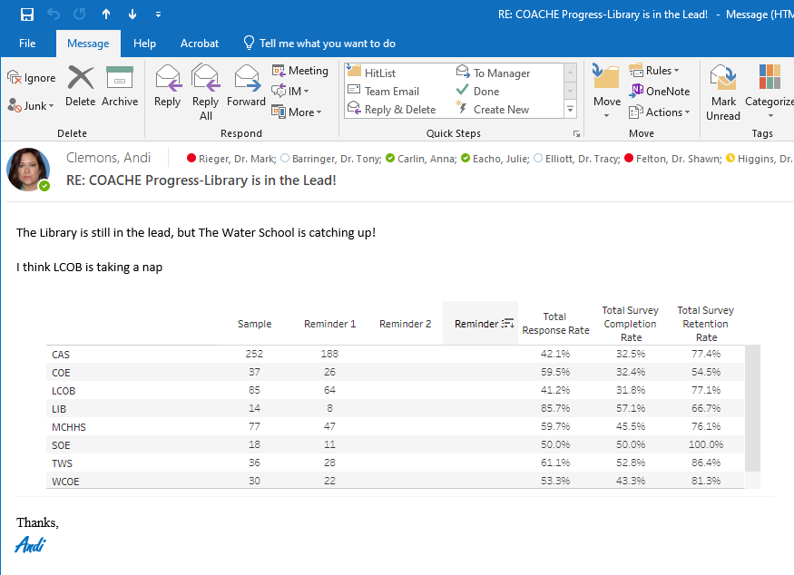
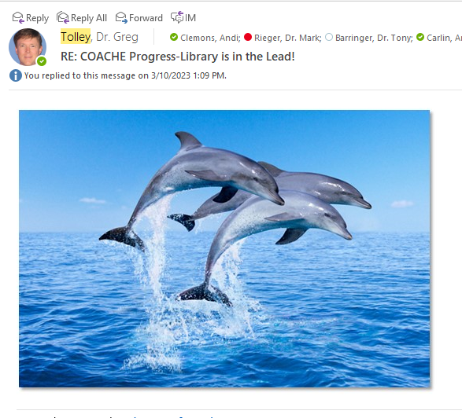
Make it Fun!
A little friendly competition among the deans
Share updates with faculty weekly

Slide 14
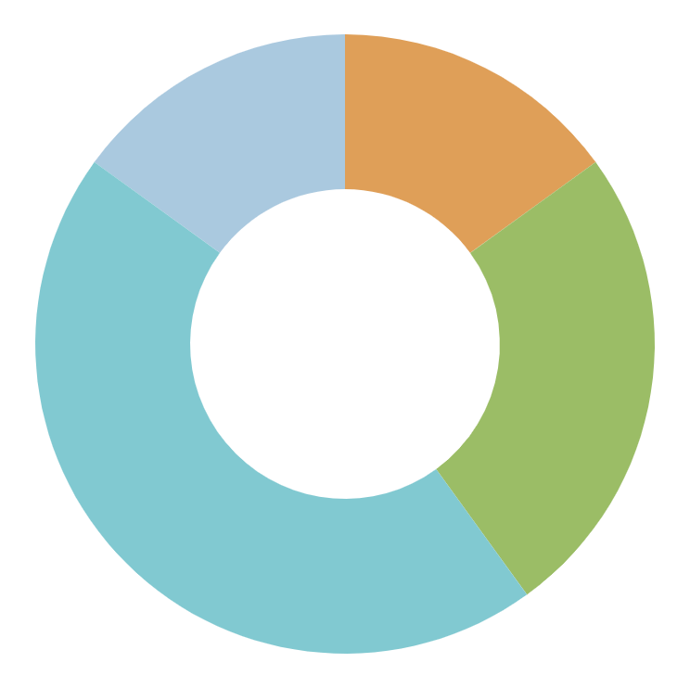
Inspire Trust
Transparency
Open Q&A with COACHE
Comparative Data
Multiple Insitutions
Validated & Reliable
IRB Approved
Research
COACHE Research
Confidentiality
Assured anonymity

Slide 15
Be Ready to Pivot
Questions | Clear Misunderstandings | Focus Support
What Questions are being asked? | Campus Coconut Telegraph | Focus new strategies on low response departments

Slide 16
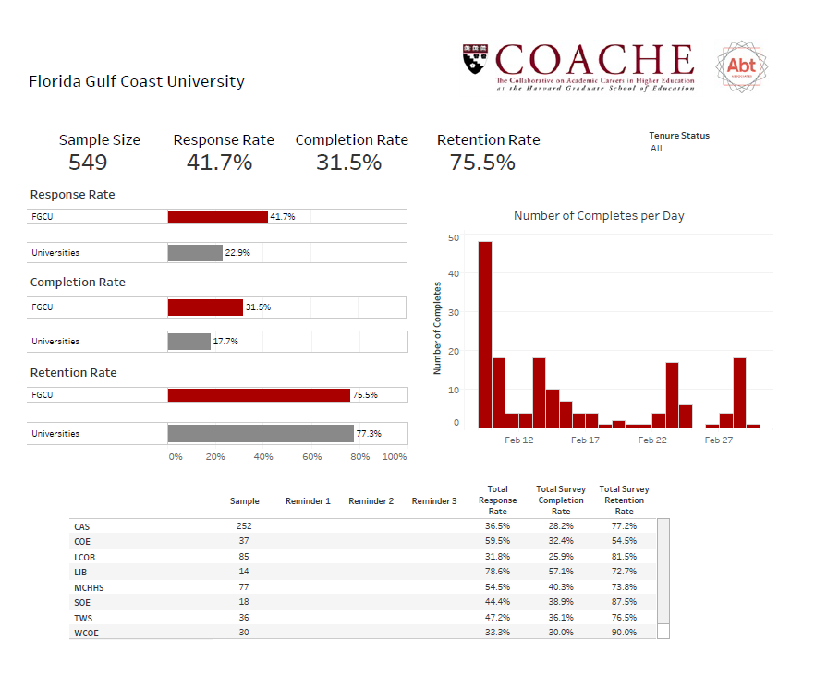
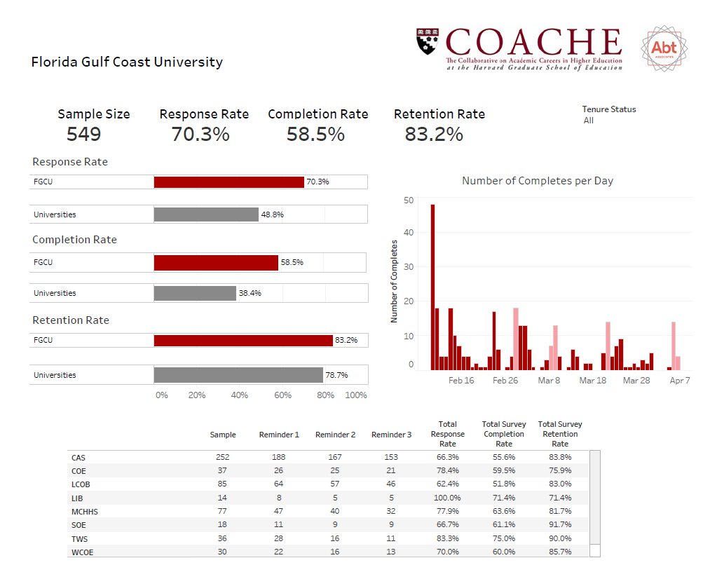
Be Ready to Pivot
March 2nd
April 7th

Slide 17
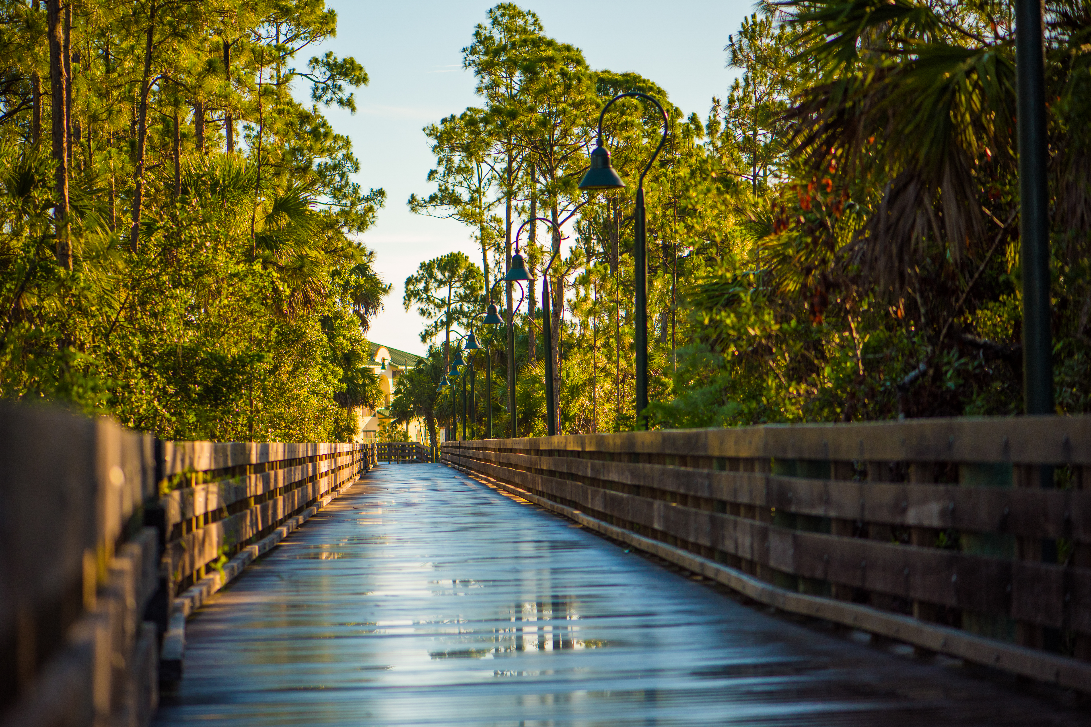
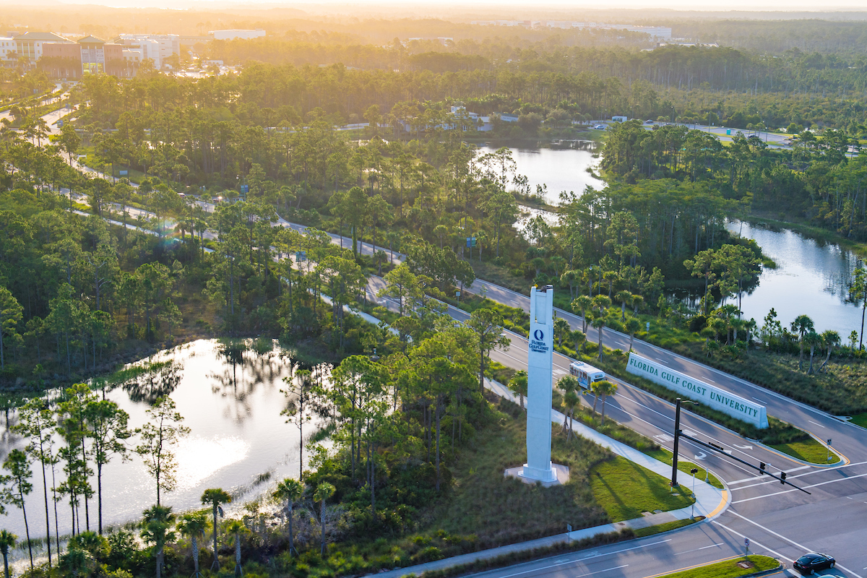
03
Advice
One piece of advice from FGCU

Slide 18
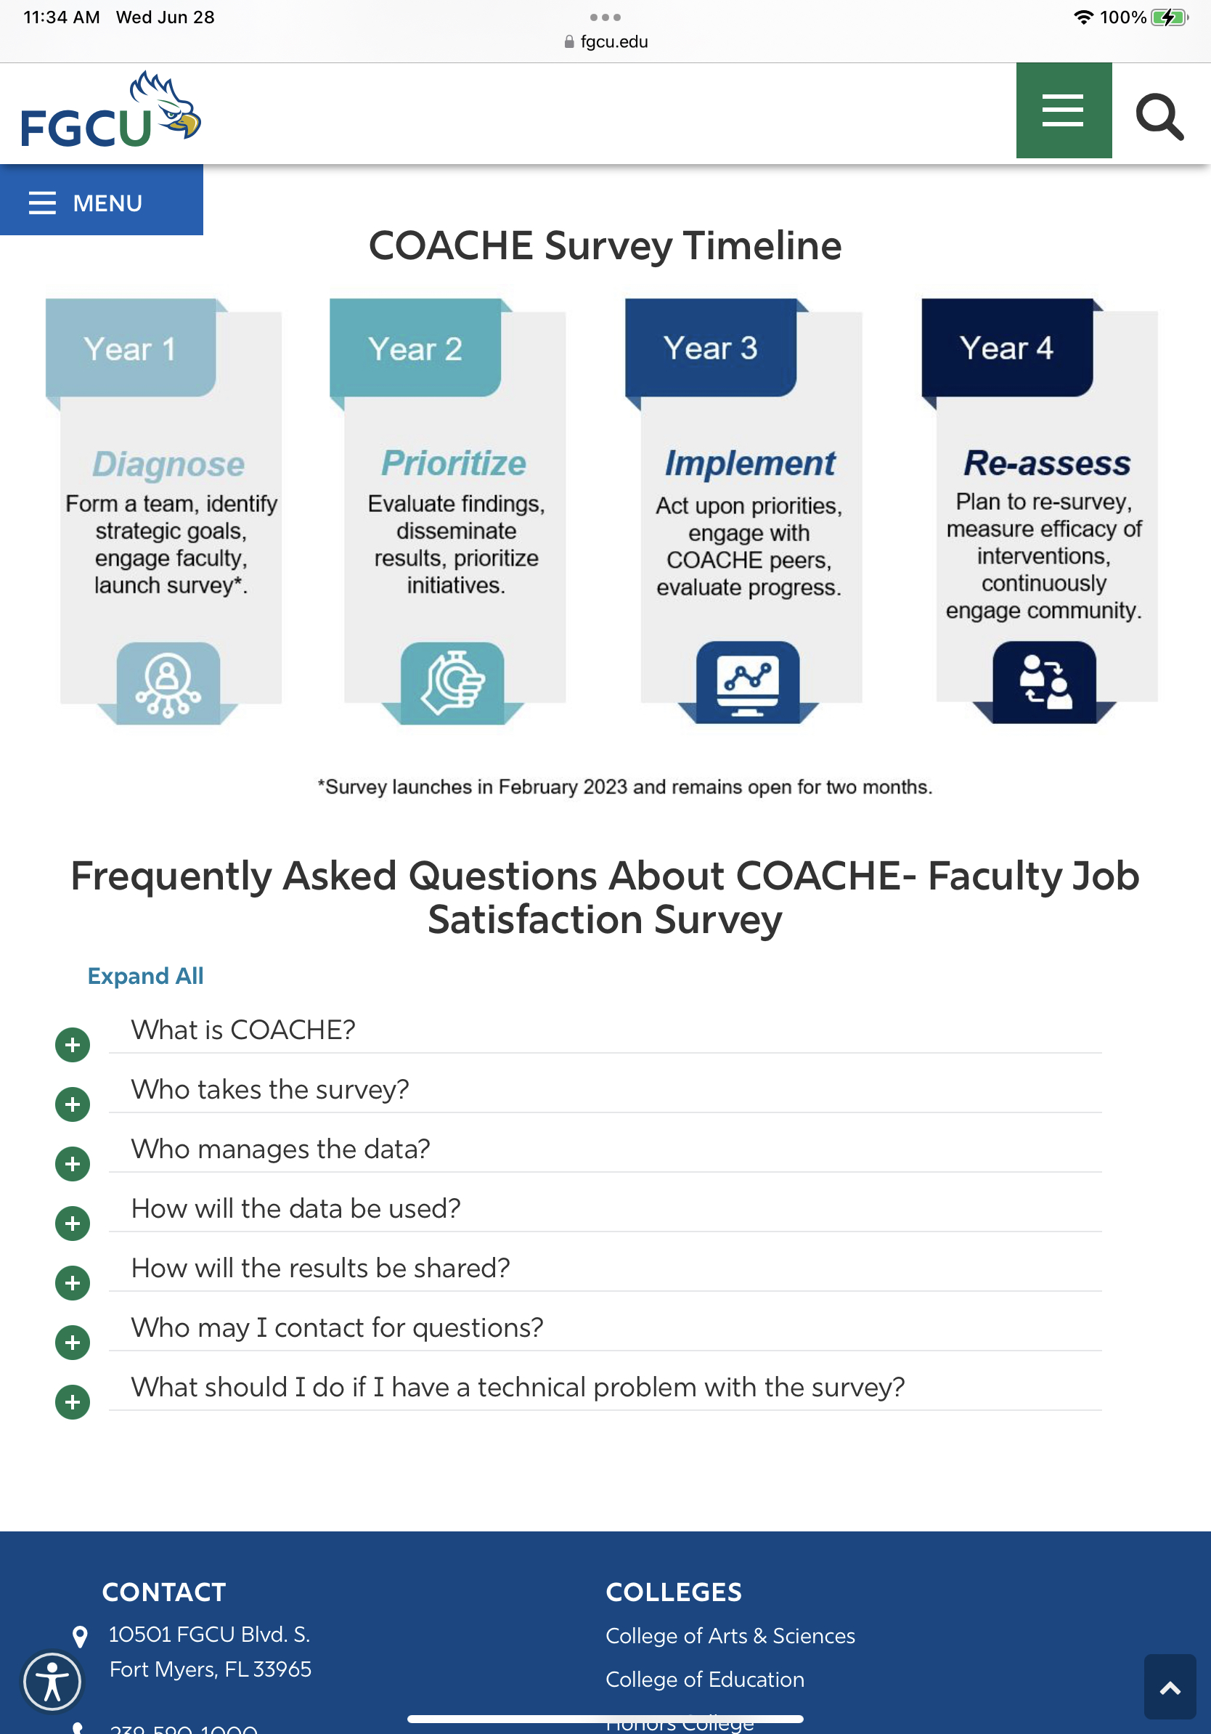
Advice
Transparency is key
  Share updates multiple ways
    Emails
    Faculty Senate Meetings
    Website
    Word of mouth
  Show the process & timeline

Slide 19
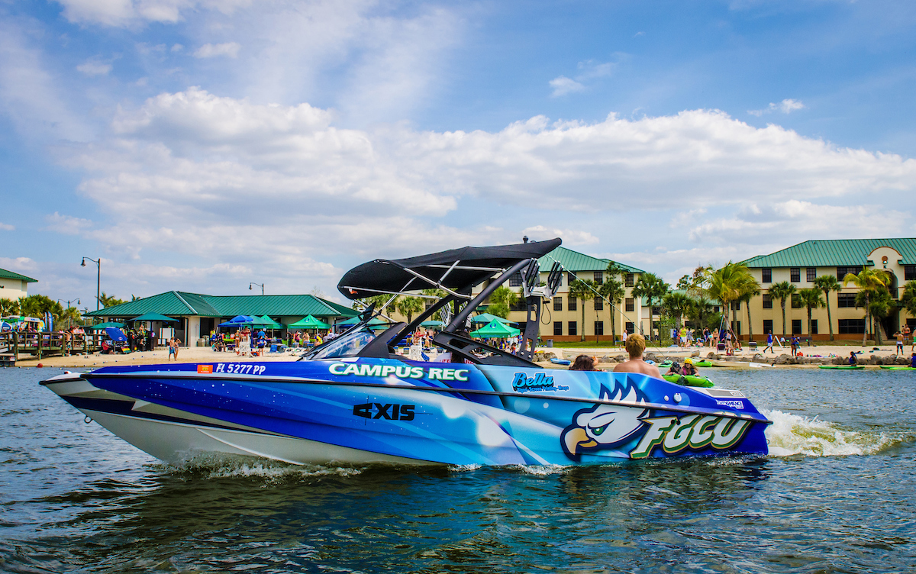
What is Next for FGCU?
04

Slide 20
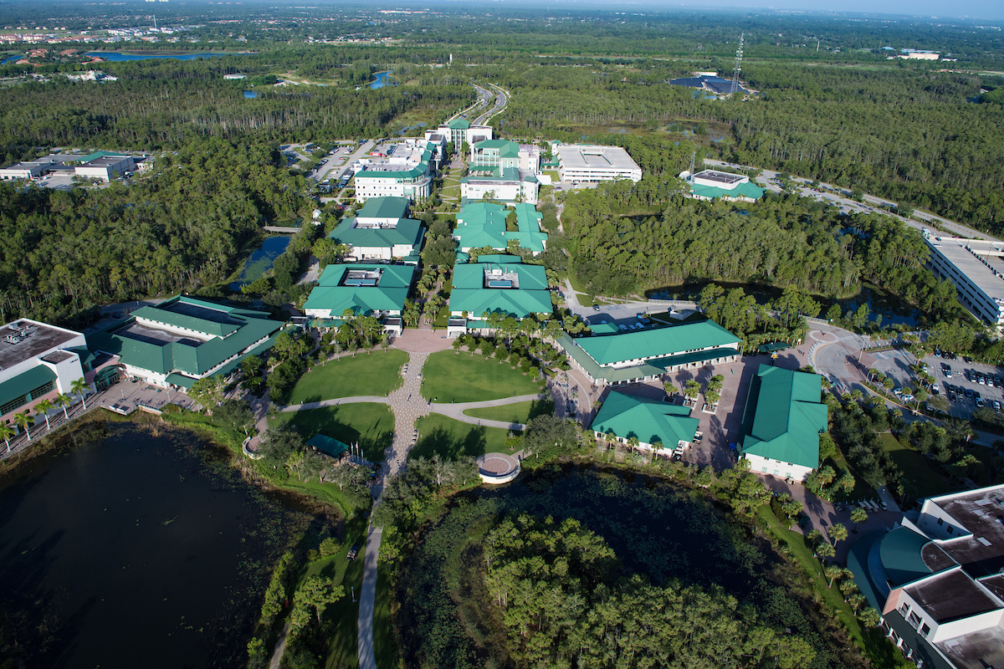
What is Next for FGCU?
Priority-Setting Taskforce
Strategy-Setting Taskforce
Working Groups Present Final Report to Campus & Implement
Ideate strategic responses for continuous improvement engage with COACHE peers.
(Spring 2024)
Re-assess
Plan to resurvey and measure progress.
(Fall 2025)
Evaluate finding and prioritize initiatives.
(Fall 2023)
Implement priorities actions
(Fall 2024)

Slide 21


We would like to thank:
FGCU Faculty Senate
Provost Mark Rieger
Academic Affairs Team
United Faculty of Florida, FGCU Chapter
FGCU COACHE Steering Committee

