Slide 1


CAMPUS CONSTITUENT SURVEYS AT KU
A process to build trust, demonstrate action,
and achieve continuous improvement
COACHE Strategy Workshop
Presented by Corinne Bannon, Chief Data Officer and Vice Provost of Analytics, Institutional Research, and Effectiveness at the University of Kansas
August 8, 2024

Slide 2
Agenda
Institutional context | 2022
COACHE survey process
Campus constituent survey process
Campus Constituent Survey Implementation Team
Take aways
Questions

Slide 3

Institutional Context | 2022
Environmental factors:
    Coming out of the COVID pandemic.
    Financial crisis.
    No systemic raises.
    Years of reduced state budget allocations.
    Fairly new executive leadership; the Provost started at KU right before COVID struck in 2020.
    Transition in Faculty Affairs leadership.

Slide 4
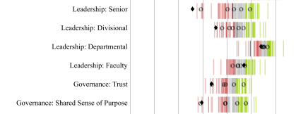
Institutional Context | 2022
COACHE survey administration and results:
    Administered for the first time in 10 years.
    No single unit consistently oversaw large campus constituent surveys for students, staff and faculty, and executive leaders were not deeply involved in the process.
    Campus constituent survey processes conducted inconsistently.
    Difficult set of results revealing a general dissatisfaction with central leadership.

Slide 5

Institutional Context | 2022
THE PERFECT STORM.
Steps needed to be taken to ensure faculty felt heard and could trust leaders to respond.

Slide 6
What we did?
Created an advisory committee with broad campus representation and executive (Provost) leadership. Cross-unit and governance representation identified.
Formed a small data team of staff and faculty to perform additional analysis as directed by the advisory committee. This team was supported by an analyst in AIRE.
Created a public webpage and communicated results via Provost campus email.
Further engaged the campus community in the results and sought additional feedback.
  14 campus engagement meetings held within academic schools
  200 faculty members attend and over 100 recommendations provided
Advisory committee reviewed results and collected feedback to create a recommendations report.
Provost and governance leaders delivered the recommendations report via a public forum.

Slide 7
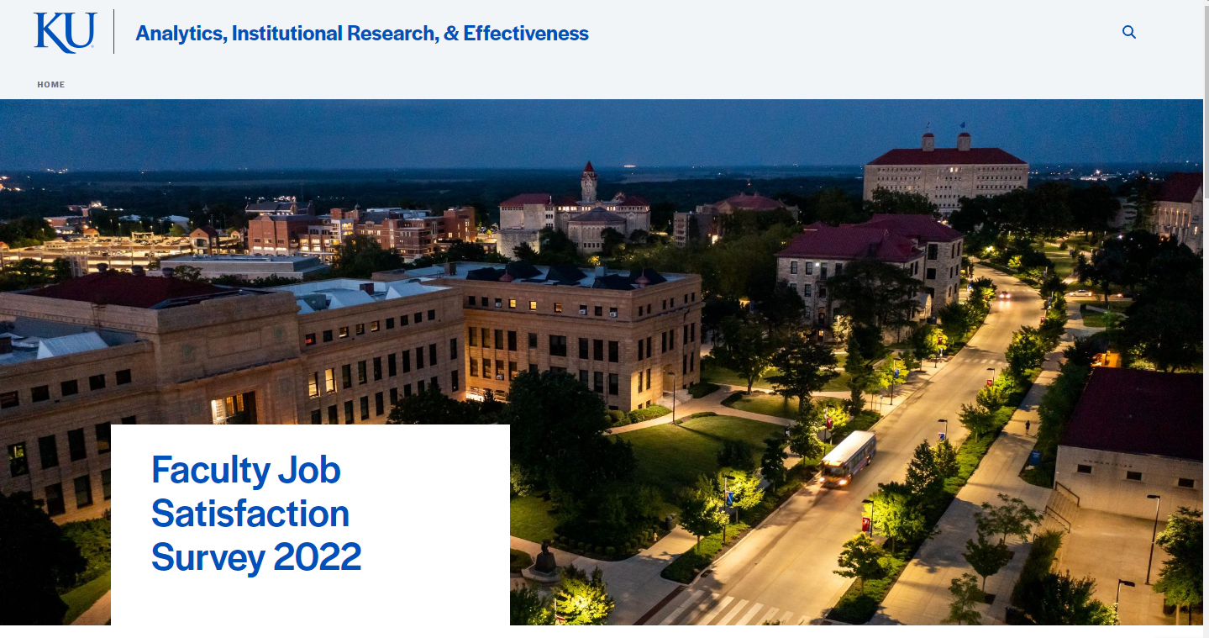
COACHE 2022 Website
https://aire.ku.edu/faculty-job-satisfaction-survey-2022

Slide 8
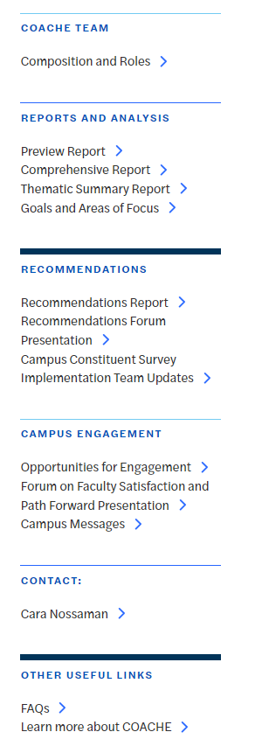

COACHE 2022 Website Content

Slide 9
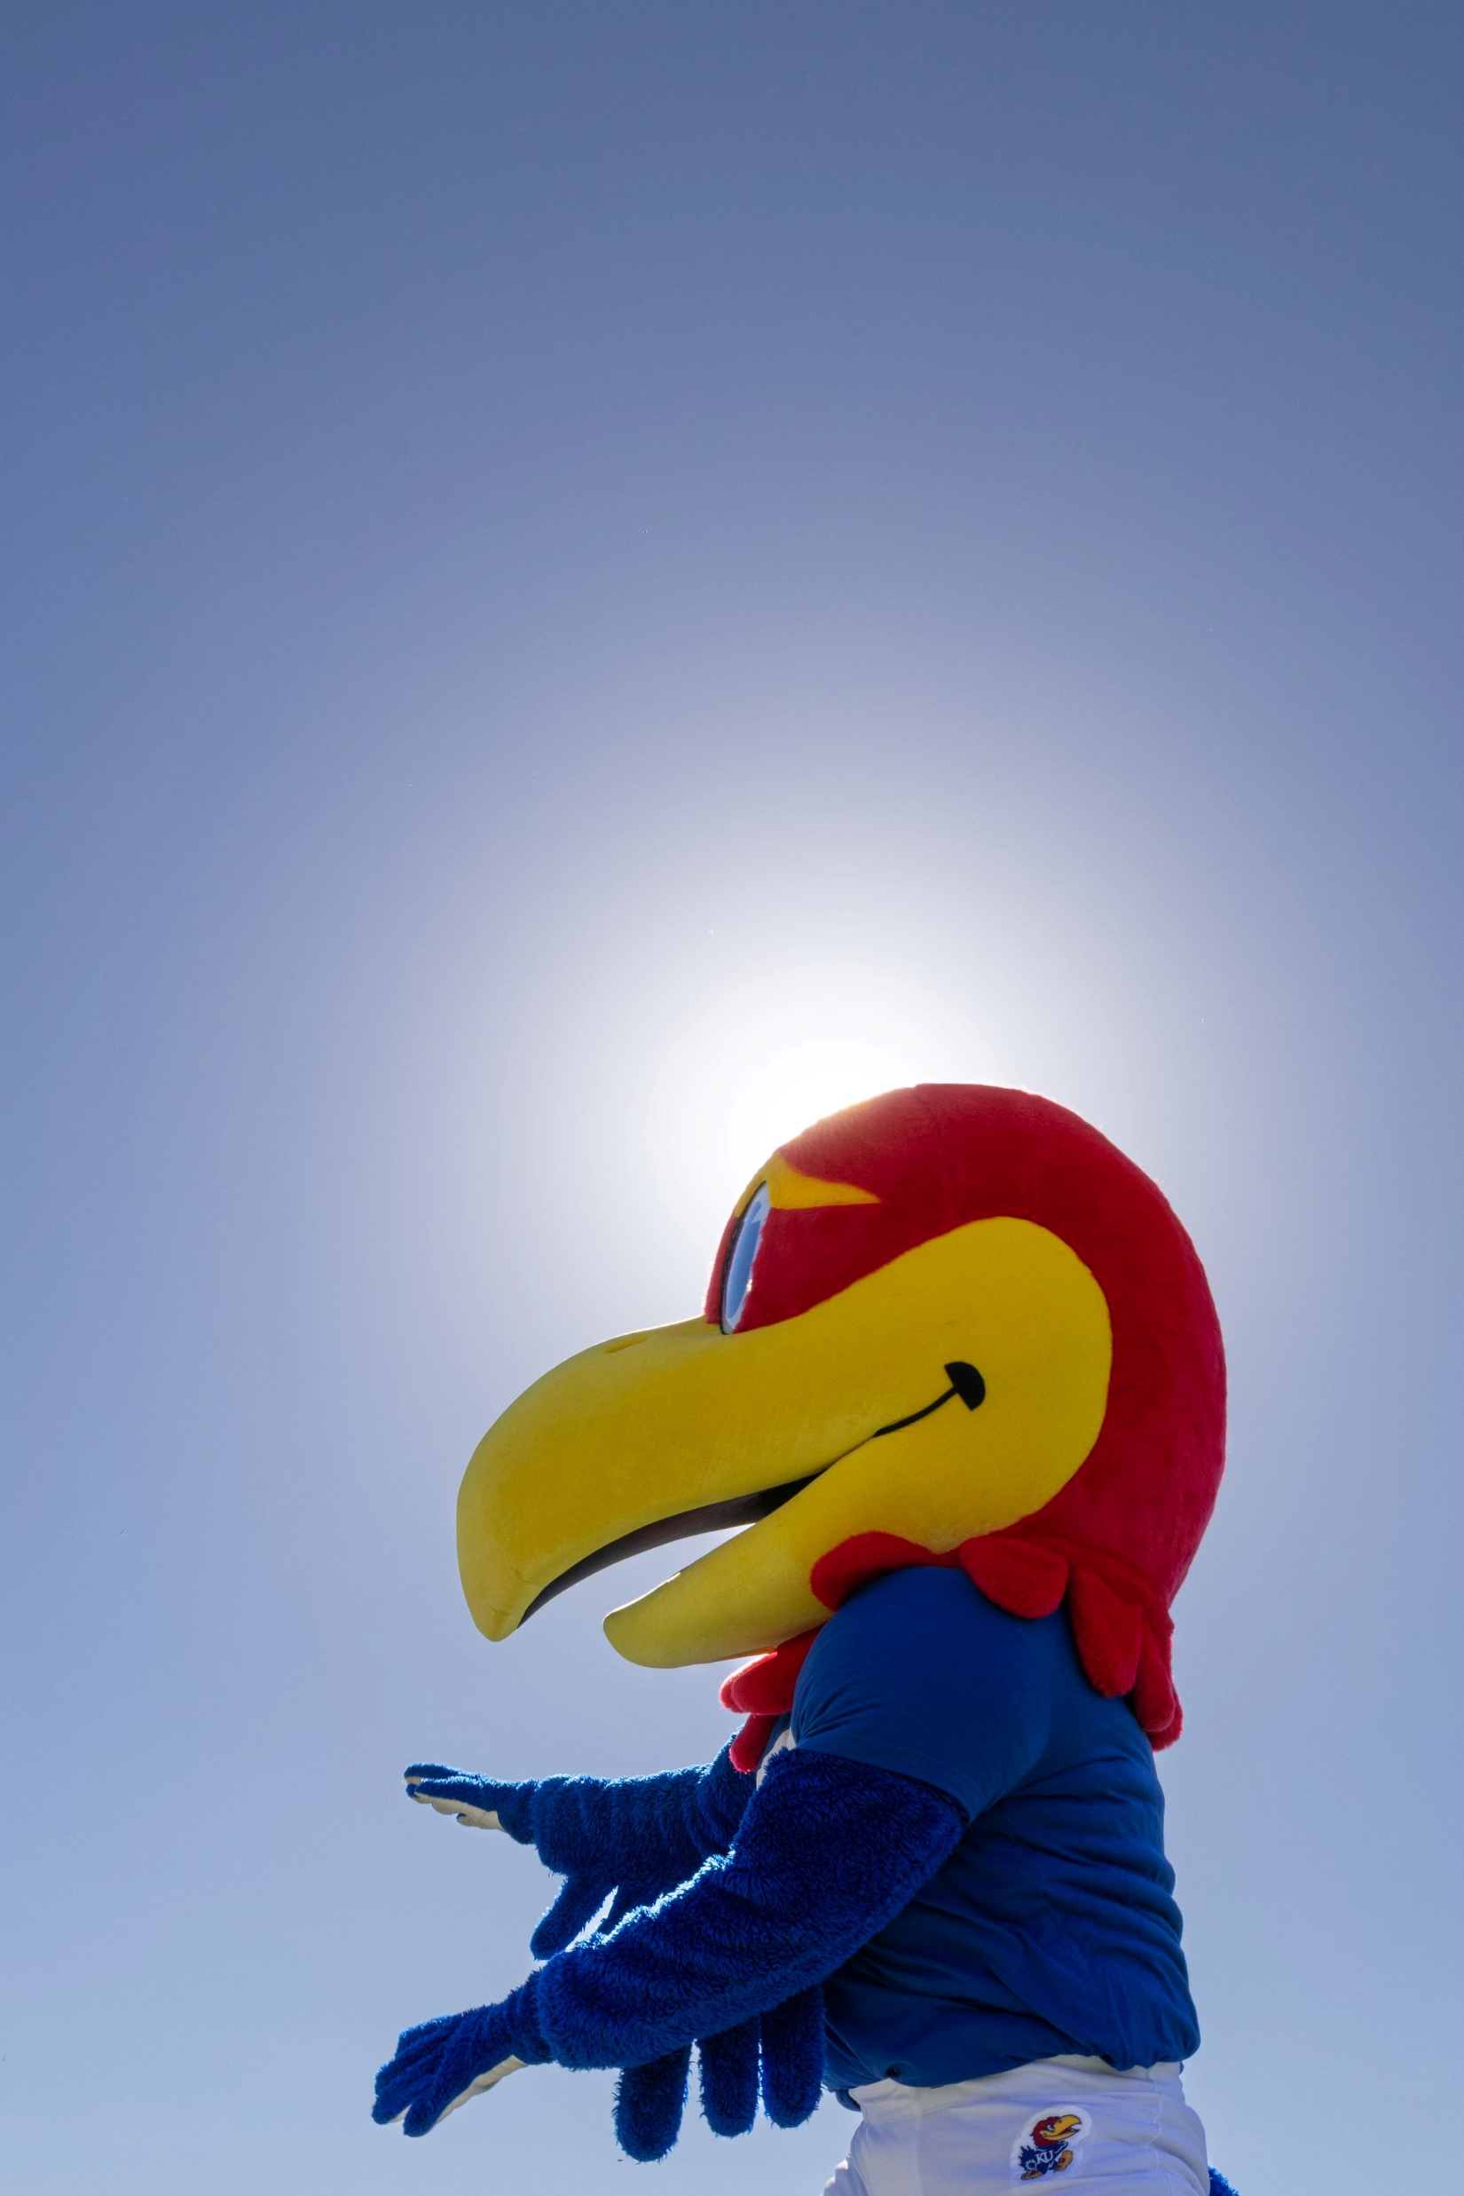
An Opportunity.
Apply the new COACHE process to all campus constituent surveys at KU.

Slide 10
Campus constituent surveys at KU
We identified a campus constituent survey for each core constituent group:
  Faculty: COACHE
  Undergraduate students: NSSE
  Graduate students: Graduate Student Experience Survey (KU created), moving to Grad Seru.
  Staff: Great Colleges to Work For.
  Executive commitment made and communicated to run each survey every three years on a rolling cadence.
Refined the COACHE process into an institutional process to ensure effective administration, participation, engagement and tracking of recommendation implementation.
KU’s Analytics, Institutional Research, & Effectiveness unit identified as the process owner.
Clear roles and responsibilities established for each stage of the process.

Slide 11
Campus Constituent Surveys Process
1
Pre-Administration Begins & Engage Survey Sponsors
AIRE engages survey sponsors to review contract terms, determine survey population and survey questions with the survey administrator (ie. COACHE).
Fall of Academic Year (AY) 1
9
Continuous Improvement & Transparency
Advisory chairs present recommendations to the campus constituent survey implementation team. This team meets on a triannual basis to prioritize, implement and track the recommendations. With the support of AIRE, this team records updates on the status of recommendations to ensure accountability and shares with campus community.
Fall of AY 3 and on-going
2
Identify Advisory Committee Chair(s)
Survey sponsors determines advisory committee chairs and partner in creation of communication strategy.
Fall of AY 1
1
9
2
3
Launch Survey
AIRE creates population file and sends to survey administrator. Survey administrator distributes survey to constituent group.
Spring of AY 1
8
8
3
Celebrate Campus Participation
Survey sponsor and advisory committee chair hold a public forum to share recommendations, updates on recommendations that were implemented since the previous survey administration and discuss next steps.
Spring of AY 2
Communications
7
4
4
Review Survey Results, Conduct Analysis, & Review Benchmarks
Advisory committee chairs and survey sponsor form advisory committee. Advisory committee reviews survey administrator reports. AIRE conducts additional analysis.
Summer of AY 1 or Fall of AY 2
7
6
5
Advisory Committee Finalizes Recommendations
Advisory committee develops advisory team report compiled of actionable recommendations.
Spring of AY 2
5
Share Results & Review Recommendations Implemented from Prior Administration
Advisory committee chairs and survey sponsor shares survey administrator report with campus community. Advisory committee plans community engagement process and reviews the implemented recommendations from previous administrations.
Fall of AY 2
6
Campus Engagement
Advisory committee holds engagement sessions to share results and collect additional feedback to inform recommendations.
Spring of AY 2
Notes:
Highlight that AIRE will keep this on track
Specifically call out from 6-9 as significant new initiatives to ensure campus engagement, transparency and continuous improvement

Slide 12
Roles and Responsibilities
Document developed to outline roles and responsibilities for the following roles for each survey (examples for COACHE provided in parentheses):
Survey administrator (COACHE)
Process owner (AIRE)
Data steward (AIRE)
Survey sponsor (Provost)
Advisory committee chair (Provost, Faculty/University Senate President)
Advisory committee member (8-10 members, broad representation chosen by the chair(s))
Campus constituent survey implementation team member (campus leaders responsible for recommendation implementation)

Slide 13
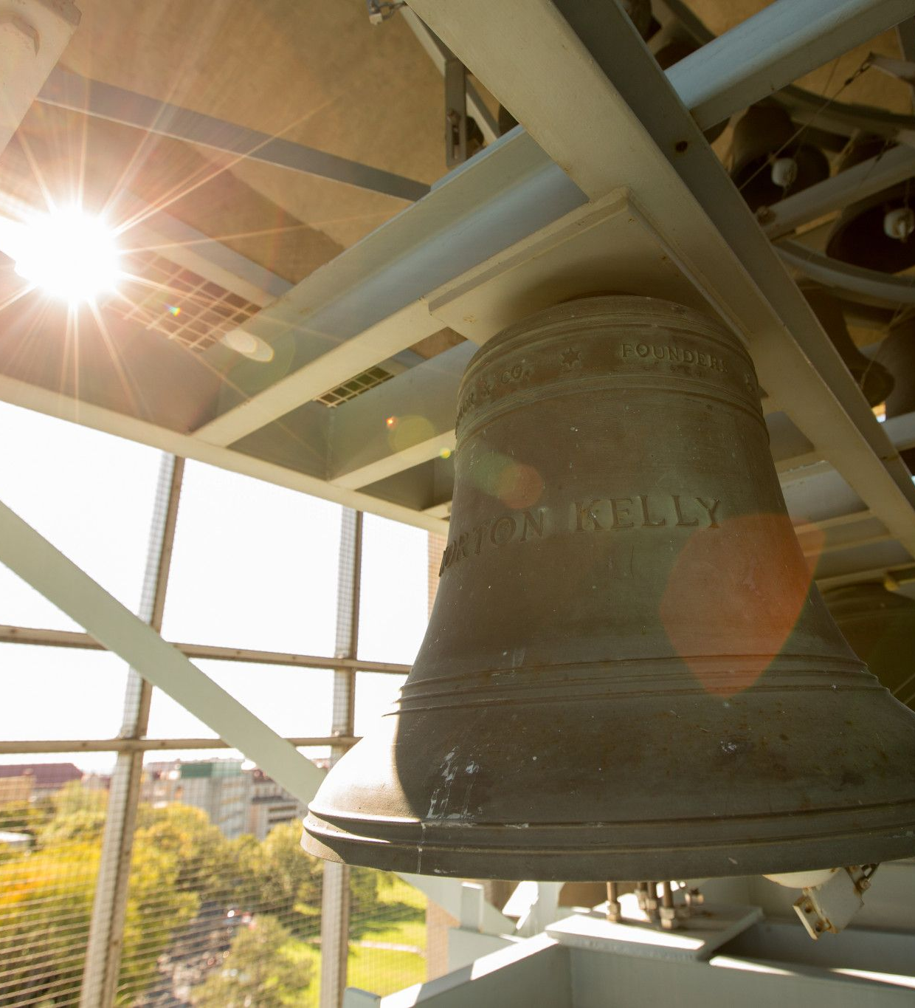
A
Realization.
“Just show us one thing you did based on survey results.”
(quote from several faculty during engagement sessions)

Slide 14
CCS Implementation Team at KU
Roles:
Review recommendations and prioritize action.
Provide updates on the status of recommendations to ensure accountability and transparency to campus constituents.
Collaborate with fellow implementation team members to forge partnerships and share how work being implemented impacts other units.
Tracking and communication:
The CCS Implementation Team meets 3x a year.
Progress is documented and provided to campus via an updated recommendations tracking spreadsheet shared on AIRE's website.
Provost and CDO send email to campus highlighting actions and how they respond to a survey recommendation.

Slide 15
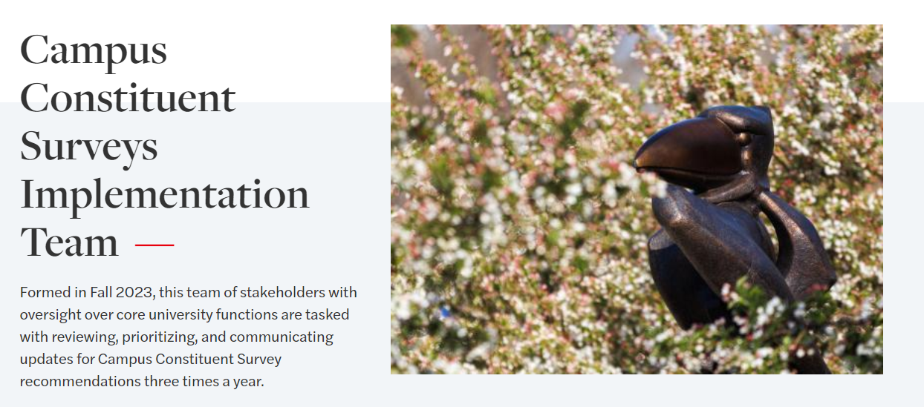
CCSI Team Website
https://aire.ku.edu/campus-constituent-surveys-implementation-team

Slide 16
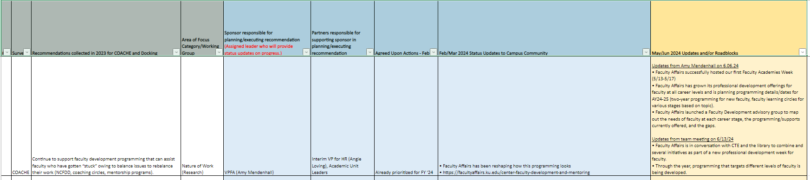
Implementation Team Tracking
We track:
Survey and recommendation
Area of Focus
Sponsor and partners responsible
Status update
Updates from each Campus Constituent Survey Implementation Team meeting
https://kansas.sharepoint.com/:x:/t/AIREReports/ETzNlxbt5dRBhMwUqsmH0xgBhMA-R4L4BN7IKsdnmmnc8Q?e=BdQIwb

Slide 17
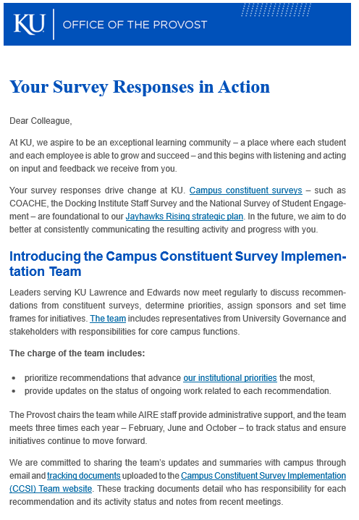
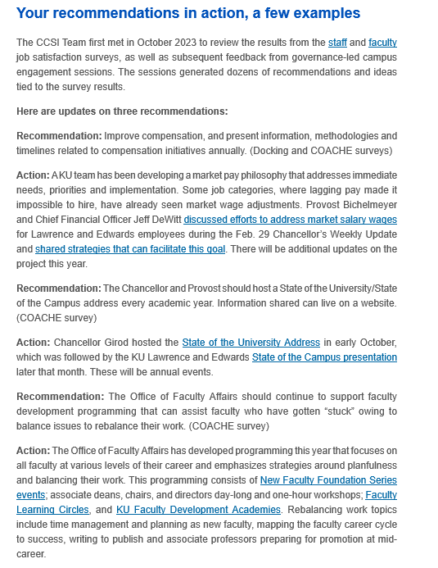
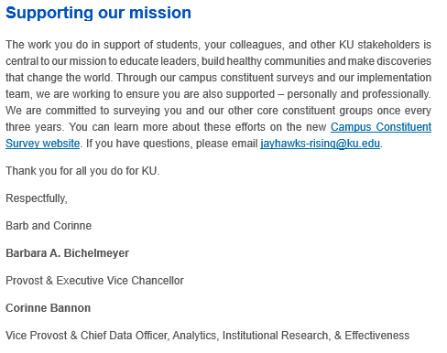
Implementation Team Email

Slide 18
Take Aways
Surveying alone isn't enough. The process is key.
Listen
Administer Survey
Engage
Share results, engage constituents
Plan
Create Recommendations
Act
Prioritize & Implement
Listen Again
Re-Administer Survey
Communication is critical at every step

Slide 19
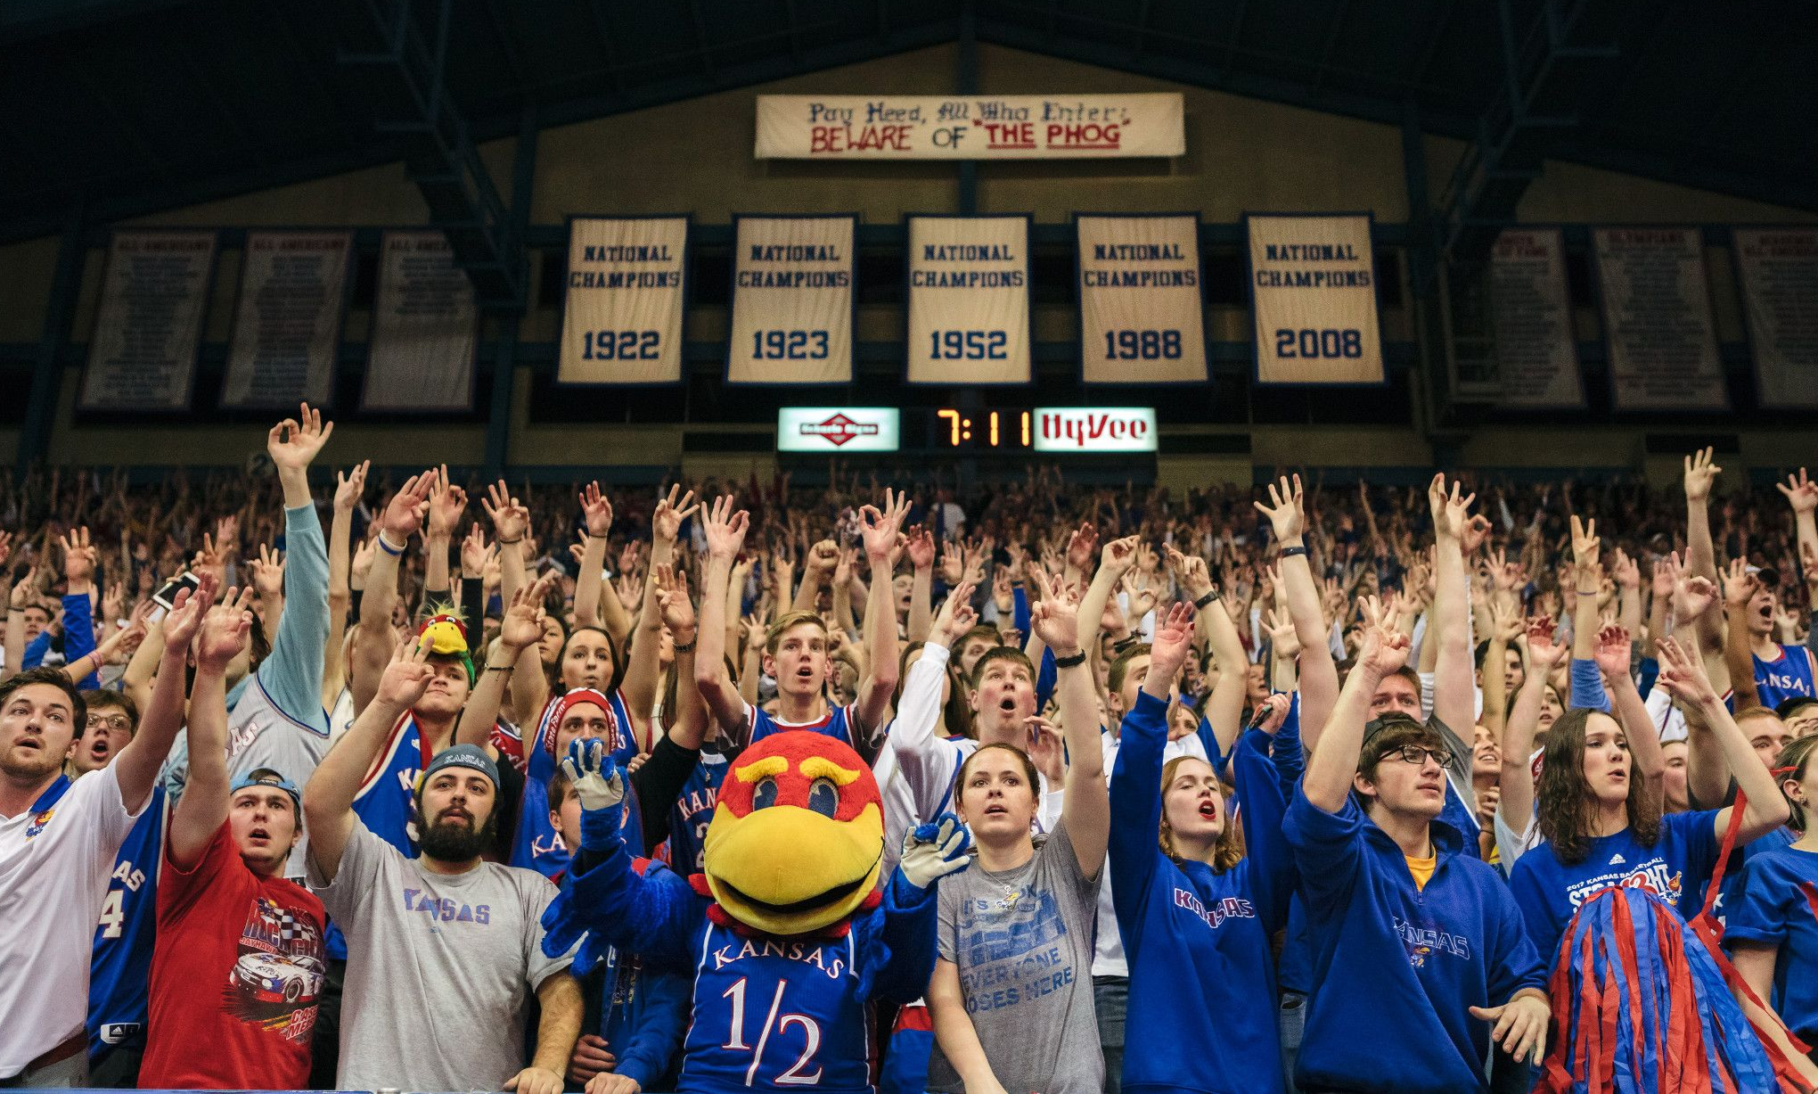
Teamwork makes the dream work

Slide 20
Key partners and acknowledgements
Key partners in developing and implementing this process:
Barbara Bichelmeyer, Provost and Executive Vice Chancellor
Ani Kokobobo, University Senate President (2022-23)
Nate Brunsell, Faculty Senate President (2022-23)
Cara Nossaman, Director of Strategic Initiatives, AIRE
Leigh Sands, Management Analyst, AIRE
Mark Sheaves, Director of Communications, AIRE
Thomas Skinner, Principal Analyst, AIRE
Additional key partner units:
  Faculty Affairs
  Graduate Studies
  Human Resources
  Undergraduate Education & Academic Success

Slide 21
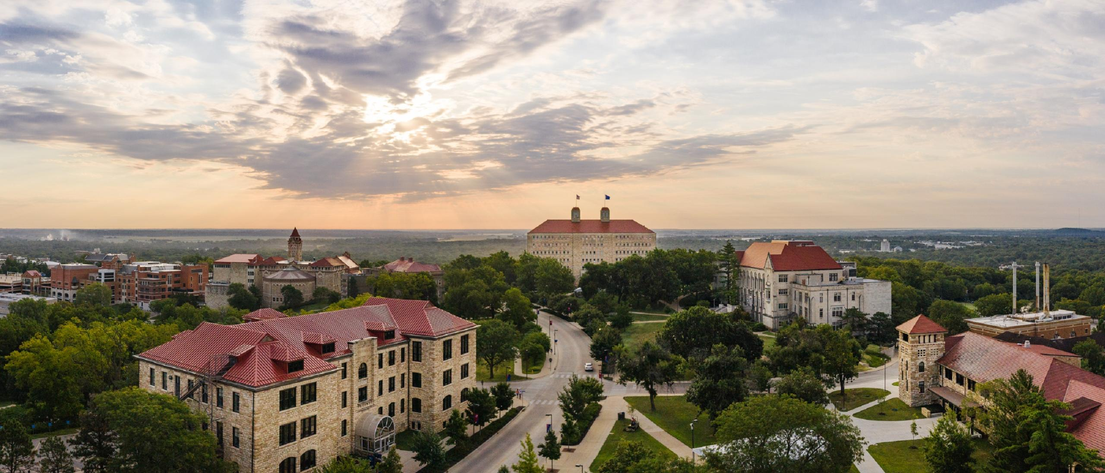
Questions

Slide 22
