Slide 1


Ramping up
for the Faculty Job Satisfaction Survey Administration
collaborative on academic
careers in higher education
Notes:
Ramping up for the Faculty Retention and Exit Survey Administration

Slide 2

Forming a Team
Guiding Principles
  Don’t try to do it alone
  Include faculty from the beginning
  Build around skills you need
  Team should mirror your campus
  Invite challenging voices
Notes:
By working with a distributed leadership model enables you to leverage the unique skills and strengths of each member of the team and also helps to send a message that the work is collaborative and inclusive. This model is also especially useful when the work is complex. COACHE teams should include members with diverse skills to manage tasks around communication, data analysis, and process/project management. Based on your institutional context, teams can be as small as a few people to a dozen or more. Some partners have created a new group to take on these tasks, while others already have committees, task forces, or advisory groups that are setup for these types of projects. Who are the key stakeholders? What might be the consequences of excluding any of those groups? Having access to key constituents will be important and helpful in survey success.
The COACHE team is important for the message its composition will send to the faculty. Including faculty in the COACHE teams also sends a message of collaboration. This also encourages more faculty to participate and take the survey more seriously.
Faculty offer different types of expertise. What are the types of skills that are most important? Communications/marketing? Custom question design? Survey design? Data analytics?
Representation is critical in garnering trust that the process has everyone’s interests in mind. Having greater response also means data will be more representative of the faculty as a whole. When there is more representative response rates, there will be more trust in the findings.
A question to ask “When I share findings who do I expect to challenge me the most?” How will your work be different if that person works with you to present findings rather than questions your choices? Tradeoff is that team leaders will have to engage in more behind the scenes work to build trust but again, another way of building trust with faculty is that dissenting voices are allowed. This will also help avoid greater dissension further down the line.

Slide 3

Questions to Ask
  What characteristics of my faculty are represented in the team?
  Do my team members bring the skills we will need to engage/communicate with faculty, analyze large complex data sets, and make recommendations regarding policies/programs?
  Are there subsets of faculty who might not feel represented? If so, how might I assuage their concerns about representation?
  What are the political/strategic implications for my choices?
  How can I frame the work so that it encourages collaboration even if there are naysayers?
  What role (if any) does my Chief Academic Officer play on the team?
Notes:
Examples of different types of team members:
Chief Academic Officer (often in ex-officio role) • senior academic officers in faculty affairs, development, diversity • division heads/Deans • chief diversity officer • committee on the status of women/minorities • tenure and promotion committee member • faculty governing body chair or similar rep • faculty collective bargaining unit representative • institutional research/effectiveness officer • director of center for teaching and learning • sponsored research director • principal investigator (e.g., NSF ADVANCE) • communications officer • faculty with expertise in higher ed., org. development/behavior, data analysis, etc

Slide 4

Faculty Job Satisfaction Roadmap
What does survey administration look like?
ONGOING
BEGIN NOW
BEGIN NOW
BEGIN NOW
1
Communication with your faculty
2
Participation Agreement
3
Institutional Review Board (IRB)
4
Prepare your population file
EARLY JANUARY
MID-NOVEMBER
LATE OCTOBER
EARLY SEPTEMBER
8
SPAM Testing
7
Population file delivery
6
Finalize custom questions
5
Data Disclosure Preference
MID-JANUARY
EARLY FEBRUARY
EARLY FEBRUARY
EARLY APRIL
9
10
11
12
Survey close
Respond to feedback population file
Greenlight Message
Survey launch
Notes:
Faculty Job Satisfaction Survey Roadmap: What does survey administration look like in the coming months?
Job Satisfaction survey administration is not difficult to conduct, however, like most projects, survey administration requires planning. Here are some items that our partners can begin to work on:
1. Communication with your faculty: Informing your faculty about the COACHE survey early and frequently is the best way to ensure greater participation. Utilize different voices, venues, and medium to share.
2. The Participation Agreement: The Participation Agreement outlines details on services and deliverables. It is a legally binding document which protects both COACHE and our partners. If you have not already begun processing the agreement, we recommend getting started now.
3. Institutional Review Board (IRB): All of COACHE’s research is reviewed and approved by Harvard’s Committee on the Use of Human Subjects. There is no requirement for our partners to complete a local IRB, but we do recommend reaching out to your institution's IRB. In many cases, informing the IRB is all you will need to do but, in some instances, a local IRB selects to conduct its own review, this can take a significant amount of time. We strongly recommend reaching out to your IRB now to ensure that your institution’s survey goals are in compliance prior to survey launch. COACHE will not launch any study if there is an outstanding local IRB Application.
4. Prepare your population file: The process of gathering the faculty data needed for your population file can take time. Begin collecting information now to ensure a healthy population file that captures all available information for delivery in mid-November.
5. Data Disclosure Preference: COACHE provides two options for Data Disclosure, discussed in detail later in this presentation. Please make sure to select a preference by early September. This will determine the level of data you will receive back as well as the message of informed consent faculty will see before they start the survey. This decision cannot be changed after survey launch.
6. Finalize custom questions: If you decide to incorporate custom questions, that decision must be made by the end of September and the questions finalized and submitted by the end of October.
7. Population file delivery: Your population file must be submitted to COACHE by the mid-November. If your institution wants to include any pass-through variables, those would be added/appended in the population file.
8. SPAM Testing: In order to SPAM test, each institution must submit a handful of e-mails, ideally from different departments/schools in the institution to which COACHE will send out a test e-mail to ensure that our messages are not being filtered into SPAM. In early January, our survey administration team will send test emails to those addresses. We will reach out to you if there is a problem with delivery. A note about whitelisting – At some institutions, individual colleges and even some departments have their own spam software. Your IT staff should know if this is a concern for your campus.
9. Respond to feedback population file: After receiving your population file in mid-November, COACHE will review the file and conduct an audit. We will then reach out to you with any questions or feedback. To ensure the highest level of survey data integrity please respond to feedback by early January.
10. Greenlight message: In early February, COACHE will send partners a message signaling that the survey is ready to launch. This alert ensures that institutional contacts will have time to send their endorsement letters to faculty regarding the upcoming survey launch date. Partner endorsement letters should not go out until the COACHE’s greenlight message has been received.
11. Survey launch: Survey launch kicks off in early February.
12. Survey close: Survey closes in early April. Congratulations and well done!

Slide 5

Preparing
Your
Population
File
Notes:
Preparing Your Population File
As a participant of COACHE’s upcoming Faculty Job Satisfaction Survey, we want to suggest some strategies for making the launch as smooth as possible.

Slide 6

Population File Preparation
Who to include?
Tenured
Tenure-Track
Non-tenure Track
Full-time;
Associate professors;
And full professors
Full-time;
Tenure-stream;
And assistant professors
Full-time;
Non-tenure track;
Senate (i.e.voting) faculty
1
2
3
Notes:
There are three major groups of faculty to include in your population file:
The COACHE Faculty Job Satisfaction Survey requires inclusion of all tenured, tenure-track, and non-tenure track faculty, building an accurate data file is more important than ever. The variables in your file will guide each faculty member through the appropriate course of adaptive branching.
Optional to include are clinical faculty (health sciences and other professions) as well as librarians.
We have branching for clinical faculty in the survey. And for librarians, institutions should make the decision based on how librarians are situated at your institution. They can be included if they are considered full faculty and have tenure or promotional processes similar to other faculty.
The population file module has all the specifics for the variables and coding but we’d like to touch on just a few of the variables where we typically get the most questions.

Slide 7

Do Not Include!
What should not be a part of the file?
  Faculty in terminal year after being denied tenure
  Senior administrators
    Dean, Assistant Dean, Associate Provosts
    (Chairs may be included)
  Faculty that have not yet been employed for a full calendar year at time of survey
  Part-time faculty
1
3
Notes:
There are certain faculty types that should not be included in your population file as their circumstances are distinct and may skew the results .
These include faculty in their terminal year after being denied tenure, senior administrators such as Deans, Assistant Deans, and Associate Provosts. However, department Chairs may be included.
Faculty who have not been employed for a full calendar year at the time of survey should also be excluded as they do not have enough experience at the institution to provide meaningful feedback.
Part-time faculty should also be excluded as we do not have branching for these populations at this time. We are currently working on building a part-time faculty survey, and if you have interest in participating in our pilot study, please reach out to Todd and me.
Now that we’ve talked about eligibility and who should and should not be included in your population file, let’s review some of the key variables that you should pay attention to when building your population file.

Slide 8


Population File Variables
What variables should I pay attention to?
1
(R)equired variables are critical for building COACHE reports.
(I)mportant variables are helpful.
(O)ptional variables are useful for potential outside research.
Notes:
COACHE created the Population File Module, which goes into detail regarding the different types of variables survey administrators should use to build their institution’s population file. Here is the shorthand for some of these variables:
Variables marked “R” are required variables and are critical for building COACHE reports and for the analyses we conduct. Missing data will affect the accuracy of response rates and disaggregated findings.
Data collection should primarily focus on these “R” variables.
Variables marked “I” are not only important variables but are also helpful for some parts of reporting, however, they will not impact key findings.
It helps to fill in as much as possible but if data for these I variables are difficult to obtain, it is less crucial.
Variables marked as “O” are optional variables and are useful for potential outside research or research that is outside of the scope of COACHE’s current reporting.
If any of these “O” variables are difficult to obtain, they should be deprioritized in the data collection efforts.

Slide 9


Key Required Variables
What variables must be included in my file?
  Institutional Data – Name and title of Chief Academic Officer (CAO), institution nickname, etc.
  Localid – unique identifiers (NOT social security numbers)
  E-mail
  Demographic data (race, gender, citizen, rank, tenure)
  Acarea or COACHE “Academic Area” code
1
Notes:
Institutional Data are important for messaging from COACHE.
The first of the key variables for faculty is Localid, unique identifiers (NOT social security numbers). It is typically an HR number assigned by your institution to all employees. Localid allows COACHE to link each record to additional, faculty-level data from your campus.
Making sure the E-mail is current and accurate so that messaging can be delivered successfully.
The next variables are demographic data (race, gender, citizen, rank, tenure). Although respondents are asked to identify/classify themselves, these variables are important so we can have a full count for the entire population and provide accurate response rate data. Respondent information will always be prioritized but population file data are used for non-respondents and in the case that respondents do not provide information.
Acarea, or COACHE “Academic Area” code, is another vital variable to include in your population file in order to produce data that can be used to compare results by discipline. This variable often generates a lot of questions. It is institutionally defined and allows researchers at COACHE and you to develop meaningful groups of faculty based on disciplinary distinctions beyond those of the traditional academic divisions.
Make sure to think about the school/division rather than the individual faculty’s exact area of study since the comparisons will be made by discipline. We want you to think about how your faculty in individual departments behave rather than which CIP code they are assigned to. For example, are your psychology faculty social scientists or biological scientists? Only you can answer that question, but we are also happy to hep facilitate that discussion.

Slide 10


Pass Through Variables
Why would I use pass through variables?
  $100 per variable​
  Maximum of 5
  Data is appended to the population file and is passed through into the unit record data file​
  You must receive unit record data​
  No identifying information
Notes:
Pass-through variables are designed to help institutions link COACHE data to other data sources. The data are appended to the original population file. Then, when a respondent completes the survey, the data for the pass-through variable are appended to the data set. Institutions have used this approach to link COACHE data to a host of other data sources such as:
• Results from other institutional surveys
• Human Resources codes for ranks or appointment statuses unique to your institution
• Faculty activity or productivity data (e.g., course loads, number of publications, presentations, teaching load, etc.)
• Contract length (e.g., nine-month, ten-month, twelve-month)
To decide if pass-through variables can be a useful tool for your team, consider the following two questions:
1. How will the pass-through variables change your approach to analyzing your results?
2. Does the addition of pass-through variables change your local IRB status? Check with your local IRB Office before proceeding
Please note that we can only work with pass through variables if an institution requests raw, deidentified data back from COACHE.

Slide 11


Data Disclosure
What data disclosure options do I have?
Option #1: Not receiving unit record data​
Advantages:
  Confidentiality
  Reduced workload for IR staff
Disadvantages:
  Outsourcing of custom analysis
1
Option #2: Receiving unit record data​
Advantages:
  Flexibility with analysis
  Data Sharing Consortia (AAUDE, COFHE, HEDS)​
Disadvantages:
  Data management and security
  Risk of lower response rate
Notes:
COACHE offers two data disclosure options. By selecting the first option, your institution will not receive unit record data. This means COACHE will analyze data and deliver a report, but not the raw survey data. By selecting the second option, institutions can choose to receive unit record data. In this case institutions will receive both COACHE reporting and their raw survey data. Your data disclosure option must be decided in advance as this will determine the informed consent form faculty at your institution will receive. Once the survey has launched, your data disclosure decision cannot be changed.

Slide 12

Statement of Data Confidentiality
Who should sign the data confidentiality form?
  Statement of data confidentiality must be signed by a data administrator!
  Data administrator must NOT:
    Be in a position to make or influence faculty personnel decisions at the institution
    In cases of promotion and/or tenure, be involved in deliberations and votes of the committee regarding such cases for a period of two (2) years following receipt of the COACHE Data File and Reports
    Distribute any survey results in which identification of individuals may be possible.
1
3
*See Statement of Data Confidentiality
Notes:
Institutions that decide to receive unit record data must submit a signed statement of confidentiality. The statement of data confidentiality must be signed by a data administrator and the data administrator must NOT:
• Be in a position to make or influence faculty personnel decisions at the institution
• In cases of promotion and/or tenure, be involved in deliberations and votes of the committee regarding such cases for a period of two (2) years following receipt of the COACHE Data File and Reports
• Distribute any survey results in which identification of individuals may be possible.

Slide 13


Custom Questions
Why would I use custom questions?
  $250 per question
  15 questions maximum
  Questions appended to the end of the survey
  Reporting consists of frequency data with limited demographic ​variables
  Open-ended responses are not redacted/cleaned
Notes:
Another decision that needs to happen early on is the addition of custom questions. If there are any salient issues on your campus that are not covered in the main survey, we offer the option to add up to 15 custom questions to the end of the survey.
Custom questions allow you to pinpoint institution specific issues without developing another faculty survey. What you lose is the comparative data.
Before allocation resources towards custom questions, consider the following:
Does COACHE already ask about this in the main survey instrument? Unless your questions are distinctly different from ours, the repetition may create survey fatigue compromising the integrity of your data.
Are these faculty issues or campus wide issues? If these issues affect more than faculty, be certain to consider how you will assess other members of your campus community.
What do we really want to know? We always encourage our members to send us a list of topics. COACHE already has an extensive library of custom questions that may suit your needs. Plus, if one of your peers already used the question, we may be able to facilitate a data exchange for just the custom questions.
Additional notes:
We have COVID questions we used in 2020 that can be used as custom questions. You can use the whole battery of COVID questions or select the ones most relevant to your institution.
The maximum number of questions allowed is 15 and that includes sub-questions. One question with parts A, B, and C will count as three separate questions.

Slide 14

IRB Approval
Speak with a representative of your Institutional Review Board (IRB) to determine if review is necessary. Although COACHE has obtained approval from Harvard’s Committee on the Use of Human Subjects, your local IRB may require you to complete additional forms.
Notes:
Once you’ve decided on a data option, you should immediately reach out to your campus IRB Committee.
COACHE has completed its own IRB review through Harvard University’s Committee on the Use of Human Subjects. For the majority of COACHE partner institutions, a copy of the Harvard approval letter is adequate documentation of this project’s bona fides. However, some institutions request additional review to approve this survey research on their campuses. Please reach out to your local IRB office and let our team know if you need assistance obtaining approval.
Any campus with a pending IRB application cannot begin survey administration with the full cohort. Delayed starts typically result in lower response rates!
Additional note: As a matter of policy, Harvard’s Committee on the Use of Human Subjects will not enter into an Institutional Affiliation Agreement for COACHE’s survey since the survey is considered a single site study – all research administration is conducted at Harvard.

Slide 15

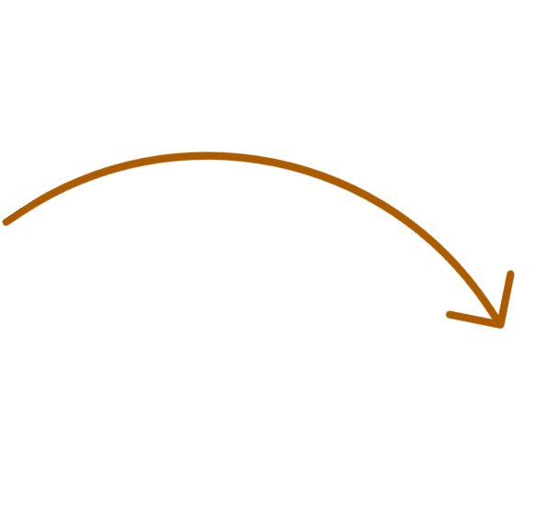



Communicating with Faculty
Launch Week
Convocations
Senate
Collective bargaining groups
Formal, direct communication ends
Endorsement letter
Follow-up e-mail
Pre-launch
Post-launch
Notes:
Communicating with your faculty throughout the survey administration process is not only critical to generating high response rates and accurate data, it is also first step towards cultivating a healthy dialogue about your survey results.
Prior to survey administration we encourage you to talk about COACHE often and everywhere. Faculty convocations, collective bargaining, and Senate meetings are excellent opportunities for you to build momentum. Print and electronic media are also encouraged. HR newsletters and school newspapers can reach faculty who are less likely to attend events. Faculty leaders, deans, and department chairs should be encouraged to spread the word.
The week prior to survey launch, a letter of endorsement should be sent from your chief academic officer. You’ll find a sample on the survey administration page. Next, COACHE will send out the formal invitation including their unique link to the survey.
Once the first round of invitations have been sent, we ask that you send out a follow-up email to your faculty from a representative of your COACHE Team. We are hoping that message from a different sender will help to attract a broader audience.
After the follow-up email, our IRB protocol requires that you no longer solicit faculty participation in the survey. However, that doesn’t mean you have to stop talking about COACHE entirely. For example, some schools have put a response rate tracker on their homepage so faculty can see how your campus’ response rate stacks up against peers. Other schools use the time of survey administration to begin dialogue about what they expect the results to reveal about your campus. This is also an excellent time to share your plans for working with the data. How will you communicate the results?
The bottom line is that discussing these things now shows your intent to use the data that we are collecting. Starting the dialogue early will help you to continue the dialogue once your report arrives.

Slide 16

Your
Survey
Administration
Portal
Notes:
Your COACHE Partner Portal

Slide 17
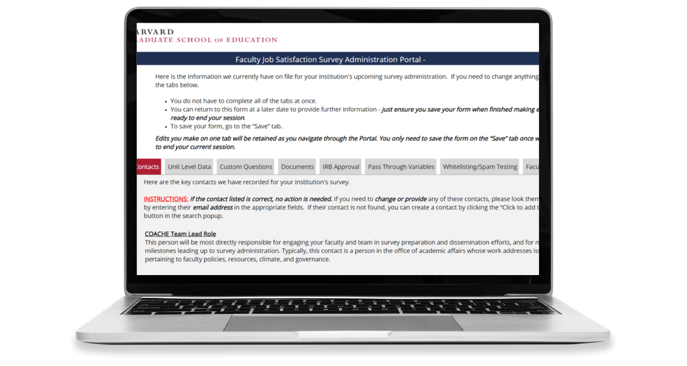




Faculty Job Satisfaction Survey Admin. Portal
Upload your team contacts
Store your documents and population file(s)
Securely share documents with COACHE team
Make institution- specific survey decisions within the partner portal
Notes:
Your COACHE partner portal is where all of your institution’s survey-related documents can be stored for easy and secure sharing with COACHE. For example, your institution’s survey administrators can upload the population file, IRB Approval document, and Statement of Data Confidentiality form into the COACHE Partner Portal. Institution specific survey decisions, such as custom questions, and peer selections, can also be made within the partner portal.
Please remember, do not email COACHE staff population files or any other confidential information. Confidential information should only be shared with COACHE securely through the portal.
We suggest designating one main person to manage the portal so that information does not get deleted or over-ridden by accident.
Also make sure to use the same e-mail where you receive COACHE messages because that is the e-mail on record that will give you access to the portal.

Slide 18
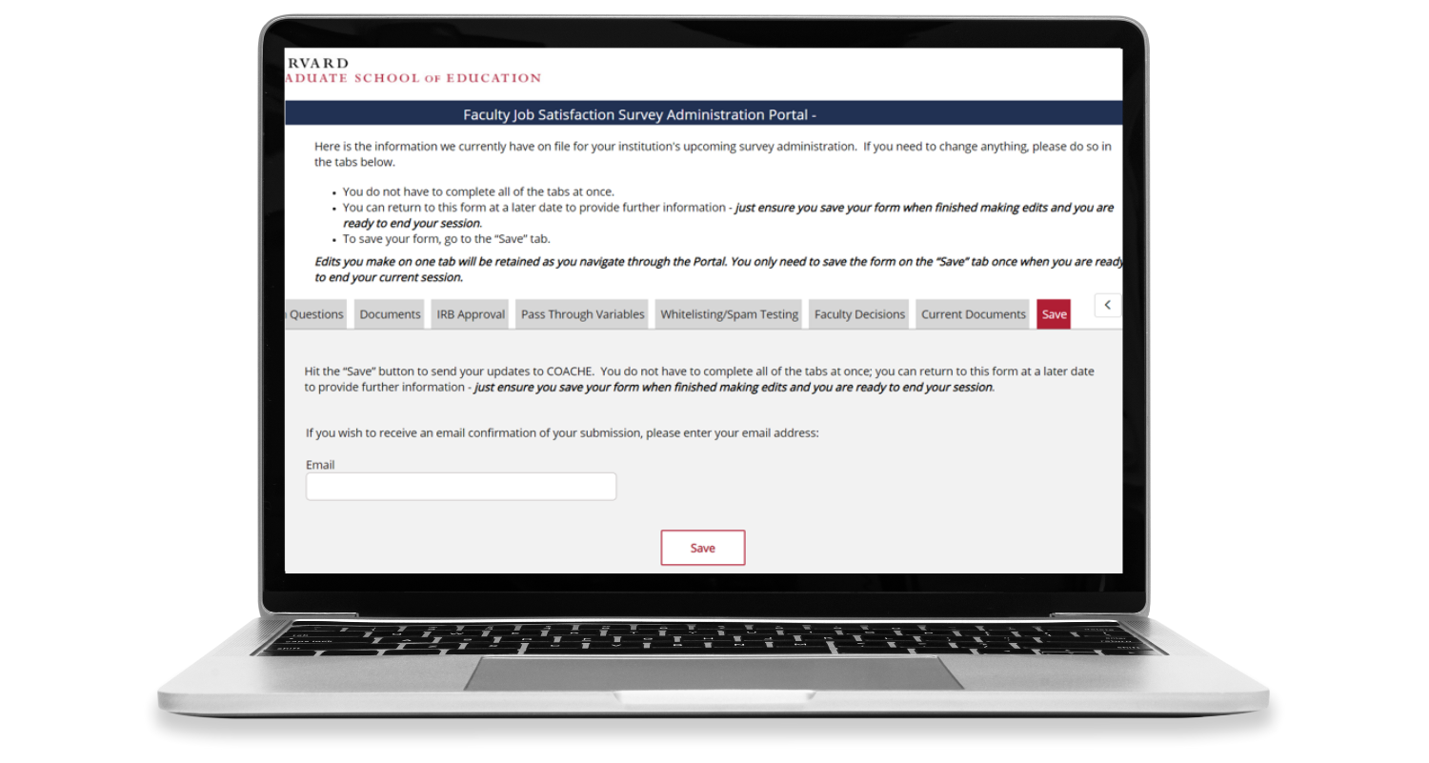

Faculty Job Satisfaction Survey Admin. Portal
Always click the SAVE button after each session
Notes:
A little tip about your COACHE Partner Portal:
You do not have to complete all the tabs in the COACHE partner portal all at once. You can return on a later date to provide additional information if needed.
Just please remember to click SAVE at the end of each session!
Additional notes:
Report delivery can be expected in the summer with scheduled seminars/strategy workshops to help with understanding and disseminating the reports.
Peer selection happens after launch. You will have most of March and part of April to select your peers. Some partners sign on as well as defer last minute, so we wait until after launch to ensure a complete cohort and peer list from which our partners can select.

Slide 19

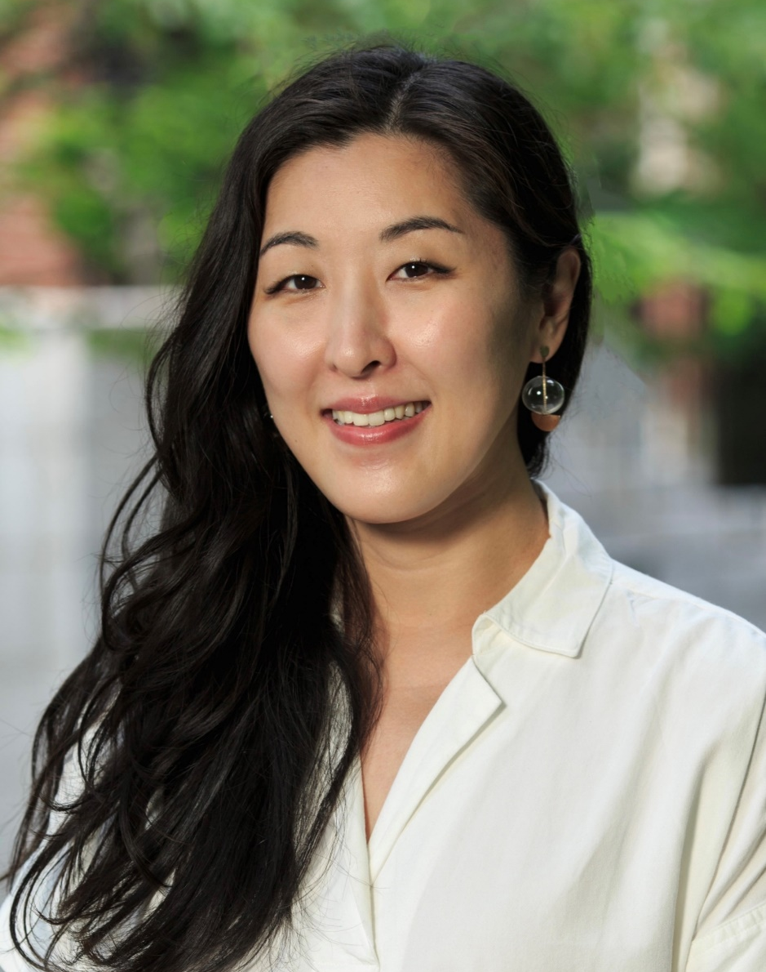
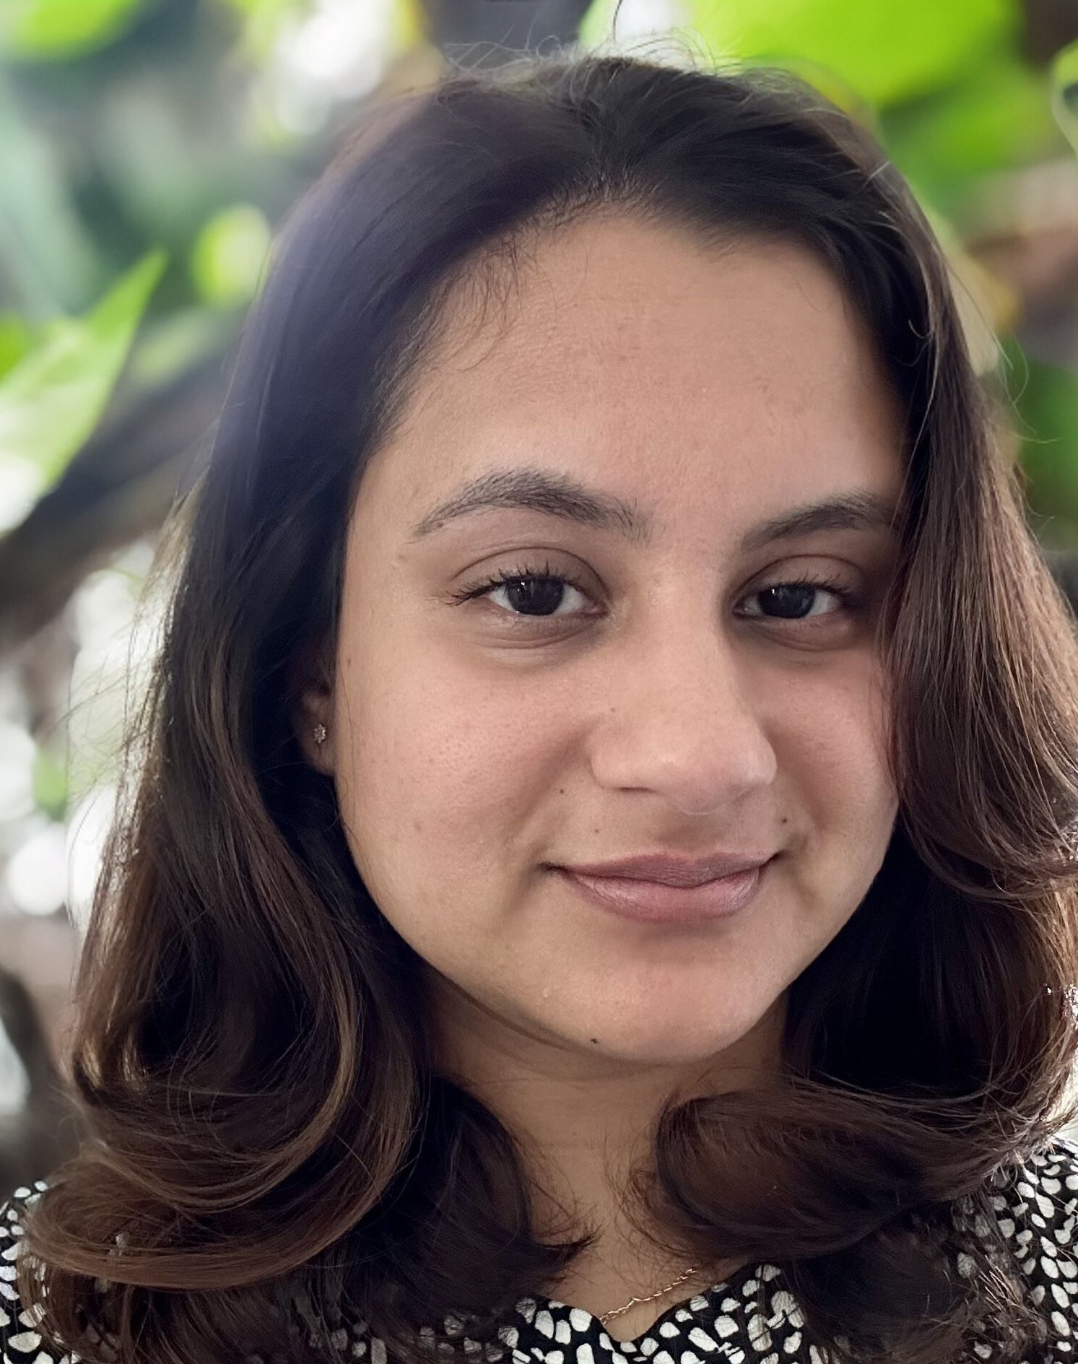



LEARN MORE
For additional information on preparing for your COACHE Faculty Job Satisfaction survey, contact:
Jeannie Kim
Assistant Director of Research
jeannie_kim@gse.harvard.edu
617-495-6010
Shabreena Danz Lopez
Research and Survey Administration Manager
shabreena_danzlopez@gse.harvard.edu
617-495-6010
Visit us online:
@ COACHE.GSE.HARVARD.EDU
Notes:
We hope this presentation helped to clarify the Job Satisfaction Survey administration process! As your team begins the process, especially when initially gathering population file data, please do not hesitate to reach out to COACHE staff with any concerns or questions. We are here to assist you!

