Slide 1


About This Slide Deck
Congratulations on receiving your Exit and Retention Survey Report! Now, what’s next? This slide deck will guide you through your report and prepare you for data dissemination.
Develop an executive summary for a specific task group, committee, or faculty leadership group
Identify key trends and patterns in faculty mobility
Identify key strengths and areas for improvements in retention programs and policies
Navigate the report platform
Interpret specific data visualizations
But the Video Guides DO! We strongly recommend reviewing the video guides on data interpretation before or alongside working on this slide.
HOW TO WORK WITH THIS SLIDE DECK:
Know Your Audience – Begin by considering who your audiences are. What are their areas of influence? Which results are they most likely to care about? You can customize your slide deck based on your audience’s needs.
Working Slides – These slides prompt you to enter key data points from your report. They include an image in the corner for easy identification. If you wish, you may change the image and add your branding to these slides.
Instructional Slides – Each working slide is preceded by an instructional slide to help you locate the relevant data. These slides have a COACHE logo on top for easy identification.
Finalize Your Slide Deck – Once completed, remove the instructional slides for a clean look.
Present Your Slide Deck – Share your findings! Work with your constituencies to make sense of data and identify recommendations.
USE CASES OF THE SLIDE DECK:
WHAT THIS SLIDE DECK WON’T HELP WITH:
UP NEXT: Mapping out the landscape of your presentation
COACHE | Faculty Retention and Exit Survey
Instructional Slide (NOT for presenting)

Slide 2
About This Slide Deck
TABLE OF CONTENTS:
THE LANDSCAPE OF YOUR PRESENTATION:
About This Slide Deck | p. 1-2
Overview of the Faculty Retention and Exit Survey | p. 3-4
The Analytic Sample* | p. 5-6
Most Compelling Factors for Decision to Stay or Leave* | p. 7-8
Unpacking Dual Careers* | p. 9-10
The Search Process* | p. 11-12
The Negotiation Process* | p. 13-14
The Negotiation Process* | p. 15-16
Overall Impressions* | p. 17-18
Next Steps | p. 19
To help you customize this slide deck, let’s map out the landscape of your presentation. Please take some time to reflect on the questions below. We will ask you to include your answers at the end of the slide deck.
Who are the primary constituencies you will be presenting to? Which section of the survey report/slide deck would be most relevant to them?
Who else will be part of your core team to support this effort (planning, presenting, or following up)?
What is the timeline for decision-making? By what date do you or your team plan to present the findings? When should recommendations be identified and shared?
ESTIMATED TIME TO COMPLETE THE SLIDE DECK: 2 HOURS
UP NEXT: Let’s look at an example of an instructional slide.
* These sections of the slide deck align with the sections of your survey report. You may jump to the sections that are most relevant for you and your audience.
COACHE | Faculty Retention and Exit Survey
Instructional Slide (NOT for presenting)

Slide 3
Instructions
Let’s start the presentation with an overview of your institution’s participation in the Faculty Retention and Exit Survey.
You DO NOT need to populate this instructional slide. The content below on the left is a preview of what you are going to complete in the next working slide. The legend on the right will help you locate the relevant data in your report.
[ A ] partnered with the Collaborative on Academic Careers on Higher Education (COACHE) to understand our institution’s strengths and areas for improvement in faculty retention. Data collection took place in [ B ]. The sample included faculty who have voluntarily departed, were retained, and (optional) received a pre-emptive retention offer¹.
The survey report presents nine key themes to identify patterns in the causes, costs, and conduct of faculty mobility. Results are disaggregated by employment status (i.e., departure, retention, or pre-emptive retention). They can also be analyzed by subgroups, including gender, race/ethnicity, tenure status, and broad disciplinary categories. In addition, the report offers comparative insights by benchmarking our results against a cohort of institutions² that participated in the same survey years.
Legend
[ A ]: Input your institution name.
[ B ]: Years can be found on your report landing page listing the interim and final report years.
[ 1 ]: The pre-emptive retention group was optional to include in the survey. If your institution did not include this group, you can take it out from your presentation.
[ 2 ]: If desired, go to "Appendix > Reporting/Analysis" in your report to see a full list of institutions in your cohort.
UP NEXT: Input data points to complete your next slide.
COACHE | Faculty Retention and Exit Survey
Instructional Slide (NOT for presenting)

Slide 4

Overview of the Faculty Retention and Exit Survey
[ A ] partnered with the Collaborative on Academic Careers on Higher Education (COACHE) to understand our institution’s strengths and areas for improvement in faculty retention. Data collection took place in [ B ]. The sample included faculty who have voluntarily departed, were retained, and (optional) received a pre-emptive retention offer.
The survey report presents nine key themes to identify patterns in the causes, costs, and conduct of faculty mobility. Results are disaggregated by employment status (i.e., retention, departure, or pre-emptive retention). They can also be analyzed by subgroups, including gender, race/ethnicity, tenure status, and broad disciplinary categories. In addition, the report offers comparative insights by benchmarking our results against a cohort of institutions that participated in the same survey years.
COACHE | 2025
COACHE | Faculty Retention and Exit Survey
5
Notes:
Note from COACHE: To change the image, 1) click on the image, 2) right click and select “Change Picture” from “This Device”, 3) select the picture from your device and click “Insert.”

Slide 5

Instructions
Great job filling in the blanks! In Module 1 of the report – The Analytic Sample, you can provide an overview of the faculty sample and the response rates. Response rates help you understand who is represented in the survey results. We have selected a few data points for you to highlight.
A total of [ A ] faculty were invited to complete the survey, with [ B ]% having left the institution, [ C ]% retained, and (optional) [ D ]% preemptively retained.
(optional) When viewing results by [ a subgroup ], [Group A] is at higher risk of leaving than [Group B].¹
The overall response rate was [ E ]% for our institution and [ F ]% for the cohort.
(optional) When viewing results by [ a subgroup ], [Group A] responded at a higher rate than [Group B].²
[ A ]: From report section 1.1, input the number from Your Institution: n=
[ B ] [ C ] [ D ]: From 1.1, input the Departure, Retention, and (OPTIONAL) Preemptive Retention percentage of your institution.
[ 1 ]: From 1.1, use the drop-down menu to view results by a subgroup. Which subgroup(s) does your audience care most about? Are there significant with-in group differences? If so, input your findings.
[ E ] [ F ]: From 1.3, click on the “Response Rates” link above the graph. You will be directed to the Appendix. Then, input your institution’s Total Response Rates and the cohort’s Total Response Rates from the data table.
[ 2 ]: From 1.3, use the drop-down menu to view results by a subgroup. Consider any noticeable differences and input your findings.
CONSIDER THIS:
What might the nonresponding groups reveal about those faculty’s exit and retention experiences? What other data sources could help you better understand these groups?
UP NEXT: Input data points to complete your next slide.
COACHE | Faculty Retention and Exit Survey
Instructional Slide (NOT for presenting)

Slide 6
The Analytic Sample
Characteristics of the Faculty Sample
A total of [ A ] faculty were invited to complete the survey, with [ B ]% having left the institution, [ C ]% retained, and (optional) [ D ]% preemptively retained.
(optional) When viewing results by [ a subgroup ], [Group A] is at higher risk of leaving than [Group B].
Response Rates
The overall response rate was [ F ]% for our institution and [ G ]% for the cohort.
(optional) When viewing results by [ a subgroup ], [Group A] responded at a higher rate than [Group B].
COACHE | 2025
COACHE | Faculty Retention and Exit Survey
5

Slide 7
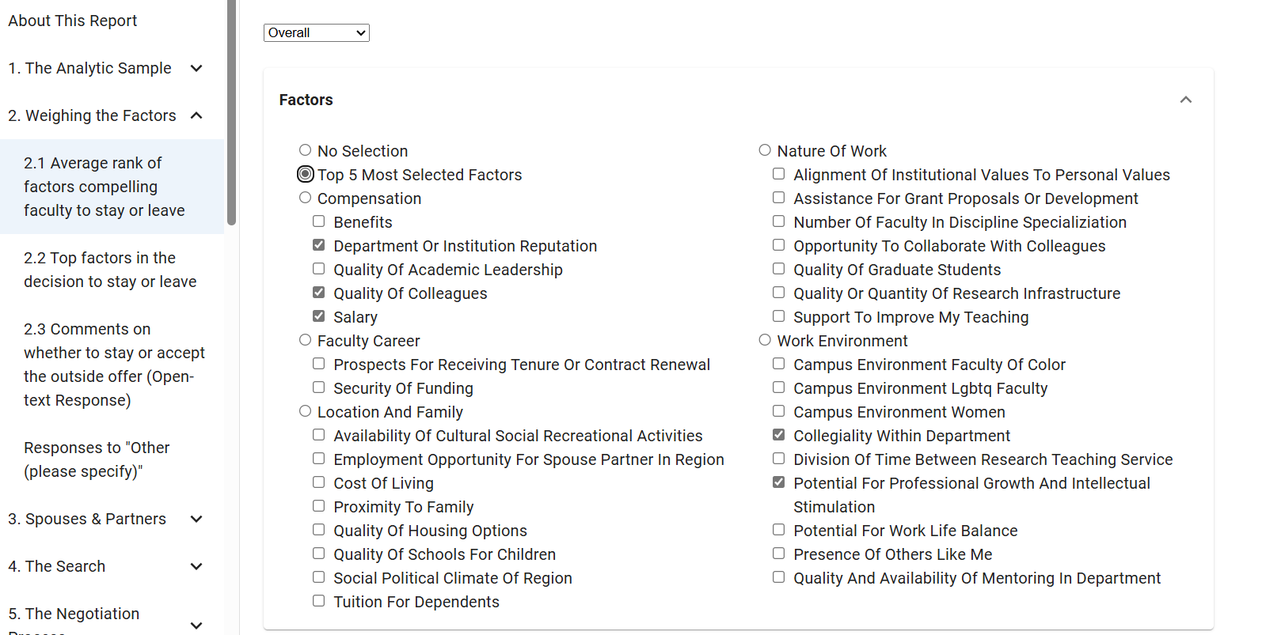
Instructions
In Module 2 – Weighing the Factors, we can highlight factors that your faculty considered most while deciding whether to leave or to stay. While some factors, like geographic location, may be outside institutional control, the data are still important because they help us to understand how faculty see the institution.
From 2.1, select the “Top 5 Most Selected Factors” button to pull factors. Note that these are the factors considered most by faculty overall.
UP NEXT: Input data points to complete your next slide.
COACHE | Faculty Retention and Exit Survey
Instructional Slide (NOT for presenting)

Slide 8





Most Compelling Factors for Decision to Stay or Leave
These are the top 5 factors our faculty respondents considered most compelling in their decision to stay or leave.
[Factor 1]
[Factor 2]
[Factor 3]
[Factor 4]
[Factor 5]
COACHE | 2025
COACHE | Faculty Retention and Exit Survey
5

Slide 9
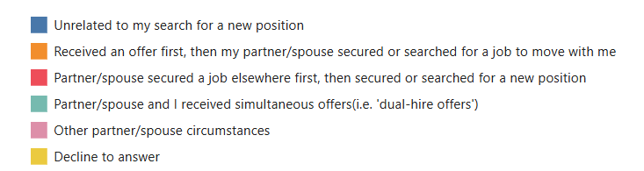
Instructions
Module 3 – Spouses & Partners explores dual careers on your campus. Spousal employment can be a contributor to faculty departure, as well as a long-term retention strategy.
[ A ]% of surveyed faculty reported being married or partnered. Of those,
[ B ]% received an offer first before their spouse searched for or secured a job. [ C ]% searched or accepted a new position after their spouse or partner secured a job elsewhere, while [ D ]% received dual-hire offers.
[ A ]: From 3.1, input the percentage of Total for Married/Partnered.
[ B ] [ C ] [ D ]: From 3.2, input the percentages of Total for the following groups as indicated in the graph.
[ B ]
[ C ]
[ D ]
CONSIDER THIS:
We recommend that academic leaders regularly check in with dual-career hires to ensure their partners are thriving in their role. Demonstrating concern for the well-being of their partners can be an effective long-term retention strategy.
UP NEXT: Input data points to complete your next slide.
COACHE | Faculty Retention and Exit Survey
Instructional Slide (NOT for presenting)

Slide 10
Unpacking Dual Careers
Role of Spouse/Partner Career in Search and Outside Offer
[ A ]% of surveyed faculty reported being married or partnered.
Of those, [ B ]% received an offer first before their spouse searched for or secured a job. [ C ]% searched or accepted a new position after their spouse or partner secured a job elsewhere, while [ D ]% received dual-hire offers.
COACHE | 2025
COACHE | Faculty Retention and Exit Survey
5

Slide 11
Instructions
Let’s move on to Module 4 – The Search. Understanding the duration of faculty job searches can help identify the window of opportunity during which your institution can engage with faculty—before they officially enter the job market.
Regarding the motivation, we can highlight how many faculty were driven by a desire to leave, versus those motivated by the counteroffer culture—seeking to renegotiate their current terms using an outside offer.
[ A ]% of faculty respondents spent more than a year considering leaving.
[ B ]% of faculty who left never considered leaving.
[ C ]% of faculty sought outside offers as leverage to renegotiate. Among those who ultimately left, [ D ]% cited this motivation.
[ E ]% of faculty began their search with the intention to leave. Of those who were successfully retained, [ F ]% initially sought to leave.
Note that this section does not apply to preemptive retentions.
[ A]: From report section 4.1, add up the percentages of Total for 1-2 years and More than 2 years. Input the sum.
[ B ]: From 4.1, input the percentage of Departure for I never considered leaving.
[ C ]: From 4.2, input the percentage of Total for To renegotiate.
[ D ]: From 4.2, input the percentage of Departure for To renegotiate.
[ E ]: From 4.2, input the percentage of Total for To leave.
[ F ]: From 4.2, input the percentage of Retention for To leave.
CONSIDER THIS:
Does your institution have practices in place to assess which faculty are exploring the job market?
UP NEXT: Input data points to complete your next slide.
COACHE | Faculty Retention and Exit Survey
Instructional Slide (NOT for presenting)

Slide 12
The Search Process
Time Spent Considering Leaving
[ A ]% of faculty respondents spent more than a year considering leaving.
[ B ]% of faculty who left never considered leaving.
Motivations Behind the Search
[ C ]% of faculty sought outside offers as leverage to renegotiate. Among those who ultimately left, [ D ]% cited this motivation.
[ E ]% of faculty began their search with the intention to leave. Of those who were successfully retained, [ F ]% initially sought to leave.
Note that this section does not apply to preemptive retentions.
COACHE | 2025
COACHE | Faculty Retention and Exit Survey
5

Slide 13
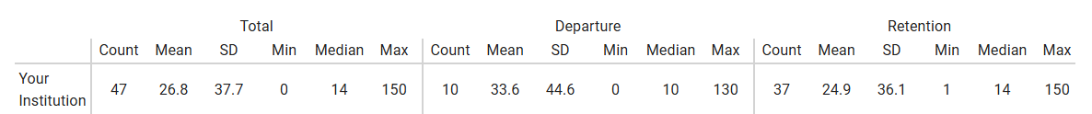
Instructions
Congratulations! You’re halfway through the report.
In Module 5 – The Negotiation Process, we’ll explore how seriously your faculty considered outside offers and examine the length of time for your institution to respond with a counteroffer decision. In some cases, timelines matters—the speed of a counteroffer response can influence a faculty member’s decision to stay or leave.
Prior to any counteroffer decision, of the faculty receiving outside offers, [ A ]% reported taking outside offers extremely seriously. Among those who were retained, [ B ]% of took the outside offer extremely seriously.
It took our institution, on average, [ C ] days to make a counteroffer after learning about an outside offer.
  For faculty who left, the response time was [ D ] days on average.
  For those who stayed, it was [ E ] days.
(optional) When viewing results by [ a subgroup ], [Group A] received counteroffers faster than [Group B] on average.
[ A ]: From report section 5.2, input the percentage of Total for Extremely seriously for total. Reference the graph on top.
[ B ]: From 5.2, input the percentage of Retention for Extremely seriously. Reference the graph on top.
[ C ] [ D ] [ E ]: From 5.3, input the mean of Total, Departure, and Retention.
[ F ]: From 5.3, use the drop-down menu to view results by a subgroup. Which subgroup would be most relevant to your audiences? Are there significant with-in group differences? If so, input your findings.
C
D
E
UP NEXT: Input data points to complete your next slide.
COACHE | Faculty Retention and Exit Survey
Instructional Slide (NOT for presenting)

Slide 14
The Negotiation Process
Seriousness with Outside Offers
Of the faculty receiving outside offers, [ A ]% reported taking them extremely seriously. Among those who were retained, [ B ]% of took the outside offer extremely seriously.
Turnaround Time for Counteroffers
It took our institution, on average, [ C ] days to make a counteroffer after learning about an outside offer.
  For faculty who stayed, the average response time was [ D ] days.
  For those who left, it was [ E ] days.
(optional) When viewing results by [ a subgroup ], [Group A] received counteroffers faster than [Group B] on average.
COACHE | 2025
COACHE | Faculty Retention and Exit Survey
5

Slide 15
Instructions
In Module 6 – The Negotiation Terms, we’ll examine the nature of counteroffers, with a focus on who seeks counteroffers compared to those who receive them, the makeup of counteroffers, and matching offers.
[ A ]% of faculty respondents reported that they sought but not received a counteroffer.
Most proposed counteroffers include a base salary increase. Other commonly reported components among retained faculty included ____[ B ]____. By comparison, the proposed counteroffers made to faculty who departed included ____[ C ]____.
Counteroffers do not always need to exceed the external offer to be effective. Among retained faculty, [ D ]% reported that their counteroffers mostly or completely matched outside offers, and [ E ]% reported exceeded outside offers.
[ A ]: From report page 6.5, input the percentage for I sought a counteroffer; none was made for faculty overall. Be sure to review this data by subgroup and highlight any notable differences in who is more or less likely to receive a counteroffer when one is requested.
[ B ] [ C ]: From 6.6, list 1 to 3 most frequently reported counteroffer components from your institution by departure (dark blue) and retention (light blue) population.
[ D ]: From 6.7, add up the percentages of Retention for Mostly and Completely. Input the sum.
[ E ]: From 6.7, input the percentage of Retention for Exceeded the outside offer.
UP NEXT: Input data points to complete your next slide.
COACHE | Faculty Retention and Exit Survey
Instructional Slide (NOT for presenting)

Slide 16
The Negotiation Terms
Counteroffers Sought vs. Received
[ A ]% of faculty respondents reported that they sought but did not receive a counteroffer.
Counteroffer Components
Most proposed counteroffers include a base salary increase. Other commonly reported components among retained faculty included ____[ B ]____. By comparison, the proposed counteroffers made to faculty who departed included ____[ C ]____.
Matching Offer
Counteroffers do not always need to exceed the external offer to be effective. Among retained faculty, [ D ]% reported that their counteroffers mostly or completely matched outside offers, and [ E ]% reported exceeded outside offers.
COACHE | 2025
COACHE | Faculty Retention and Exit Survey
5

Slide 17
Instructions
Congratulations! We are at the final section of the report.
In Module 8 – Overall Impressions, we’ve selected a key finding for you to highlight with your audience: What’s the one thing that could have made a difference? Additionally, consider whether your institution’s retention efforts paid off. How satisfied were faculty—both those who stayed and those who left—with the support they received?
[ A ]% of departing faculty reported that nothing could have convinced them to stay.
Among those who could, the top 3 most frequently cited factors were ____[ B ]____.
[ C ]% of departing faculty were satisfied with the institution’s retention efforts. For retained faculty, [ D ]% reported satisfaction.
Among faculty who were pre-emptively retained, [ E ]% reported somewhat or very likely to seek or consider another offer in the next 12 months. For retained faculty, that was [ F ]%.
[ A ]: On report page 8.1, input the percentage for I could not have been convinced to remain at INSTITUTION.
[ B ]: On 8.1, list the top 3 most frequently cited factors that could have convinced faculty to stay.
[ C ] [ D ]: On 8.2, input the sum of the percentages for Satisfied and Very Satisfied for departing faculty and retained faculty.
[ E ] [ F ]: On 8.4, input the sum of the percentages for Somewhat Likely and Very Likely for pre-emptively retained faculty and retained faculty.
UP NEXT: Input data points to complete your next slide.
COACHE | Faculty Retention and Exit Survey
Instructional Slide (NOT for presenting)
Notes:
Remind them to delete the last paragraph if pre-emptives don’t apply

Slide 18
Overall Impressions
Could faculty have been convinced?
[ A ]% of departing faculty reported that nothing could have convinced them to stay.
Among those who could, the top 3 most frequently cited factors were ____[ B ]____.
Satisfaction with Retention Efforts
[ C ]% of departing faculty were satisfied with the institution’s retention efforts. For retained faculty, [ D ]% reported satisfaction.
Likelihood for Job Search
Among faculty who were pre-emptively retained, [ E ]% reported somewhat or very likely to seek or consider another offer in the next 12 months. For retained faculty, that was [ F ]%.
COACHE | 2025
COACHE | Faculty Retention and Exit Survey
5

Slide 19
Next Steps
The primary constituencies I will be presenting to are [insert constituencies]. The section of the survey report/slide deck that would be most relevant to them is [insert section title, i.e. The Search Process].
My core team supporting this effort will include [insert team members]. Specifically, [insert team members] will be involved in data analysis, [insert team members] will support presenting, and [insert team members] will support following up efforts.
My team plan to present the findings by [insert date], with recommendations identified by [insert date] and shared by [insert date].
COACHE | 2025
COACHE | Faculty Retention and Exit Survey
5
Notes:
Note from COACHE: This "Next Steps" slide is for your reference. Use it to outline your presentation plan and map out a clear roadmap moving forward.

