Slide 1


COACHE Faculty Job Satisfaction Survey:
Report Data Dissemination Workbook
(CAO Report)

Slide 2

FROM DATA TO DIALOGUE
This logo indicates a removable instructional slide.
This logo indicates a removable instructional slide.
Welcome to Your CAO Report Data Dissemination Workbook!
You've achieved many milestones in your COACHE Faculty Job Satisfaction Survey progress so far—engaging faculty, launching the survey, and receiving your Chief Academic Officer (CAO) Report. Now, it’s time to translate data into dialogue. This workbook will help you navigate the full report, identify key findings, and create a presentation-ready slide deck to communicate insights to your stakeholders.
How to Use the Workbook
The workbook focuses on two levels of work—data and strategy—and includes two types of slides—instructional and working slides.
🔍 Level 1: Data-Level Work
You will dive into the CAO report and extract key data points to build a tailored executive summary.
🧭 Level 2: Strategy-Level Work
You will focus on data dissemination strategies and engagement, determining when, how and what to communicate.
💡 Instructional Slides
These slides provide detailed instructions. You can identify them by the COACHE logo on top.
📁 Working Slides
Designed to be plug-and-play, these slides offer templates for you to fill in. Choose the ones that are relevant to you. When you are done, simply remove the instructional slides.
Collaborative on Academic Careers in Higher Education | COACHE
Instructional Slide (NOT for presenting)

Slide 3

WORKBOOK STRUCTURE
This logo indicates a removable instructional slide.
This logo indicates a removable instructional slide.
Part 1: Survey Overview (p.4-8)
Part 2: Benchmarks Analysis (p.9-15)
Recap on the Institutional “Why”
Comparison Group & Response Rates
Areas of Strengths & Concerns
Deepening Analysis: Thematic Breakouts
🔍 Data-Level Work
🔍 Data-Level Work
🧭 Strategy-Level Work
Part 3: Global Views (p.16-23)
Part 4: Dissemination Plan (p.24-31)
Global Views: Best & Worst Aspects
Deepening Analysis: Best & Worst Aspects
Global Views: How to Improve
What Are We Already Doing?
What’s Next?
Planning What (and How) to Share
Things to Keep In Mind
🔍 Data-Level Work
🧭 Strategy-Level Work
Estimated time to complete this workbook: 2 hours
Collaborative on Academic Careers in Higher Education | COACHE
Instructional Slide (NOT for presenting)

Slide 4

PART 1
This logo indicates a removable instructional slide.
SURVEY OVERVIEW
(p.4-8)
  Recap on the Institutional “Why”
  Comparison Group & Response Rates
Your progress with the workbook: 12% completed
Collaborative on Academic Careers in Higher Education | COACHE
Instructional Slide (NOT for presenting)

Slide 5
RECAP ON THE INSTITUTIONAL “WHY”
Before building your data dissemination strategy, take some time to reflect on your institutional “Why.” Why did your institution sign up for COACHE last year? A strong dissemination plan begins with a clear understanding of the goals, context, and institutional priorities driving this work.
Discuss with Your Team:
Coming up next:
  What initiative, strategic goal, or leadership priority connected to this survey?
  What questions did you hope the survey will help answer—or validate through data?
  How did this survey align with or complement other data collection efforts?
  For returning COACHE institutions: What previous COACHE data or outcomes helped contextualize your most recent year of participation?
  Step 1: On slide 6, input your institution name and year of participation in the first paragraph.
  Step 2: On slide 6, summarize the goals, context, and priorities behind the COACHE survey.
If you are unsure about the “why” behind your institution’s participation in the COACHE survey, who can you reach out to for context?
[e.g., someone from the provost’s office, an IR professional, or a “COACHE historian” on your campus.]
Collaborative on Academic Careers in Higher Education | COACHE
Instructional Slide (NOT for presenting)

Slide 6
Add Your Branding Here
WHY THE COACHE SURVEY MATTERS
[Institution Name] has partnered with the Collaborative on Academic Careers on Higher Education (COACHE) on the Faculty Job Satisfaction Survey, administered from February to April [Year]. Below are the institutional priorities and key questions that guided our participation in the survey.
Institutional Priorities
Key Questions We Hoped to Answer
This survey supported our work in __________________________________.
[e.g., faculty satisfaction with leadership, climate for mid-career faculty, faculty mental health]
We hoped the survey will help us understand or confirm _____________________________.
[e.g., if faculty feel supported in general, or whether mentoring opportunities are consistent and meaningful across departments]
Related Data Efforts
(optional) Prior COACHE Efforts
This survey built on ______________________.
[e.g., the recent campus climate surveys, exit surveys, grant programs, accreditation studies]
Based on our [Year of participation] COACHE results, we aimed to focus this year’s efforts on ____________________ because the previous data revealed ________________________________.
Collaborative on Academic Careers in Higher Education | COACHE

Slide 7
COMPARISON GROUPS & RESPONSE RATES
Now that you’ve clarified the purpose behind your survey effort, it’s time to review your CAO report. We encourage you to start by reviewing the response rates. Why? Response rates signal two important things—1) how engaged your faculty have been in the survey process, and 2) how representative the results are of different groups across your campus.
Coming up next:
  Step 1: In your COACHE report, go to “Preview > Comparison Institutions and Response Rates.”
  Step 2: On the next slide, record 1) the five peer divisions, 2) the cohort size, and 3) your institution’s overall response rate and response rates by tenure status, rank, gender, and race.
  Step 3: Use the discussion prompts on the right to guide your interpretation of response rates.
  Step 4: (If applicable) Go to the “Response Rates” tab of your report and review your Divisional Response Rates.
Discussion Prompts:
  Do the response rate numbers surprise you?
  Are there faculty groups whose voices may not be fully represented?
  How might this affect how you interpret or communicate results?
  Which areas signal a need for better outreach in the subsequent data dissemination efforts?
Collaborative on Academic Careers in Higher Education | COACHE
Instructional Slide (NOT for presenting)

Slide 8
Add Your Branding Here
COMPARISON GROUP & RESPONSE RATES
Comparison Group
Our COACHE survey results were compared to 5 peer divisions that we selected to reflect shared characteristics:
  Peer 1: _______________________________
  Peer 2: _______________________________
  Peer 3: _______________________________
  Peer 4: _______________________________
  Peer 5: _______________________________
In addition, faculty from ___(number of divisions in the cohort)___ divisions make up the full comparison cohort.
Response Rates
Our overall Institutional Response Rate: __________ %
Response Rates by Group:
  Tenure Status: _____________________________________
  Rank: _____________________________________
  Gender: _____________________________________
  Race / Ethnicity: _____________________________________
Collaborative on Academic Careers in Higher Education | COACHE

Slide 9

PART 2
BENCHMARKS ANALYSIS
(p.9-15)
  Areas of Strengths & Concerns
  Deepening Analysis: Thematic Breakouts
Your progress with the workbook: 27% completed
Collaborative on Academic Careers in Higher Education | COACHE
Instructional Slide (NOT for presenting)

Slide 10
AREAS OF STRENGTHS & CONCERNS
The COACHE Faculty Job Satisfaction Survey includes 25 Benchmarks. Each benchmark is the unweighted means of several survey items that share a common theme. Thus, the benchmark scores provide a general sense of how faculty feel about a particular aspect of their work/life.
To start, we’ll identify your institution’s areas of strength and concern. These findings are an excellent starting point for framing early conversations with stakeholders.
Coming up next:
  Step 1: Review the compiled benchmarks on slide 11.
  Step 2: Go to the "Preview > COACHE Benchmarks: Strengths and Concerns" section. On slide 12, record your institution’s areas of strength and concern.
Additional Resources:
COACHE captured partner institutions' programs and policies across the twenty benchmarks (as of the 2011-12 cohort's survey results) and published them in a series of white papers entitled, "Benchmark Best Practices."
Collaborative on Academic Careers in Higher Education | COACHE
Instructional Slide (NOT for presenting)

Slide 11
COACHE BENCHMARKS & THEMATIC BREAKOUTS
A broad theme
Nature of Work
  Research
  Service
  Teaching
Resources and Support
  Facilities and Work Resources
  Personal and Family Policies
  Health and Retirement Benefits
Cross-Silo Work and Mentorship
  Interdisciplinary Work
  Collaboration
  Mentoring
Tenure and Promotion
  Tenure Policies
  Tenure Expectations: Clarity
  Promotion to Full
Institutional Leadership
  Leadership: Senior
  Leadership: Divisional (School/College)
  Leadership: Departmental
  Leadership: Faculty
Shared Governance
  Governance: Trust
  Governance: Shared Sense of Purpose
  Governance: Understanding the Issue at Hand
  Governance: Adaptability
  Governance: Productivity
The Department
  Departmental Collegiality
  Departmental Engagement
  Departmental Quality
Appreciation and Recognition*
Retention and Negotiation*
Benchmarks under a theme
*The Appreciation and Recognition theme includes a single benchmark of the same name, while the Retention and Negotiation theme does not include any benchmarks.
Collaborative on Academic Careers in Higher Education | COACHE
Instructional Slide (NOT for presenting)

Slide 12
Add Your Branding Here
OUR STRENGTHS & CONCERNS
What Are Benchmarks?
The COACHE Faculty Job Satisfaction Survey includes 25 Benchmarks. Each benchmark is the unweighted means of several survey items that share a common theme. Thus, the benchmark scores provide a general sense of how faculty feel about a particular aspect of their work/life.
What Are Areas of Strength & Concern?
COACHE defines an "area of strength" as a Benchmark where our division ranked top 2 among peers and top 30% of the cohort. An "area of concern" is a Benchmark where we ranked bottom 2 among peers and bottom 30% of the cohort.
Our Strengths
Our Concerns
  ________________________________
  ________________________________
  ________________________________
  ________________________________
  ________________________________
  ________________________________
  ________________________________
  ________________________________
Collaborative on Academic Careers in Higher Education | COACHE

Slide 13
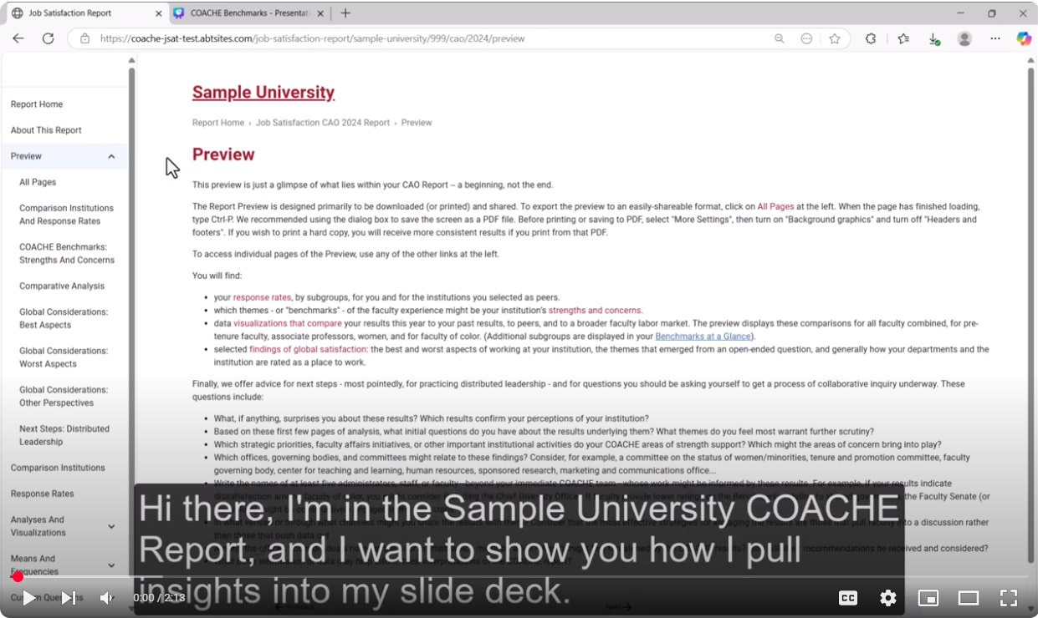
DEEPENING ANALYSIS: THEMATIC BREAKOUTS
While areas of strength and concern are a helpful starting point, there is much more that lies deeper within the report.
Remember, each benchmark score is an average of multiple survey items, meaning that important context can be missed if you stop at the surface.
Watch this 2-min demo video to learn how to:
  Look beyond a benchmark’s mean score
  Understand how different faculty subgroups experience the benchmark
Link to video: https://youtu.be/GZhqcFU0Avg
Collaborative on Academic Careers in Higher Education | COACHE
Instructional Slide (NOT for presenting)

Slide 14
DEEPENING ANALYSIS: THEMATIC BREAKOUTS
It’s time to take your benchmark analysis to the next level. Consider the following:
Are there lower-rated subitems within an otherwise strong benchmark, or higher-rated subitems within a weaker benchmark?
Does a benchmark’s mean score mask a mix of strong and weak subitem ratings?
Which campus subgroups (consistently) give lower ratings to the benchmark and its subitems?
Coming up next:
Example: Analysis for “Interdisciplinary Work”
While our benchmark score for “Interdisciplinary Work” is strong overall, the subitem “Interdisciplinary work is rewarded in tenure decisions” received lower ratings.
When examining within-campus differences:
  Tenured faculty reported lower satisfaction on several subitems within this benchmark compared to pre-tenured and non-tenure-track faculty.
  White faculty also expressed lower satisfaction than faculty from other racial and ethnic groups.
  Step 1: Navigate to “Analyses and Visualizations > Thematic Breakouts” in your report. On this overview page, locate the theme to which your benchmark belong.
  Step 2: Go to the designated theme and click “Visualization.”
  Step 3: For each benchmark of interest, explore item-level details and within-campus differences. Here is an example →
  Step 4: Record your own findings on the next slide.
Collaborative on Academic Careers in Higher Education | COACHE
Instructional Slide (NOT for presenting)

Slide 15
DEEPENING ANALYSIS: THEMATIC BREAKOUTS
Add Your Branding Here
Looking Beneath the Mean Score
Does a benchmark’s mean score mask variation across subitems? Are there subitems that stand out from the overall benchmark score?
__________________________________________________________________________________________________
__________________________________________________________________________________________________.
Subgroup Differences
Which campus subgroups consistently gave lower ratings?
Subgroup(s)_________________________________
Benchmark / subitems affected: __________________________________
Insights/Question Raised
What does this deeper look suggest for interpretation or action?
__________________________________________________________________________________________________
__________________________________________________________________________________________________.
Collaborative on Academic Careers in Higher Education | COACHE

Slide 16

PART 3
GLOBAL VIEWS
(p.16-23)
    Global Views: Best & Worst Aspects
    Deepening Analysis: Best & Worst Aspects
    Global Views: How to Improve
Your progress with the workbook: 52% completed
Collaborative on Academic Careers in Higher Education | COACHE
Instructional Slide (NOT for presenting)

Slide 17
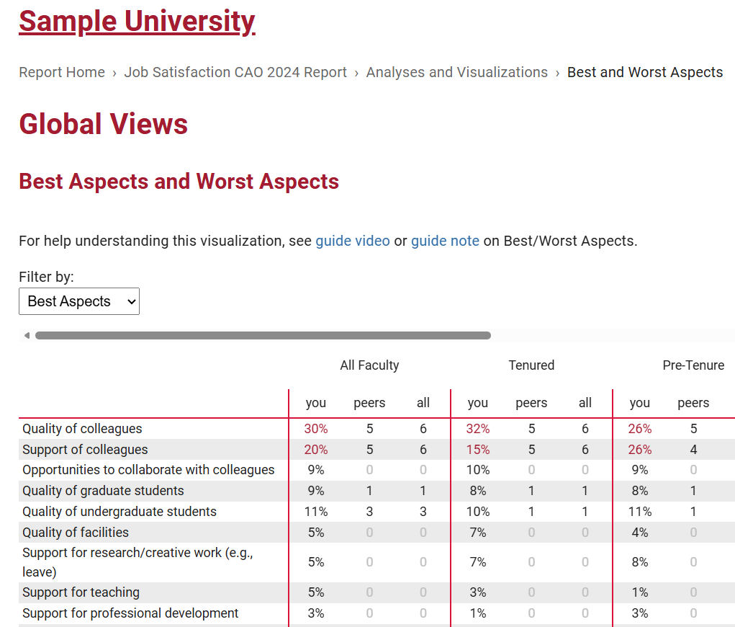
GLOBAL VIEWS: BEST & WORST ASPECTS
We are going to unpack Global Views (or Global Considerations). This section of your CAO report includes survey items that touch on overall faculty experiences rather than specific themes.
We’ll review what your faculty reported as the best or worst aspects of working at your institution and highlight the top 4 most frequently cited responses in each category.
Coming up next:
  Step 1: Go to the "Preview > Global Considerations: Best Aspects“ section of your report.
  Step 2: On slide 18, list your institution’s top 4 most frequently cited “Best Aspects,” indicated by the percentages in red on your report.
  Step 3: Use the dropdown menu to continue to "Worst Aspects".
  Step 4: On slide 18, list your institution’s top 4 most frequently cited “Worst Aspects,” indicated by the percentages in red on your report.
Collaborative on Academic Careers in Higher Education | COACHE
Instructional Slide (NOT for presenting)

Slide 18
Add Your Branding Here
GLOBAL VIEWS: BEST & WORST ASPECTS
What Are the Best & Worst Aspects?
The COACHE survey also asked faculty to identify two best and two worst aspects of their work experience at the institution, when thinking about the institution as a whole. The four most frequently cited responses are listed below:
Top Four Best Aspects
Top Four Worst Aspects
  _________________________, ____% selected
  _________________________, ____% selected
  _________________________, ____% selected
  _________________________, ____% selected
  _________________________, ____% selected
  _________________________, ____% selected
  _________________________, ____% selected
  _________________________, ____% selected
Collaborative on Academic Careers in Higher Education | COACHE
Collaborative on Academic Careers in Higher Education | COACHE

Slide 19
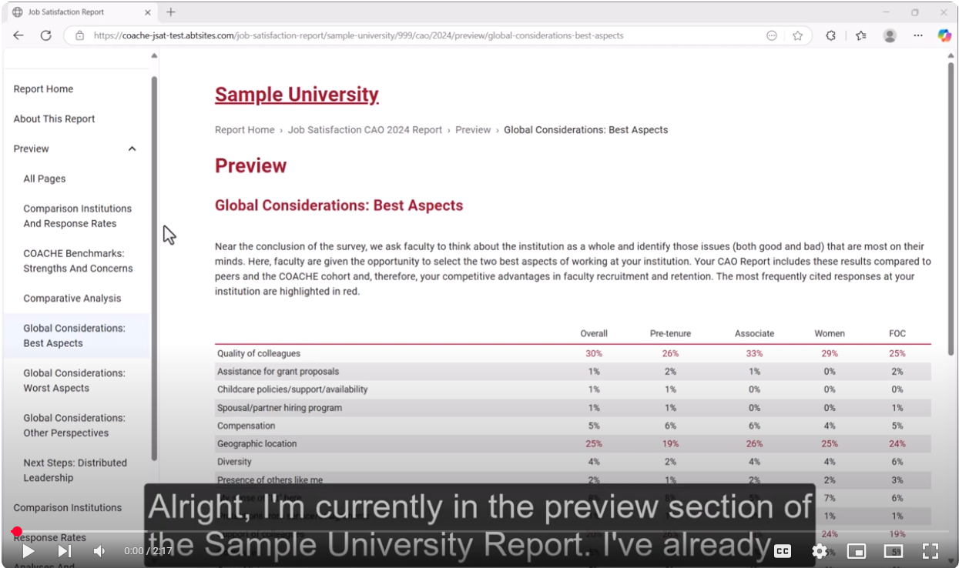
DEEPENING ANALYSIS: BEST & WORST ASPECTS
Similar to our work with Benchmarks, we’re now going to dig deeper into the Best and Worst Aspects data.
In this section, we’ll explore comparative insights and within-campus differences to help you more effectively frame conversations about these data.
Watch the 2-minute demo video to learn how to:
Compare your results with those of your peers and cohort
Understand how different faculty subgroups experience the best and worst aspects
Link to video: https://youtu.be/GZhqcFU0Avg
Collaborative on Academic Careers in Higher Education | COACHE
Instructional Slide (NOT for presenting)

Slide 20
DEEPENING ANALYSIS: BEST & WORST ASPECTS
It’s time to take Global View items to the next level. Consider:
How do your results compare with peers and cohort institutions?
How do perceptions of best and worst aspects vary across faculty subgroups?
Coming up next:
  Step 1: In your report, navigate to the “Analyses and Visualizations > Global Views > Best & Worst Aspects”.
  Step 2: For each item of interest, explore comparison with peers and the cohort. Then, explore within-campus differences. Here is an example on the right →
  Step 3: Go to “How To Improve” and filter open-text comments by the theme of interest. If desired, choose a few illustrative examples to include in your slide deck.
  Step 4: Record your findings on the next slide.
Example: Best Aspect – Academic Freedom
Academic freedom was identified by our faculty as one of the top four best aspects of working here—something none of our peers and only one other institution in the cohort reported, making it a unique strength for us.
However, this strength is not experienced equally: non-tenure-track faculty, associate professors, and Asian/Asian-American faculty are less likely to view academic freedom as a best aspect.
Collaborative on Academic Careers in Higher Education | COACHE
Instructional Slide (NOT for presenting)

Slide 21
DEEPENING ANALYSIS: BEST & WORST ASPECTS
Add Your Branding Here
Comparative Insights
Best aspect(s) where our institution stands out: __________________________________________.
Worst aspect(s) where our institution stands out: __________________________________________.
Other areas where our results differ meaningfully from peers/cohort: __________________________________________.
Subgroup Differences
Which campus subgroups consistently gave lower ratings?
Subgroup(s)_________________________________
Benchmark / subitems affected: __________________________________
Insights/Question Raised
What does this deeper look suggest for interpretation or action?
__________________________________________________________________________________________________
__________________________________________________________________________________________________.
Collaborative on Academic Careers in Higher Education | COACHE

Slide 22
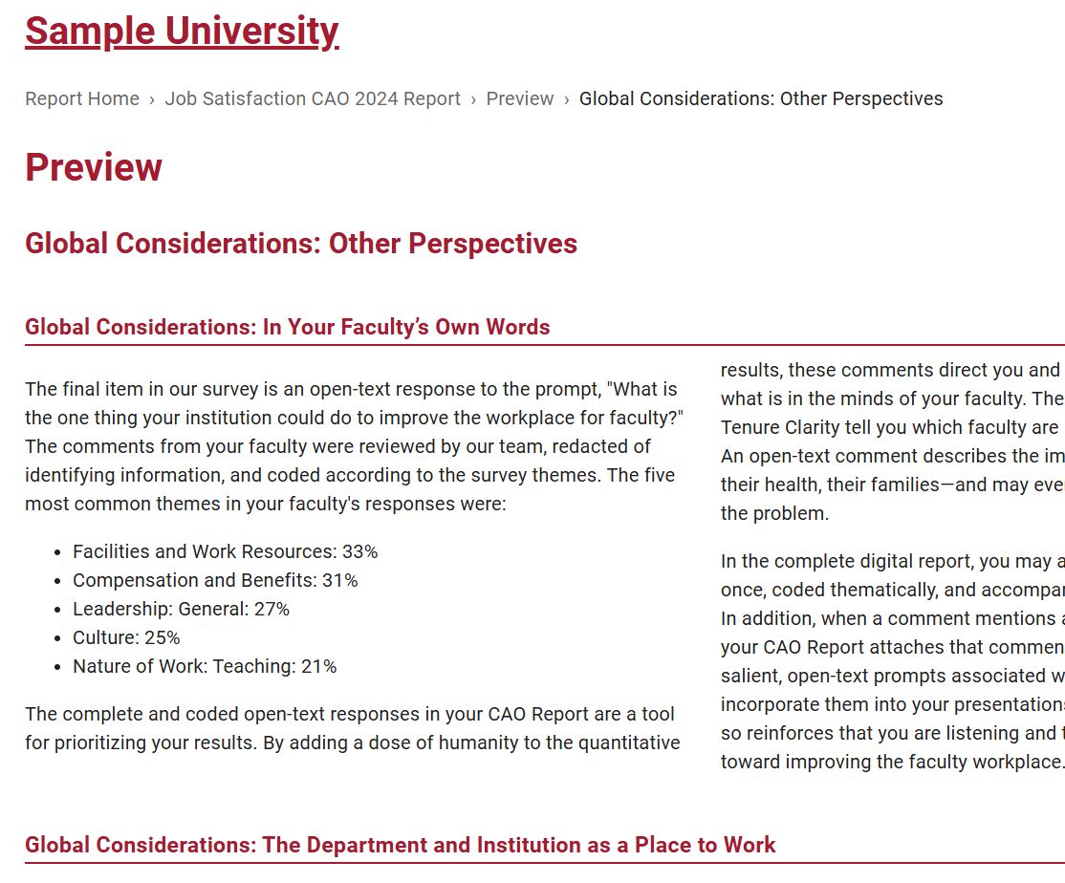
HOW TO IMPROVE
At the end of the survey, we asked faculty, "What is the one thing your institution could do to improve the workplace for faculty?" These comments, redacted and coded thematically by COACHE, can add depth and context to the quantitative results you see earlier.
Another “big picture” finding worth highlighting is your faculty respondents' overall satisfaction with your institution as a place to work.
Coming up next:
  Step 1: Go to "Preview > Global Considerations: Other Perspectives“ section of the CAO report. On slide 23, list five most common themes that faculty identified for improvement.
  Step 2: On the same page, take a screenshot of the bar graph “Institution as a place to work” and insert it to slide 23.
    For Windows, press Windows logo key+Shift+S to open the snipping tool.
    For Mac, press Shift + Command + 4.
Collaborative on Academic Careers in Higher Education | COACHE
Instructional Slide (NOT for presenting)

Slide 23
Add Your Branding Here
HOW TO IMPROVE
Top 5 Most Common Themes Identified for Improvement:
The COACHE survey provided faculty the opportunity to answer an open-text question, "What is the one thing your institution could do to improve the workplace for faculty?“ Comments were redacted and coded thematically by COACHE. The five most common themes are:
  _________________________, ____% selected
  _________________________, ____% selected
  _________________________, ____% selected
  _________________________, ____% selected
  _________________________, ____% selected
Department as a Place to Work:
e.g., Facilities and Work Resources, 33%
e.g., Facilities and Work Resources, 33%
Collaborative on Academic Careers in Higher Education | COACHE
Collaborative on Academic Careers in Higher Education | COACHE

Slide 24

PART 4
DISSEMINATION PLAN
(p.24-31)
  What Are We Already Doing?
  What’s Next?
  Planning What (and How) to Share
  Things to Keep In Mind
Your progress with the workbook: 76% completed
Collaborative on Academic Careers in Higher Education | COACHE
Instructional Slide (NOT for presenting)

Slide 25
WHAT ARE WE ALREADY DOING?
By digging into the report, you may now have some ideas of what to prioritize and how to shape early conversations. But remember, action planning is a multi-year effort. To get started, can you identify some “low-hanging fruit”?
One approach to this is by identifying what’s already underway at your institution. Faculty aren’t always aware of ongoing efforts—especially when they’re localized to a single department or unit. This is also a chance to find allies working on similar issues and avoid reinventing the wheel.
Discuss with Your Team:
Coming up next:
  Which benchmarks or global view items are already being addressed by ongoing initiatives at your institution?
  Are those efforts widely known to the faculty most concerned about them?
  Who is currently involved in these initiatives?
  How can you align with existing committees or task forces?
  Use the template on slide 27 to map current efforts and identify potential collaborators addressing the benchmark or area of concern.
Collaborative on Academic Careers in Higher Education | COACHE
Instructional Slide (NOT for presenting)

Slide 26
Add Your Branding Here
WHAT ARE WE ALREADY DOING?
Benchmarks/Global View Items | What’s Already Being Done? | Who’s Involved? | Immediate Next Step
e.g., Support and recognition for interdisciplinary work (tenured faculty) | e.g., A cross-college research initiative offers seed grants for interdisciplinary projects | e.g., Office of Research | e.g., Share data bites from the report with the project lead; schedule a meeting to explore disseminating project results institution-wide
Collaborative on Academic Careers in Higher Education | COACHE

Slide 27
MAPPING PRIORITIES: WHAT’S NEXT?
Good work! You’ve already:
✅ Reflected on your institutional why
✅ Reviewed strengths, weaknesses, best & worst aspects
✅ Considered faculty suggestions for improvement
✅ Identified what’s already underway
Now it’s time to prioritize.
Not every issue can (or should) be addressed at once—some are long-standing and systemic, others are emerging and time-sensitive. Mapping your issues helps clarify where to focus your energy now and who you need to engage to make progress.
Coming up next:
  Work with your team to map the issues using the template on the next slide. Classify each issue as:
    New vs. Ongoing (old) — Is this a newly surfaced concern, or a known issue?
    Short-term vs. Long-term — Can this reasonably be addressed soon, or does it require sustained effort over time?
    Who to invite to the conversation?
Collaborative on Academic Careers in Higher Education | COACHE
Instructional Slide (NOT for presenting)

Slide 28
Add Your Branding Here
MAPPING PRIORITIES: WHAT’S NEXT?
Issues Identified | New or Ongoing? | Short-term or Long-term? | Who to Invite to the Conversation?
e.g., Support for faculty who are mentors for other faculty | e.g., New | e.g., Short-term | e.g., Provost’s Office, Faculty Development Committee, department chairs, current faculty mentors
Collaborative on Academic Careers in Higher Education | COACHE

Slide 29
PLANNING WHAT (AND HOW) TO SHARE
Once you’ve reviewed your survey results, the next step is deciding what to share, how much detail to include, and through which channels. Your choices should reflect:
  Strategic priorities: Which themes or issues align most closely with your audience?
  Audience needs: What level of detail will engage them without overwhelming?
  Available resources: Do you have design or data support—or just a small team with limited time?
No matter your resources, there are simple, effective ways to communicate your findings. Consider the following examples:
Resource-Tiered Sharing Examples
Level | What You Might Share | How You Might Share It
Basic | Selected survey themes with quick data visuals | A newsletter blurb
Intermediate | A tailored report executive summary | A slide deck for faculty meeting
Advanced | Full report or multi-theme highlights | Web dashboard
Coming up next:
  Use the template up next, map out what and how to share, and the level of effort required, for each audience group you plan to reach.
Collaborative on Academic Careers in Higher Education | COACHE
Instructional Slide (NOT for presenting)

Slide 30
Add Your Branding Here
PLANNING WHAT (AND HOW) TO SHARE
Audience | What to Share (Full report? Themes?) | How to Share (Which channel?) | When to Share
e.g., Faculty at large | e.g., A customized executive summary derived from this workbook activity. | e.g., Faculty newsletter + Provost’s website | e.g., Before the start of the Fall semester
Collaborative on Academic Careers in Higher Education | COACHE

Slide 31
THINGS TO KEEP IN MIND
🗂️ Be the Historian of Your COACHE Effort
Your work doesn’t end with this report — and future progress depends on preserving what you’ve accomplished.
  Document decisions, plans, and communication strategies in a place accessible to your team and future members.
  Be able to tell the larger community what was accomplished by your COACHE team and communicate your successes.
👥 Reassess Your Team
  Do you need additional expertise — such as an institutional research professional, communications lead, or specific committee member — to interpret, share, or act on the results?
  Plan for continuity: identify who is currently leading these efforts and who will take over if roles change.
🌐 Look Beyond Your Institution
  Review your peer and cohort comparisons to identify strengths you want to replicate or share.
  After your institutional action planning, consider reaching out to COACHE to connect with other institutions that excel where you’d like to improve, or to offer your own insights to peers.
🚀 Next Steps
  Finalize Your Communication Plan
  Set Key Dates and Milestones
  Stay Connected
Collaborative on Academic Careers in Higher Education | COACHE
Instructional Slide (NOT for presenting)

Slide 32

THE END
CONGRATULATIONS!
By taking time to reflect, map, and strategize, you've laid a strong foundation for a thoughtful and effective dissemination plan around your Chief Academic Officer (CAO) Report. Remember:
  Your plan can evolve—adapt it as new opportunities, questions, or stakeholders emerge.
  You don’t have to do it alone—lean on your team, your campus partners, and the COACHE community.
💬 We’d love to hear from you.
What worked well? What would make this workbook more useful? Please take 3 minutes to fill out this feedback survey to help us improve future resources and better support your efforts.
Thanks again—and we look forward to learning about what you’ll do with your plan.
Your progress with the workbook: 100% completed
Collaborative on Academic Careers in Higher Education | COACHE
Instructional Slide (NOT for presenting)

Slide 33



LEARN MORE
For questions or comments about this slide deck, contact:
For partnerships with COACHE, contact:
​
Qianzhen (Annie) Fu
Instructional Designer
anniefu@gse.harvard.edu
Deborah Ruiz
Assistant Director of Engagement​
deborah_ruiz@gse.harvard.edu

