Slide 1

From Action Plan
to Action Taken
Charting Next Steps with COACHE at Marist
Addrain Conyers
Interim Provost & Dean of Faculty
COACHE Convening · Harvard Graduate School of Education
Notes:
Welcome. 45 minutes together. This is not a victory-lap talk. It's an honest account of moving from a written plan to actual change — the impediments, how we navigated them, what we built, and where reality pushed back. We'll open by putting YOUR experience in the room first.

Slide 2

Let's start with you
Before I share Marist's story — name your own.
HIGHLIGHT
LOWLIGHT
What has felt like a genuine win in your COACHE experience?
A moment of traction, momentum, or trust earned.
Where has it stalled, frustrated, or met resistance?
The impediment you didn't see coming.
Take 5 minutes. Jot both down. We'll surface the patterns — you'll see you're not alone.
Notes:
INTERACTIVE #1 (~8-10 min). Hand out index cards or use a shared board/Mentimeter. Give them 5 min to write one highlight + one lowlight. Then 3-4 min: ask for a show of hands / call out a few. Cluster the themes live on a flip chart or slide. The point: they discover the lowlights rhyme across institutions — trust, turf, and power show up everywhere. That primes my three impediments.

Slide 3
Faculty showed up for this
An 80% response rate — one of the highest nationally among COACHE partners.
80%
of all faculty responded
Nearly double the peer
and cohort averages.
Source: 2024 Marist COACHE Faculty Job Satisfaction Survey · 86 partner institutions
Notes:
Credibility anchor. Lead with this: faculty didn't just tolerate the survey — 80% engaged, versus 45% at peers and 41% cohort-wide. That participation is itself evidence that faculty WANTED a seat at the table. It earns you the right to make the 'preparing the meal' argument that follows.

Slide 4

The impediments
before action
A strong plan is not the same as a moving one.
We had obstacles.
Notes:
Transition: whatever your patterns were, ours clustered into three. Naming them plainly is what let us move.

Slide 5
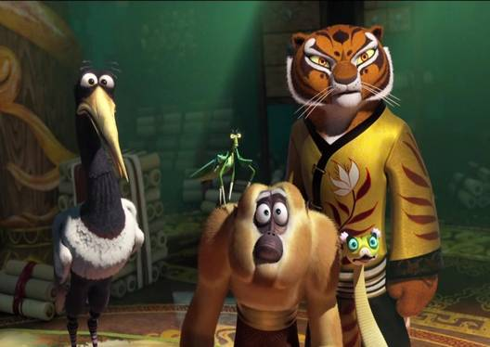
The Faculty Furious Five

Slide 6
Three impediments before we could move on
01
02
03
Trust
Territory
Power
Would a survey become one more thing done TO faculty rather than WITH them?
A turf question with faculty governance.
The honest limit: faculty influence over compensation is structurally constrained.
None of these are solved by a better report. They're solved by how you work.
Notes:
Walk each card. TRUST: the deepest one — faculty had seen surveys vanish before. TERRITORY: I had to be explicit that COACHE strengthens governance, doesn't replace it (our booklet says exactly this). POWER: be candid — I can't promise raises. Pretending otherwise destroys trust. Naming the limit honestly is itself trust-building.

Slide 7
How we navigated
We didn't hand faculty a finished plan.
We invited them to help prepare the meal.
Notes:
This is the heart of the method. The 'preparing the meal' metaphor: if you cook for people, they critique the food. If they cook with you, they own the outcome — and they forgive the parts that didn't come out perfectly.

Slide 8
Three moves that built ownership
COACHE Ambassadors
Faculty empowered as leaders of the movement — not subjects of it.
1
EMPOWERMENT
Listening Sessions
Structured spaces for engagement and empathy.
2
ENGAGEMENT
COACHE as Faculty Development
Reframed the whole effort as professional growth. Faculty helped 'prepare the meal' — so they owned it when served.
3
OWNERSHIP
Notes:
Ambassadors = distributed leadership; the movement had many faces, not just mine. Listening sessions = empathy first, solutions second. COACHE-as-development = the reframe that changed everything: this isn't compliance, it's growth. Together these turned skepticism into co-authorship.

Slide 9
From action plan to action taken cultivated a growth mindset — where improving faculty welfare is an ongoing state of mind, sustained through collaboration.
The plan was the destination. The mindset was the unexpected arrival.
Notes:
Pause here. This is the thesis. A plan is a document; a mindset is a culture. The win isn't the artifacts on the next slides — it's that faculty welfare became an ongoing, collaborative habit rather than a one-time report.

Slide 10
From menu to kitchen
The shift that made the difference — faculty stopped being served and started cooking.
THE MENU
THE KITCHEN
Cooking FOR faculty
Cooking WITH faculty
A finished plan, handed down
Faculty critique the food
Something done TO them
Compliance, not ownership
Faculty help prepare the meal
They own what's served
Something done WITH them
A shared, ongoing mindset
When people cook with you, they forgive the dishes that don't come out perfectly — and they come back to the table.
Notes:
This visualizes the thesis. LEFT is the trap most action plans fall into — a polished document handed to faculty, who then critique it like diners sending food back. RIGHT is the reframe: ambassadors, listening sessions, and COACHE-as-development made faculty co-cooks. The forgiveness line matters for the honest slide later — co-authorship is what let faculty stay at the table even when comp moved the wrong way.

Slide 11
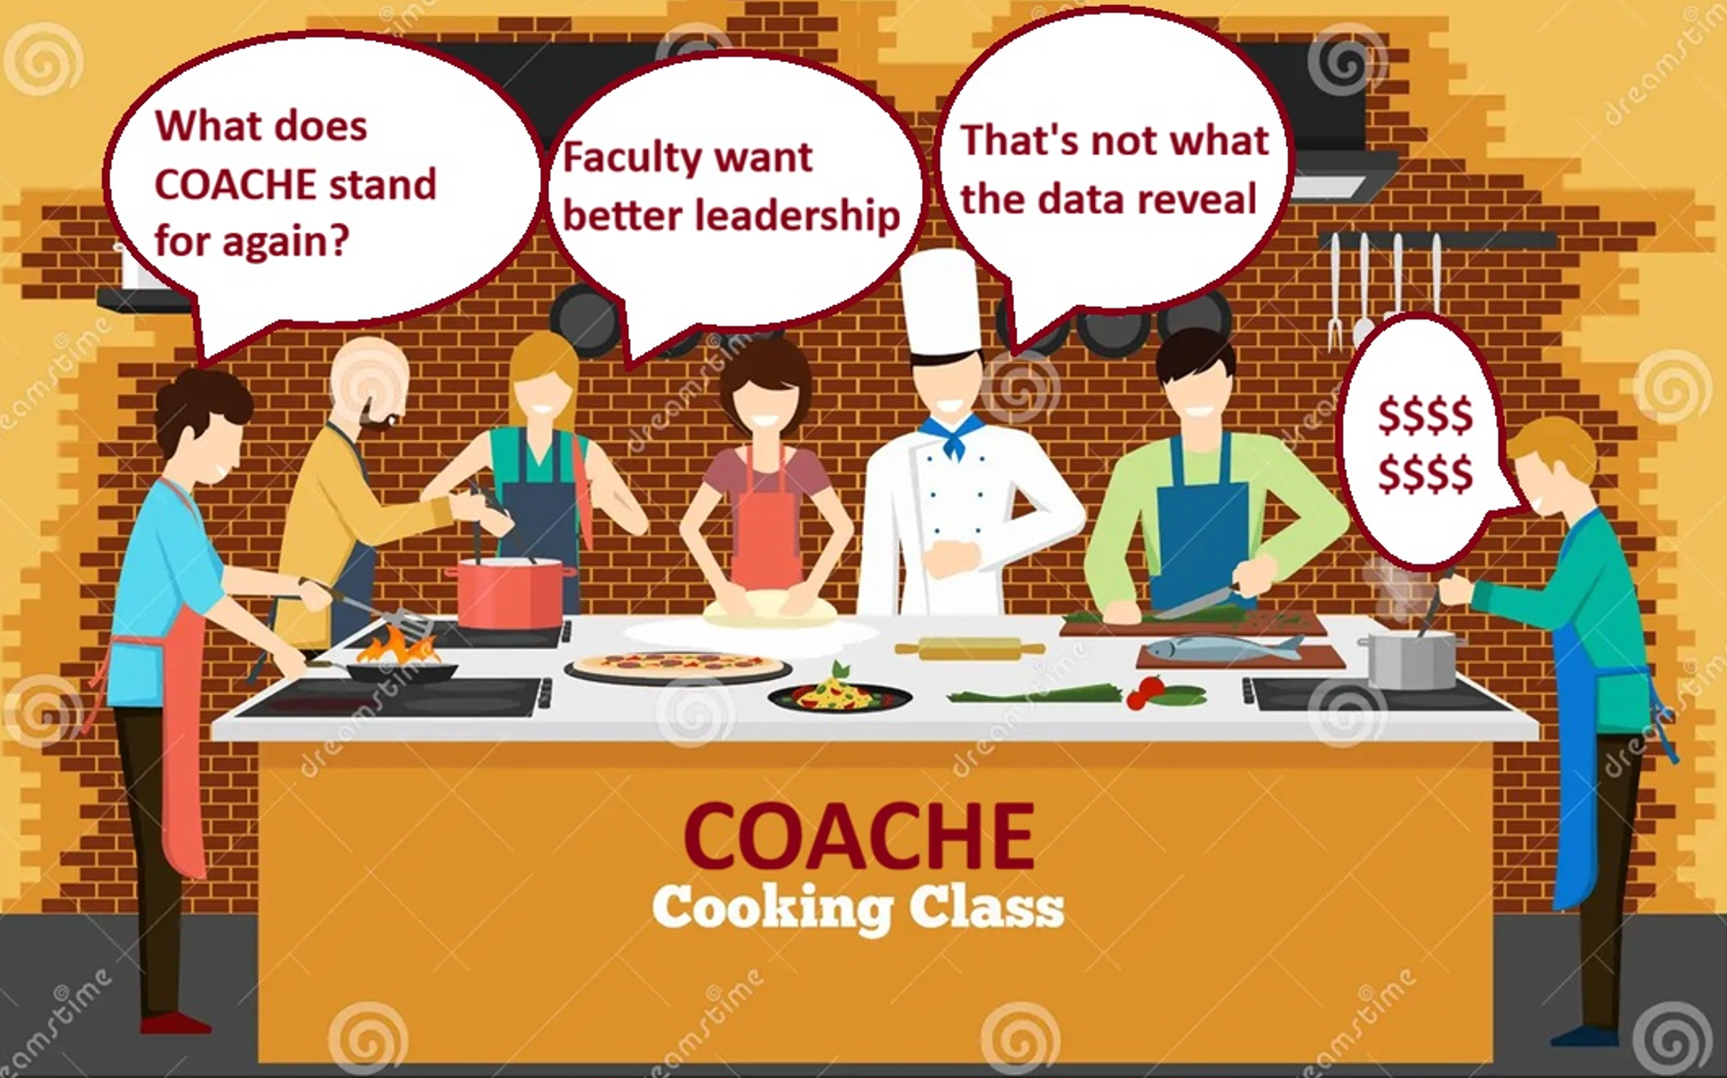

Slide 12
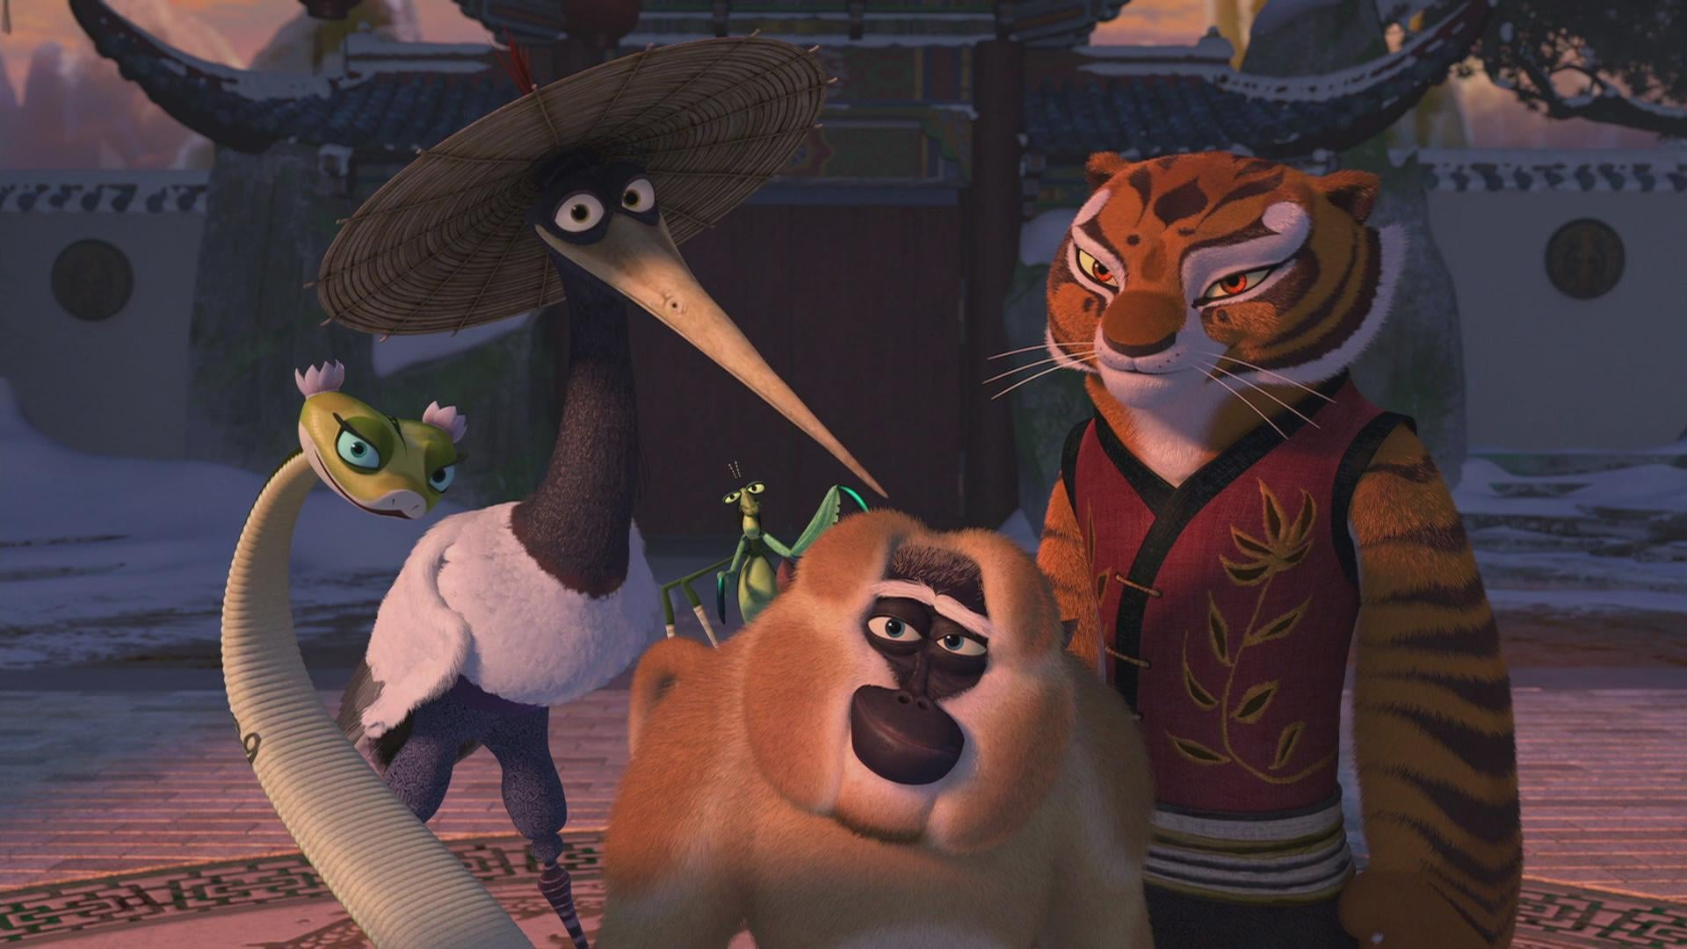
The Furious Five Return

Slide 13
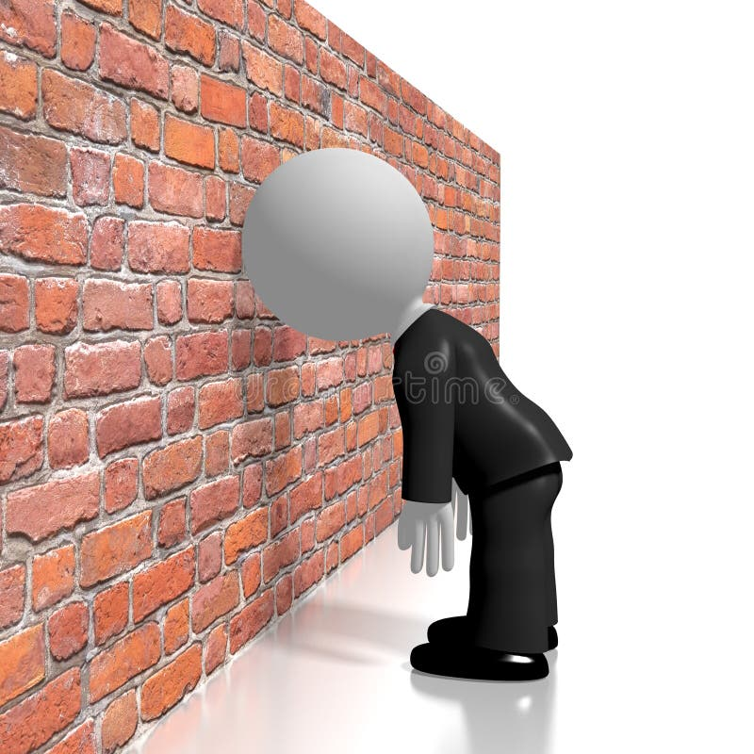
When Furious Five refuse to change.

Slide 14
PAUSE · TABLE DISCUSSION
Turn to your table — 5 minutes
Who are your Furious Five/Hateful Eight?
What makes their resistance challenging?
What's one “ambassador” you could recruit — a faculty leader who'd carry the work? What makes them ideal?
Two or three tables report out.
Notes:
INTERACTIVE #2 (~6-7 min). 4 min table talk, 2-3 min report-out. This gets provosts naming their own loudest impediment and — crucially — a concrete faculty ambassador. Ambassadors are the single most transferable move; make them leave with a name.

Slide 15
Action taken
Four concrete things now in motion — from template to database.
Notes:
Now the proof. Not aspirations — artifacts. Each maps to a COACHE area of concern from the survey.

Slide 16
You said. We did.
Every artifact traces back to a bottom-30% COACHE benchmark faculty flagged.
FACULTY SAID (COACHE concern)
WE DID (action taken)
Promotion criteria are unclear — especially Associate → Full
→
T&P template each department publishes over the year
Service load is heavy and unevenly distributed
→
Service dashboard tracking load by School
Interdisciplinary work isn't recognized or rewarded
→
Marist ARC — an annual research & creative showcase
Few opportunities to collaborate across the institution
→
Faculty Research Connectivity database
Not a wish list — a response. Faculty named the gap; we shipped something for each one.
Notes:
This is the data-to-action proof COACHE audiences care about most. Read it left to right: each row is a benchmark where Marist scored in the bottom 30% of cohort, paired with the concrete thing built to answer it. The discipline — every artifact ties to a real concern, nothing invented — is the credibility move. Next slide shows the four artifacts in detail.

Slide 17
What we built
Each artifact answers a specific concern faculty raised.
1
T&P Template
2
Service Dashboard
PROMOTION PROCESS
NATURE OF WORK: SERVICE
3
Marist ARC
4
Collaboration Database
INTERDISCIPLINARY WORK
COLLABORATION
Notes:
Walk all four quickly, then let the next two slides go deeper on the dashboard and database — those are the ones people will ask to steal. Emphasize: every one traces to a bottom-30% COACHE benchmark. This is data-to-action, made tangible.

Slide 18
Captured each fall:
SPOTLIGHT
Faculty Research Connectivity Database
Department & rank
Who they are
Areas of expertise
Methodological + content
Current research & projects
An annual 2-minute survey builds a living map of who does what — so collaboration doesn't depend on who you happen to know.
What's active now
Available resources
Equipment, datasets, lab space
Current research needs
Data, stats, theory support
Notes:
The database is my favorite because it's low-cost, high-signal. Two minutes a year per faculty member creates institutional memory that outlasts any one administrator. It directly attacks the 'limited collaboration' benchmark and seeds Marist ARC.

Slide 19
The Honest Part
Some impediments don't disappear once you start. They arrive mid-stride.
Structural limits on
faculty power
Why we name it anyway
Credibility. Pretending the plan fixed everything would forfeit the trust we built. Naming the limit is itself an act of good faith — and it keeps the collaboration honest.
During implementation, compensation and benefits moved the wrong way — a reminder that faculty influence over the budget is real but bounded.
Notes:
Keep this HIGH-LEVEL and composed — don't air grievances. The 2% raise below inflation and the benefits reduction are real, but the message is about trust, not complaint. Provosts will respect the candor. Tie it to reciprocity: a plan can't manufacture resources it doesn't control — but it can keep faith by being honest.

Slide 20
What transfers to your campus
✓
Recruit ambassadors
✓
Be honest
Distributed, faculty-led credibility beats any administrator's memo.
Honesty about power protects trust more than optimism does.
✓
Cook with faculty
✓
Build artifacts, not aspirations
Co-authorship turns a plan into a shared, self-sustaining mindset.
A template, a dashboard, a database — small, durable, visible.
Notes:
These four are the takeaways I want them to write down. If they remember nothing else: recruit ambassadors, name the limits, cook together, ship artifacts.

Slide 21
COACHE didn't hand us answers. It gave us a shared table — and the habit of returning to it.
Discussion: What will your deliverable be?
Addrain Conyers · Interim Provost & Dean of Faculty addrain.conyers@marist.edu
Notes:
CLOSING + Q&A (remaining ~5 min of interactive budget). End on the kitchen metaphor, then open the floor with the prompt: 'What's the first meal you'll cook with your faculty?' Gives provosts a concrete, forward-looking exit. Have contact/QR ready.

