Slide 1
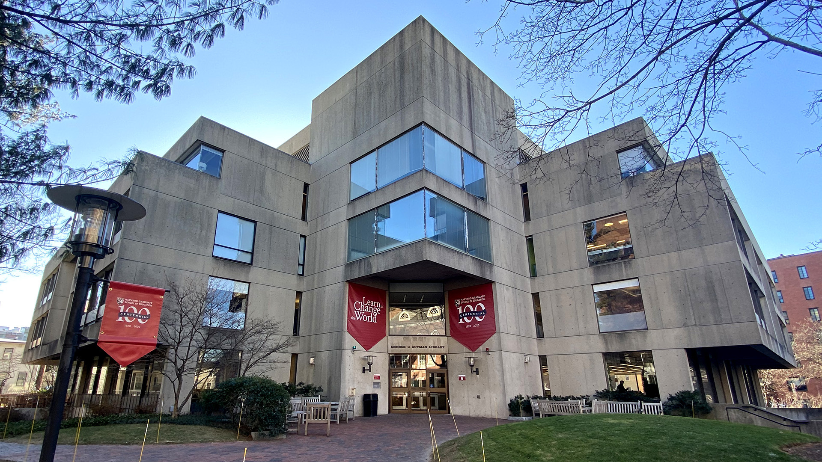

Talks & Treats
Website
coache.gse.harvard.edu

Slide 2

TALK & TREATS:
Data, Decisions, and Duty in AI in Higher Education
2:00 pm – 3:30 pm
Prompt 1:
Where to Start?
Part 1. Let's start with a benchmark question:
  Where does your institution stand with AI right now?
  Is there a policy? A conversation happening? A task force? Or is it still mostly the Wild West?
Part 2. As a leader, how are you personally navigating that, especially when the people you support (faculty, students, staff) are already making decisions about AI whether there's guidance or not?
2026 COACHE Strategy Workshop

Slide 3

TALK & TREATS:
Data, Decisions, and Duty in AI in Higher Education
2:00 pm – 3:30 pm
Prompt 2:
Can We See How It Got There?
If an AI tool gives you an answer or recommendation but can't fully explain how it got there – do you trust it?
What do we owe the people affected by AI-assisted decisions in terms of being able to understand, and push back on, what the AI is saying?
Video clip: A before-and-after example of how Michelle refined her approach to be more deliberate about asking AI to explain itself https://youtu.be/1iZ8rIeMXVI?si=TqKEzd8rpRZDyKx4&t=1477
2026 COACHE Strategy Workshop

Slide 4
TALK & TREATS:
Data, Decisions, and Duty in AI in Higher Education
2:00 pm – 3:30 pm
Prompt 3:
Where Does Our Data Actually Go?
When we or members of our community use AI tools – to analyze faculty data, draft communications, run reports, or anything else – where does that information actually go?
What should institutions be doing to make sure sensitive information doesn't end up somewhere it was never meant to be?
Video clip: Michelle talks about how she partnered with IT to evaluate AI tools, established criteria for which tools were appropriate to use with sensitive data, and put guardrails in place to protect faculty information. https://youtu.be/1iZ8rIeMXVI?si=Z-RwvYlHYcBmm9gF&t=1236
2026 COACHE Strategy Workshop

Slide 5
TALK & TREATS:
Data, Decisions, and Duty in AI in Higher Education
2:00 pm – 3:30 pm
Prompt 4:
Who's Still in the Driver's Seat?
AI can help us make sense of information faster than ever before – but who's checking its work?
How do we make sure that human judgment stays meaningfully in the loop?
Video clip: Michelle walks through her step-by-step approach to using AI for data analysis, including how she builds in checkpoints for human review. https://youtu.be/1iZ8rIeMXVI?si=7XVOx1gbKLZiNy0j&t=1016
2026 COACHE Strategy Workshop

Slide 6
TALK & TREATS:
Data, Decisions, and Duty in AI in Higher Education
2:00 pm – 3:30 pm
Prompt 5:
Where Do You Land on All of This?
We've talked a lot about what AI can do and what institutions should do about it. Now, setting aside the practicalities for a moment – where do you personally feel the tension (if at all)?
What concerns you most about the direction AI is heading, and what would you want your institution to stand for when it comes to how AI is used?
2026 COACHE Strategy Workshop

