Slide 1
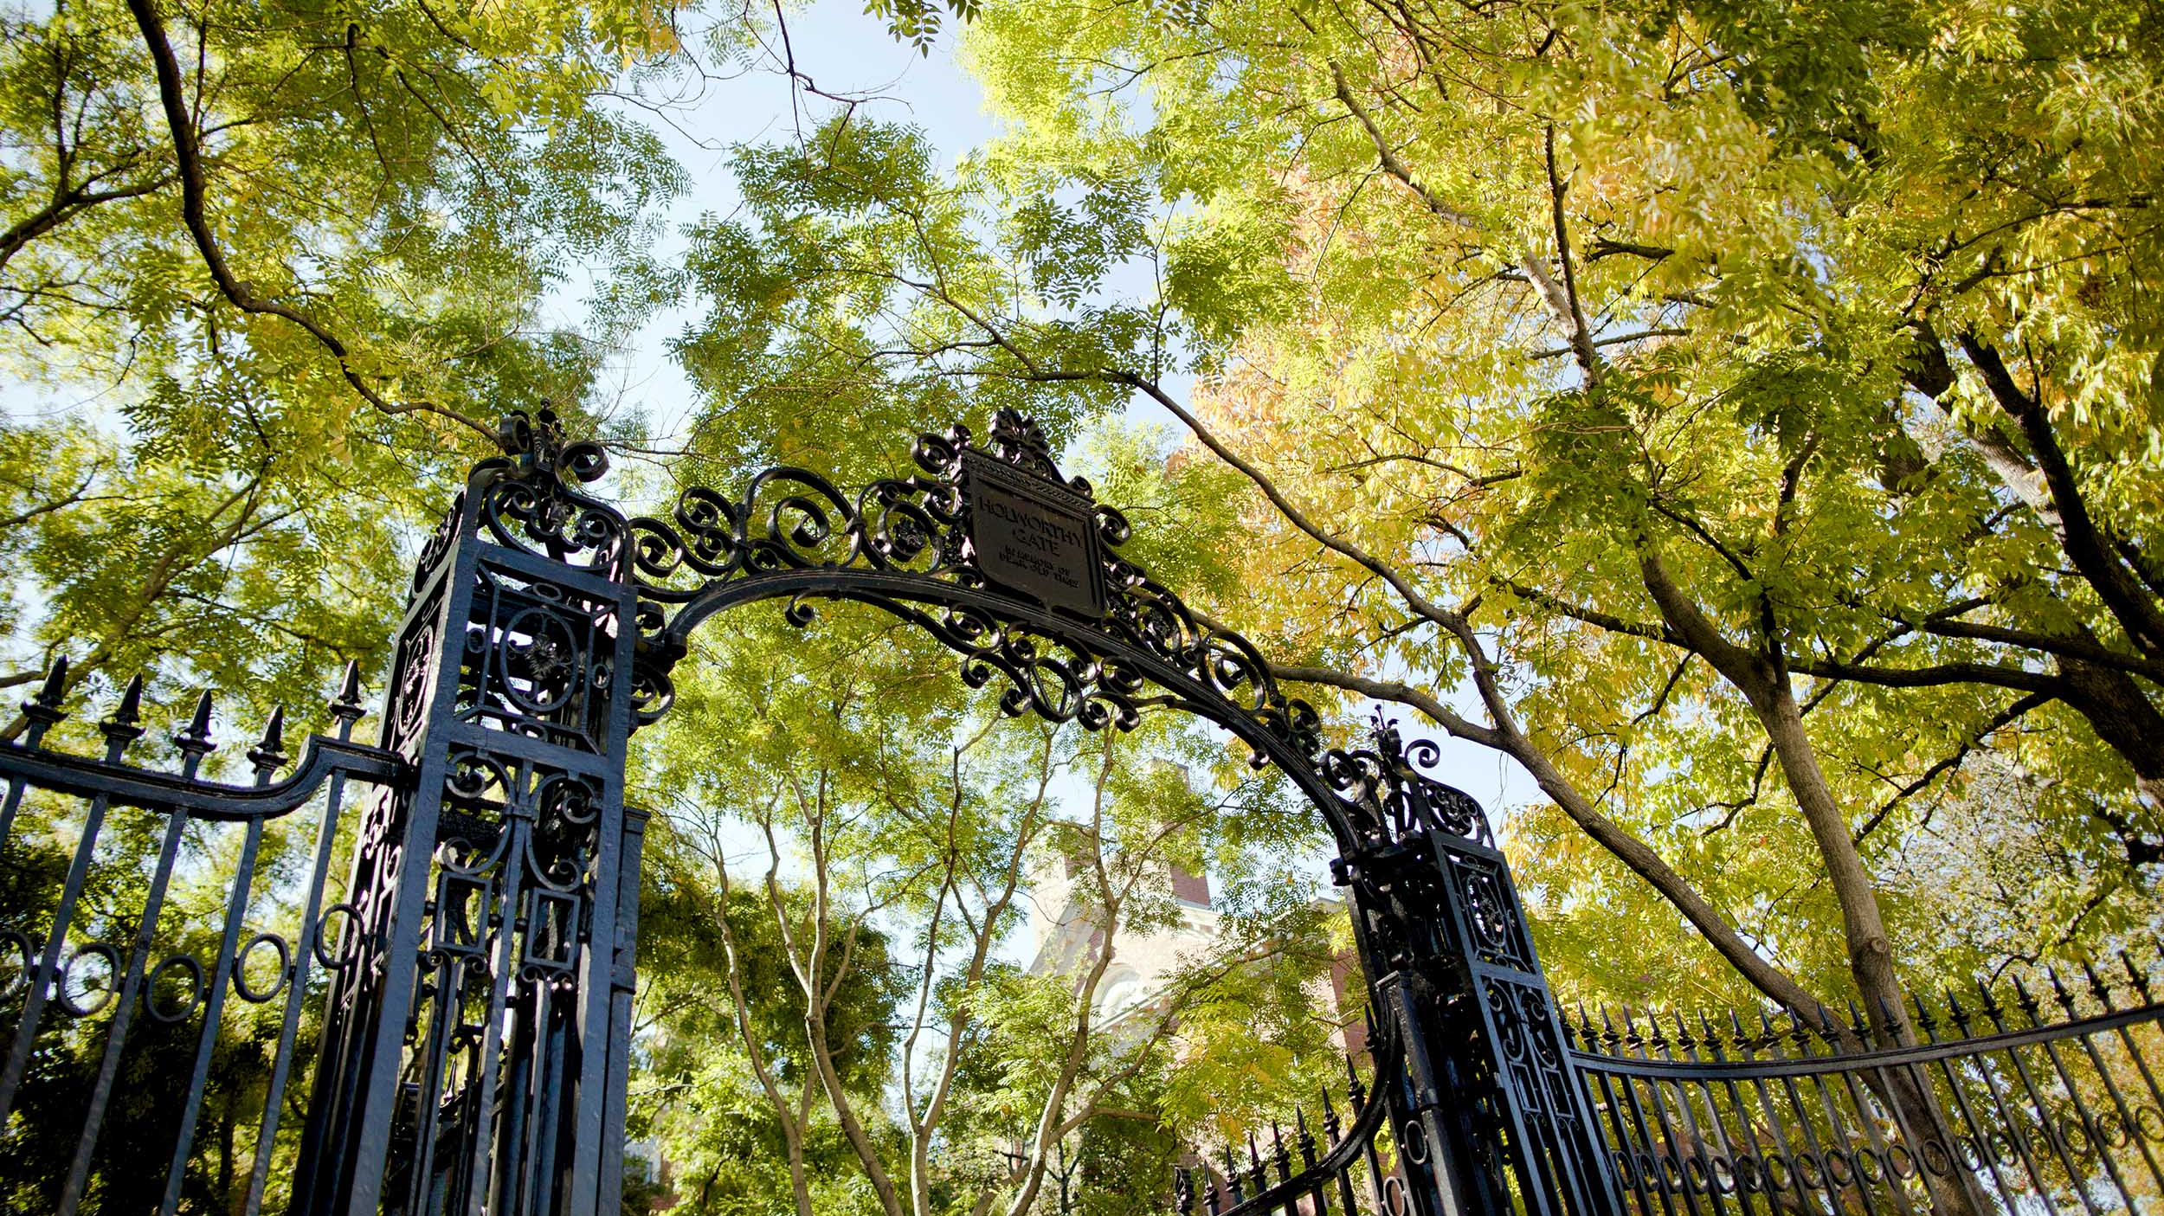

Enhancing Understanding of Faculty Negotiation and Retention
2024 COACHE Webinar
collaborative on academic
careers in higher education

Slide 2


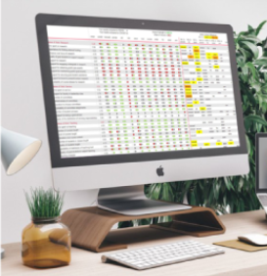

Presenter
About COACHE: A research-practice partnership
Faculty Job Satisfaction Survey
The Faculty Job Satisfaction Survey offers academic affairs leaders unique insights into the faculty experience. The survey captures faculty sentiment with regard to teaching, service and research, tenure and promotion, departmental engagement and collegiality, and other aspects of the academic workplace.
Faculty Retention & Exit Survey
The Faculty Retention & Exit Survey involves COACHE partners in the only comparative study of faculty retentions and departures. The results show the implications of certain policies and offer insight into the causes, costs, and conduct surrounding faculty exit.
R. Todd Benson
Executive Director and
Principal Investigator of COACHE
COACHE | 2024
Slide 2

Slide 3

Agenda
01
02
03
04
05
06
Framing the Problem
Ambiguity in Negotiation
Ambiguity Has “Real Cost”
Faculty Negotiation from an Equity Lens
Other Half of the Negotiation Equation
Questions Worth Asking
COACHE | 2024
Slide 3

Slide 4




Framing the Problem
(Tenure line) Faculty is a unique type of employee; they can expect to remain at the same institution and are hard to be replaced.
Negotiation phase can be the difference between a departure and successful retention; how negotiation is handled signals whether the institution cares.
Inconsistent decisions on faculty treatment and unintended inequities often emerge in these “unscripted interactions” (Ridgeway & Correll, 2004).
The lack of data makes even the best-intentioned administrators ill-equipped to negotiate with faculty consistently, equitably, and effectively.
Do you need an outside offer to renegotiate the terms of your faculty contract?
What percentage of faculty at your institution believe that outside offers are necessary as leverage in compensation negotiations?
COACHE | 2024
Slide 4

Slide 5
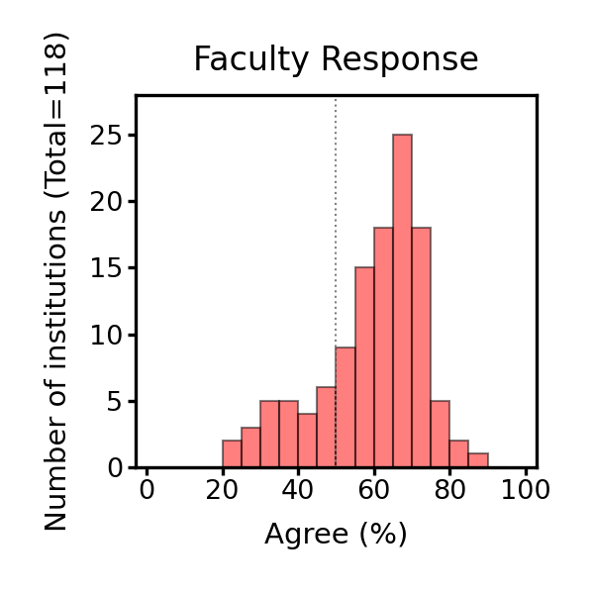
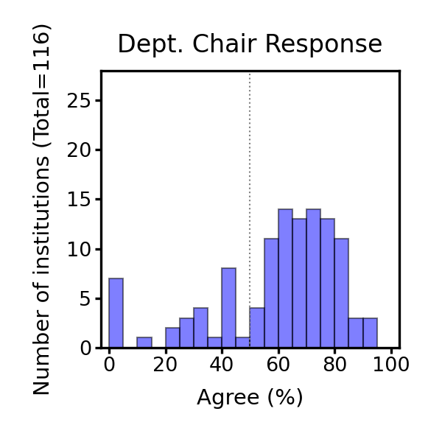
Framing the Problem
Are outside offers necessary as leverage in compensation negotiations?
From 2021 – 2024, COACHE asked this question to faculty and department chairs from 118 institutions as part of the Faculty Job Satisfaction Survey.
We found a lack of consensus within both faculty group and department chairs group at many institutions.
Level of Consensus
Faculty Response
Dept. Chair Response
Institution (n=118)
Institution (n=116)
High
Low
0 20 40 60 80 100
Agree (%) by institution
Agree (%) by institution
Agree (%) by institution
COACHE | 2024
Slide 5

Slide 6
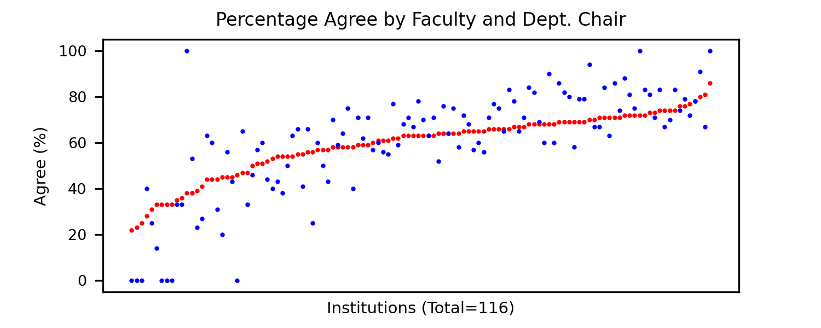
Framing the Problem
Are outside offers necessary as leverage in compensation negotiations?
From 2021 – 2024, COACHE asked this question to faculty and department chairs from 118 institutions as part of the Faculty Job Satisfaction Survey.
Additionally, discrepancies exist between the responses of faculty and department chairs at many institutions.
Faculty
Dept. Chair
COACHE | 2024
Slide 6

Slide 7
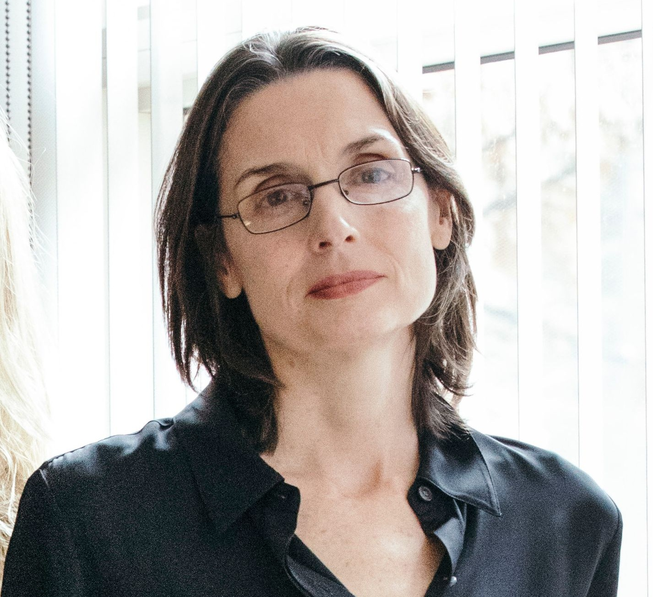

Ambiguity in Negotiation
Hannah Riley Bowles
Co-Director, Center for Public Leadership
Co-Director, Women and Public Policy Program
Roy E. Larsen Senior Lecturer in Public Policy and Management
Ambiguity, defined as the lack of objective norms or standards regarding WHAT is negotiable, HOW to negotiate, or WHO the negotiators are, increases chances for biases to influence decisions (Bowles et al. 2024).
WHAT is negotiable
  Pay (e.g., compensation standards)
  Roles (e.g., development opportunities)
  Work-Personal Life Balance (e.g., flexible work arrangements)
HOW to negotiate (e.g., norms for accessing resources and opportunities)
WHO the negotiators are (e.g., talent assessment and networking)
Reference: Bowles, H. R., Mazei, J., & Liu, H. H. (2024). “When” versus “Whether” Gender/Sex Differences: Insights from Psychological research on Negotiation, Risk-Taking, and Leadership. Perspectives on Psychological Science.
COACHE | 2024
Slide 7

Slide 8

Ambiguity in WHAT is negotiable
Retention
My Dean suggested that my requests for additional start-up money and summer salary were not applicable to this process, and that those were only things offered for new hires, which I knew not to be the case both broadly in academia and with colleagues who have received outside offers.
Departure
The counteroffer needed to involve my partner. I was told that the Dean of the college that could accommodate my partner was unwilling to negotiate an offer for my partner. I was very disappointed by the outcome. I wanted to stay in [home institution].
Retention
What I really wanted from [home institution] and what I failed to get was an opportunity to create the transdisciplinary research and teaching program that I would have been able to join at other institutions where I received an offer.
Retention
The impetus at [home institution] is towards greater and greater numbers of students in each class which does not suit humanities teaching. Moreover, the grading, service, and grad advising burdens in my two departments are extremely high. While [home institution] matched the material aspects of the offer, they could not match any of these other conditions which bear strongly on work-life balance. This made the decision very hard.
Source: COACHE Faculty Retention and Exit Survey
COACHE | 2024
Slide 8

Slide 9
Ambiguity in HOW to negotiate
Departure
Discussed offer with Chair. He said he would discuss with Dean. I checked in several days later and did not really hear back. I decided to take the other offer partially out of a lack of feeling like my Chair was fighting for a counteroffer for me.
Departure
The Dean told me it was because I had only been employed for 2 years and he had a threshold of expecting at least 4 years of service before offering a counteroffer.
Departure
I was told that since my offer was not from an R-1 institution, it was not a "peer institution" I would not be receiving any counteroffer.
Source: COACHE Faculty Retention and Exit Survey
COACHE | 2024
Slide 9

Slide 10
Ambiguity in WHO the negotiators are
Departure
In making the counteroffer to me over email, my department chair seemed to signal through her tone that she did not think that I was seriously considering the outside offer, even though I was. She at no point asked to meet with me or to discuss my reasons for applying elsewhere, and she did not try to open a conversation about why I was considering leaving or why I might consider staying.
Departure
I had historically a very contentious relationship with the dean of faculty at the time for many reasons, including him reneging on a spousal hire after a previous outside offer and promotion (which he acknowledge was wrong many years later). Despite requesting to negotiate with another party, I had to negotiate with the dean of faculty at the time. Given this background, I didn't really negotiate.
Retention
It was a stressful process. But in the end, I admired the way my dean, and also my chair, interacted with me through the process. She made me feel I was deeply valued. They also demonstrated an authentic enthusiasm for my wife and her work. In contrast, the chair of the department from which I had the outside offer seemed relatively indifferent.
What stood out to you the most? Were there any statements that surprised you?
Source: COACHE Faculty Retention and Exit Survey
COACHE | 2024
Slide 10

Slide 11
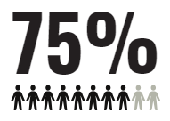
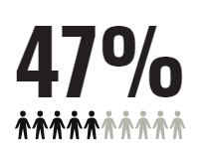
Ambiguity Has “Real Cost”
In 2016, COACHE developed the Faculty Retention and Exit Survey to study faculty mobility. We survey faculty who received an outside offer and left the institution, received an outside offer but stayed at the institution, and faculty who received a pre-emptive retention gesture
We learned that unclear processes and policies around negotiation can unintentionally drive faculty away.
What was your primary motivation for initiating a search for a job offer?
2016-19
2020-23
​Primary Motivation | Year Group
 | 2016-19 | 2020-23
To use an offer as leverage to renegotiate the terms of my employment at [INSTITUTION] | 12.10% | 13.40%​
To leave [INSTITUTION] | 58.6% | 51.7%​
I did not initiate a search for a job offer | 13.30% | 9.20%​
Other | 8.10% | 23.80%​
I decline to answer​ | 7.90% | 1.90%​
Total | 669 | 933
What percentage of these groups of faculty ended up leaving the institution?
Source: COACHE Faculty Retention and Exit Survey
COACHE | 2024
Slide 11

Slide 12

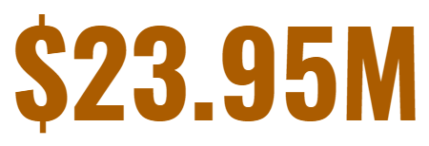




Ambiguity Has “Real Cost”
How would you calculate the cost of a faculty member's departure and the subsequent hiring of a replacement?
Total spent by the University of Wisconsin–Madison on faculty retention and reward in 2023-24*
Direct Financial: Advertising, travel and accommodations for campus visits, relocation costs, and start-up packages
Indirect financial: HR Staffing, Administrative Support Staff
Human capital: Faculty time spent reviewing materials, training for Search Chairs, Onboarding
Political and social costs: Reputation (good or bad)
It isn’t just the costs of replacing a faculty member. Most institutions of higher education aspire to build a community that treats its members equitably. When processes and policies are unclear, they can exacerbate inequities.
*Reference: UW–Madison finalizes 2023–2024 compensation strategy. (March 14, 2024). https://news.wisc.edu/uw-madison-finalizes-2023-2024-compensation-strategy/#:~:text=The%20compensation%20strategy%20includes%20an,addressing%20market%2Dinformed%20compensation%20issues.
COACHE | 2024
Slide 12

Slide 13
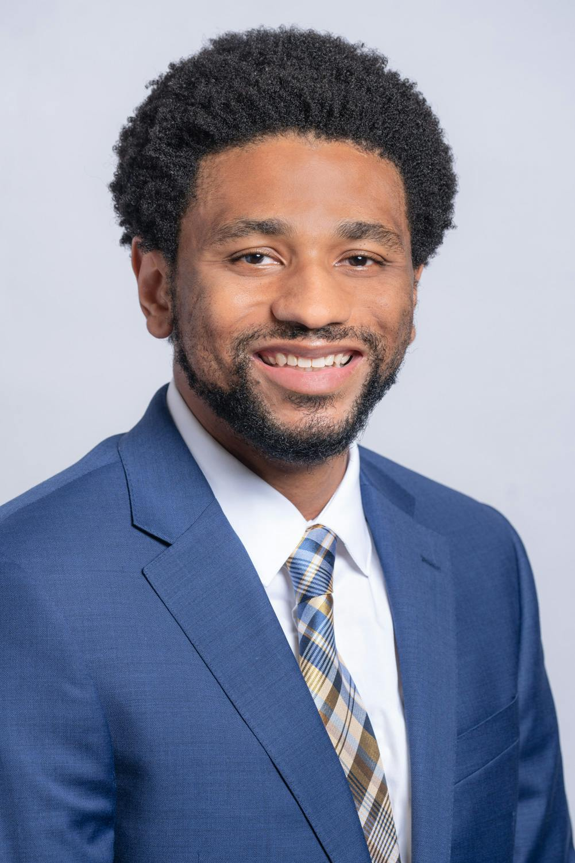
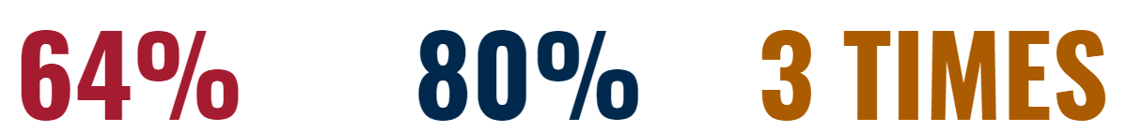
Faculty Negotiation from an Equity Lens
Using quantitative data from 650 faculty collected by COACHE’s Faculty Retention and Exit Survey (2016-19), White-Lewis et.al. (2024) explored which faculty populations were more likely to receive counteroffers, and why.
When controlled for other variables, such as whether the faculty member notified their Chairs or Deans about their outside offer, the study identified statistically significant relationships between counteroffer receipt and personal identity factors.
RACE
GENDER
TENURE STATUS
White faculty were
more likely to receive counteroffers than their faculty of color peers.
Men were nearly
more likely than women to receive counteroffers.
Tenured faculty were
as likely to receive counteroffers than untenured faculty.
Damani White-Lewis
Assistant Professor
University of Pennsylvania
Reference: White-Lewis, D. K., O’Meara, K., Mathews, K., & Havey, N. (2024). Counteroffers for faculty at research universities: who gets them, who doesn’t, and what factors produce them? Higher Education.
COACHE | 2024
Slide 13
Notes:
Controlling for notification of leadership…

Slide 14

Faculty Negotiation from an Equity Lens
Using data from about 31,000 faculty at 191 institutions collected by COACHE’s Job Satisfaction Survey (2012-20), Wright-Kim & Perna (2023) found gender- and race-based differences in institutional responses to negotiation.
Percentage of Faculty Who Reported Employment Adjustment As A Result of Negotiation by Gender and Race/Ethnicity Among Faculty Who Reported Negotiating Employment (N=3,018)
​ | Total Adjustments (n=5,022) | Men ​ (n=2,775)​ | Women (n=2,247)​ | White men (n=2,340)​ | White women (n=1,817)​ | Men of color (n=408)​ | Women of color (n=401)​
Base salary ​ | 26% | 27%​ | 23%​ | 28%​ | 24%​ | 27%​ | 21%​
Supplemental salary​ | 9% | 10%​ | 8%​ | 10%​ | 8%​ | 10%​ | 6%​
Tenure clock​ | 3% | 3%​ | 4%​ | 2%​ | 4%​ | 4%​ | 6%​
Teaching load​ | 11% | 11%​ | 12%​ | 11%​ | 13%​ | 9%​ | 10%​
Research support​ | 8% | 8%​ | 7%​ | 9%​ | 8%​ | 7%​ | 6%​
Jeremy Wright-Kim
Assistant Professor
The University of Michigan’s Center for the Study of Higher and Postsecondary Education (CSHPE)
Reference: Wright-Kim, J., & Perna, L.W. (2023). Gender and Race-Based Differences in Negotiating Behavior among Tenured and Tenure-Track Faculty at Four-Year Institutions. The Review of Higher Education 47(1), 61-91.
COACHE | 2024
Slide 14

Slide 15






Other Half of the Negotiation Equation
Individual Actors
Institutional Actors
Alignment with institution needs
Negotiation training
Access to comparative data (comparable salaries within the market)
Social capital
Typically, institutional actors have more experience negotiators than individual actors
Institutional actors have access to comparative data
Discretion to decide the perceived value of the individual actor
A better understanding of the negotiation process and the terms that can be negotiated
A rock star faculty
Peer advising
Part of a collective bargaining agreement
COACHE | 2024
Slide 15

Slide 16
Other Half of the Negotiation Equation
What gaps appeared in research and practice?
Research:
Focuses almost exclusively on faculty negotiation experiences, with much less on academic leaders' perspectives.
Often highlights strategies for minoritized faculty to “level the playing field” (Bowles, 2023; Shaw et al., 2021). This focus suggests that individual actors are the primary drivers of negotiation outcomes. Consequently, institutions can become more equitable by “training” individual actors to become better negotiators.
Practice:
Negotiation is a discretionary space lacking oversight.
Sensitive and idiosyncratic nature of negotiation makes it difficult for academic and administrative leaders to openly discuss their perspectives or strategies.
Do you think there is a need to fill in the gap by studying academic leaders’ perspectives in faculty negotiation?
How would you like to use the findings from such a study?
COACHE | 2024
Slide 16

Slide 17



Other Half of the Negotiation Equation
“We also see high value in conducting qualitative research in this area. Ethnographic and/or interview-based studies of department chairs and deans responsible for making such decisions are necessary to demystify the conduct of counteroffers.”
- White-Lewis et.al., 2024
COACHE is developing a new study to examine faculty negotiation from the perspectives of academic leaders.
Structured interviews with academic leaders
Institutional report highlighting inconsistencies in responses
Comparative report for benchmarking
Understand the decision-making processes of academic leaders
Identify where ambiguity arises in negotiation processes and policies
Network and learn from peers in the cohort
Would you be interested in learning more about COACHE’s new study?
COACHE | 2024
Slide 17
Notes:
The light blue is methodology and the dark blue is outcome

Slide 18

Questions Worth Asking
If you want to push your institution to be more introspective about the ways it perpetuates ambiguity, these are the questions worth asking:
1
Does your institution provide clear guidelines and protocols for academic leaders to negotiate with faculty?
2
What percentage of academic leaders are aware of those guidelines and protocols? What percentage of them consistently apply these guidelines?
3
How do academic leaders assess the effectiveness of the existing guidelines and their alignment with the needs of their departments/schools?
4
What specific types of support do academic leaders require, and what strategies could be implemented to enhance this support?
What support or resources do you believe your institution currently lacks that would assist you or academic leaders in navigating faculty negotiations more effectively?
COACHE | 2024
Slide 18

Slide 19
LEARN MORE
We sincerely invite inputs for our new study. Please do not hesitate to reach out with suggestions or questions.
  Annie Fu
  Instructional Designer
  anniefu@gse.harvard.edu
Visit us online: https://coache.gse.harvard.edu/
collaborative on academic
careers in higher education

